Slide 1
Maximum ILLiad
Let ILLiad Do The Work!
Jennifer Johns & Stephanie Spires
OCLC Resource Sharing Conference
March 14, 2018

Slide 2
ILLiad Authentication
Password requirements
Maximum ILLiad

Slide 3
Password Requirements (8.6+)
Default password validation requires
  At least 8 characters
  At least 1 lowercase letter
  At least 1 uppercase letter
  At least 1 number
Validation is managed in the ILLiad Customization Manager
  Web Interface | Validation | WebValidation
  Default regular expression
    ^(?=.*\d)(?=.*[a-z])(?=.*[A-Z]).{8,}$
Notes:
Starting with ILLiad 8.6 sites were able to enforce password requirements for patrons using ILLiad Authentication
Set up by default on new installations

Slide 4
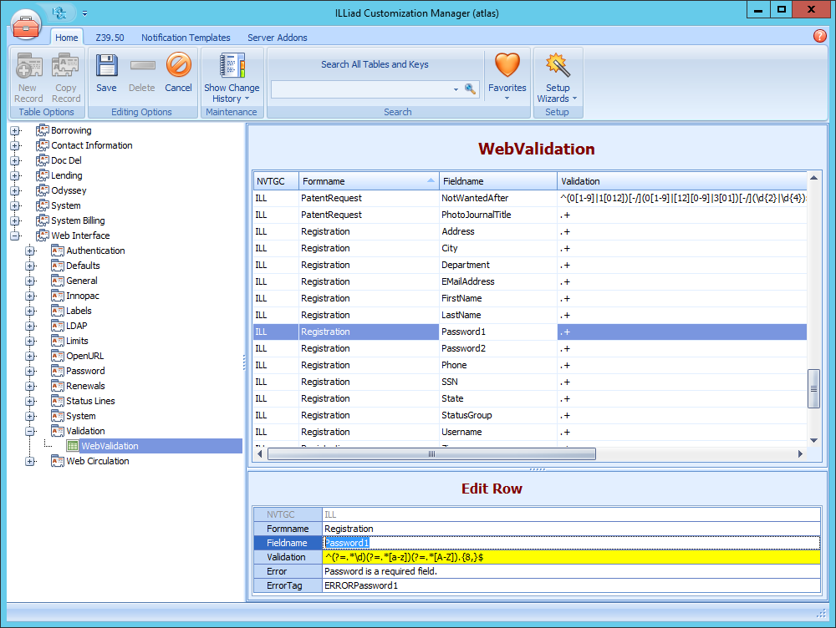
Password Requirements
Notes:
Edit Registration and Change Password FormName
Add entry for Password1 and Password2 FieldName

Slide 5
Password Requirements
Default password requirements can be edited to fit your institutions needs
Common Examples
  ^(?=.*\d)(?=.*[a-zA-Z])(?=.*\W).{8,}$
    Requires at least eight characters; one letter, one number and one symbol
  ^(?=.*\d)(?=.*[a-zA-Z]).{8,20}$
    Require between 8 and 20 characters; at least one letter and one number
  ^.{10,}$
    Require at least 10 characters
Notes:
Existing sites can change their password requirements by editing the regular expression in the WebValidation table

Slide 6
Text Messaging
Maximum ILLiad

Slide 7
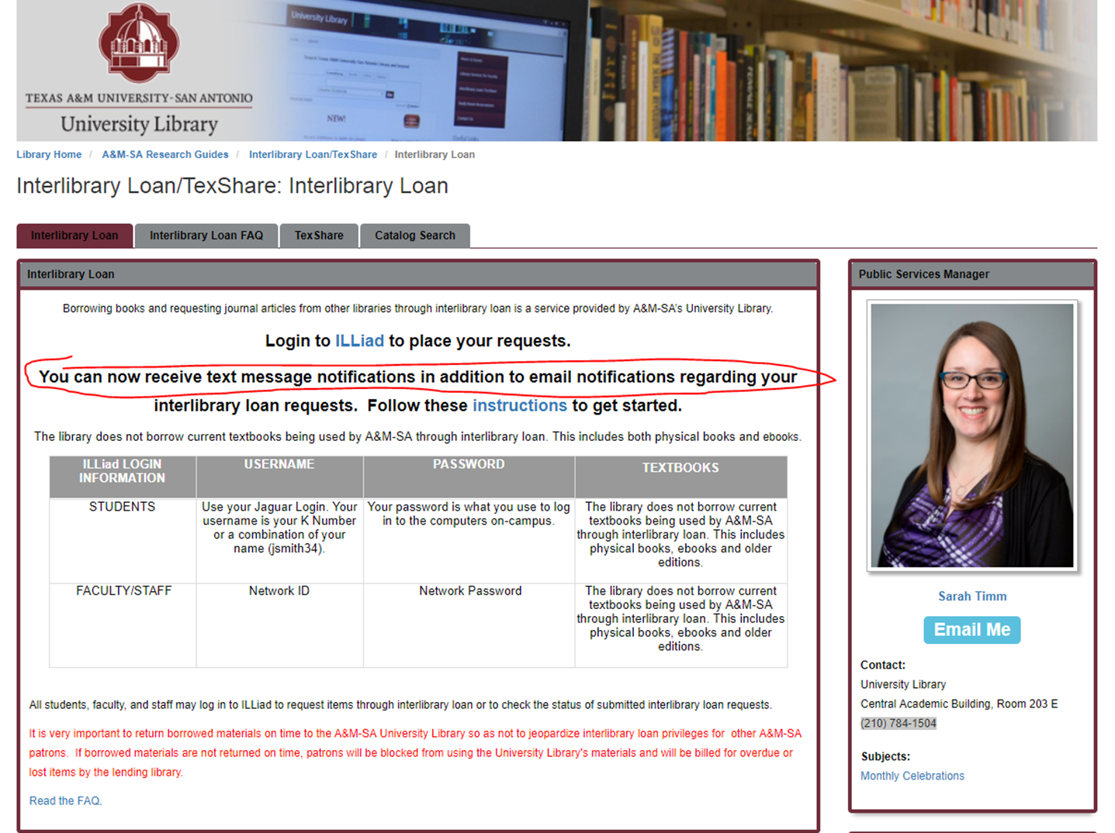

Slide 8
Text Messaging
https://prometheus.atlas-sys.com/display/illiad/Text+Notifications
https://prometheus.atlas-sys.com/display/ILLiadAddons/ILLiad+Twilio+SMS+Addon
Texas A & M LibraryH3lp

Slide 9
API
Maximum ILLiad

Slide 10
What is an API?
Application programming interface
An API is a way for developers to perform actions in ILLiad and build their own integrations with it.
https://prometheus.atlas-sys.com/display/illiad/The+ILLiad+Web+Platform+API

Slide 11
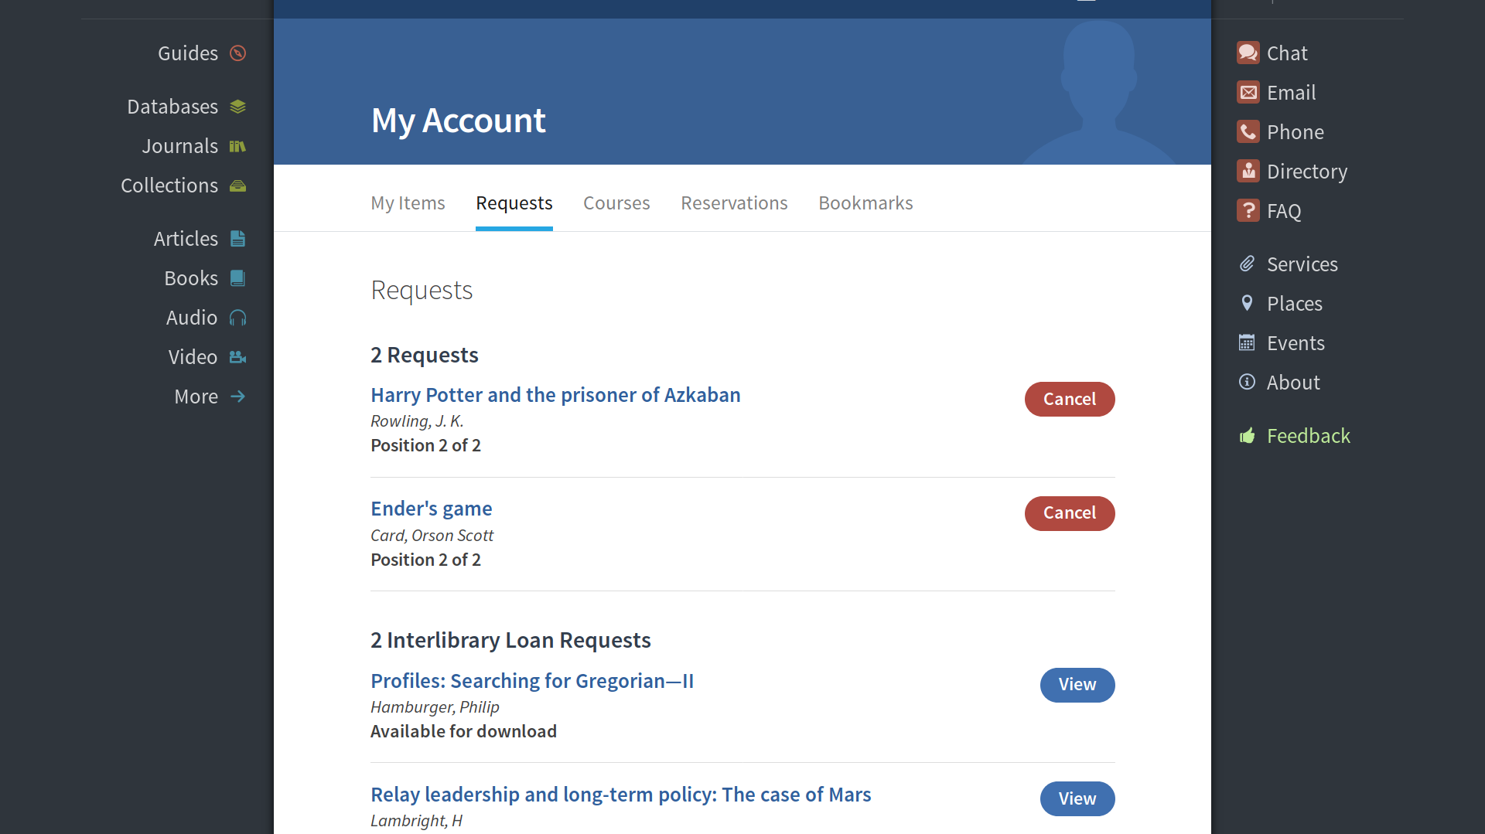
BYU API Integration

Slide 12
Custom Queues
Maximum ILLiad

Slide 13
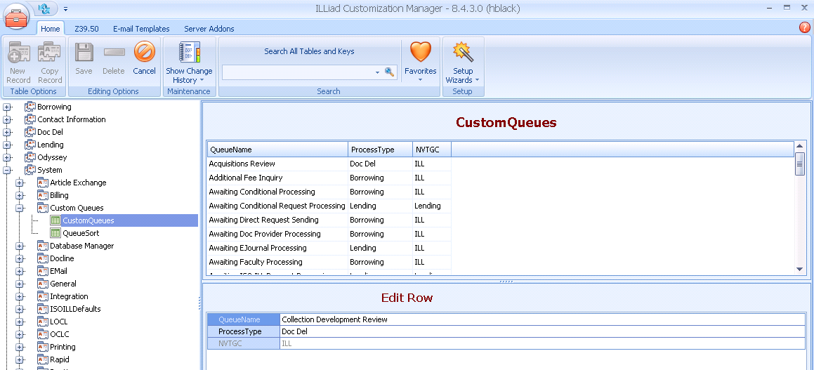
Create a Custom Queue
Notes:
Custom queues are created in the Customization Manager under System | Custom Queues | CustomQueues
Three columns – QueueName, ProcessType and NVTGC
Multiple NVTGCs can have the same Custom Queues if they apply to their workflows

Slide 14
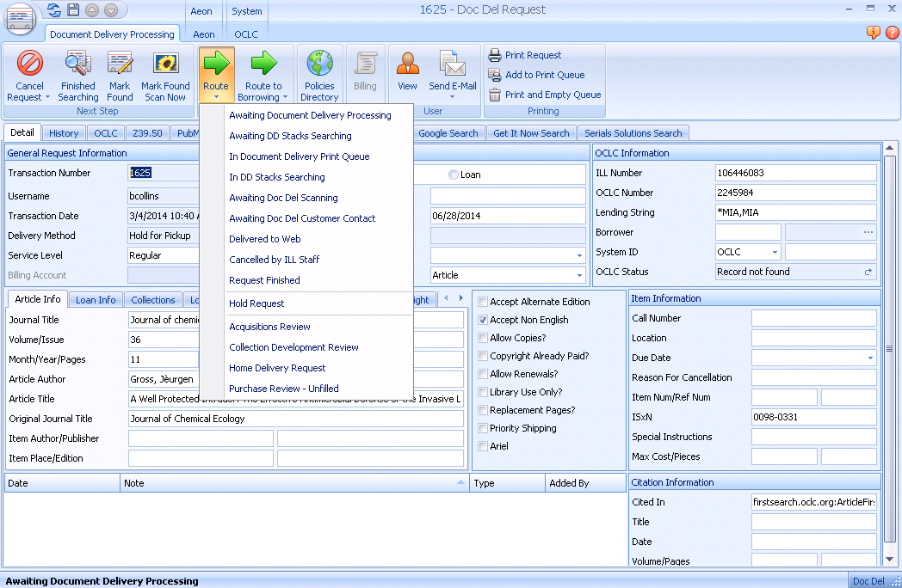
Using Custom Queues
Route manually
Use with email routing and routing rules
Notes:
Custom Queues can be used in three different ways
Route manually - will display as an option under the Route drop down in the client for the process type specified in the custom configuration
Route with Email or System routing
Keep in mind that the selected name will display to patrons in the web interface

Slide 15
EMAIL ROUTING
Maximum ILLiad

Slide 16
Email Routing
Configured in the Customization Manager
  System | EMail | EMailRouting
Uses customized Notification Templates
  Notification Templates
Simultaneously updates Transaction Status
  Often using Custom Queues
Notes:
Process to Create Custom Emails merging request data with other content
Usually to contact customer but can also send to others within the library
Accessible from the Email menu in the ILLiad Client
Can use to update status simultaneously

Slide 17
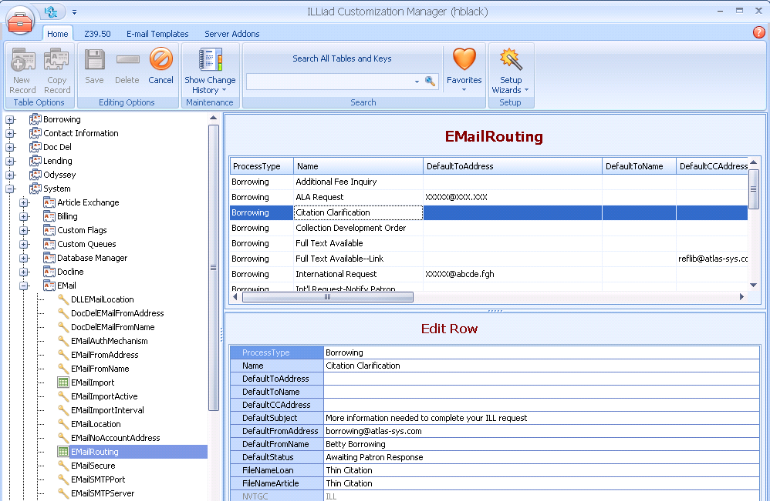
Email Routing

Slide 18
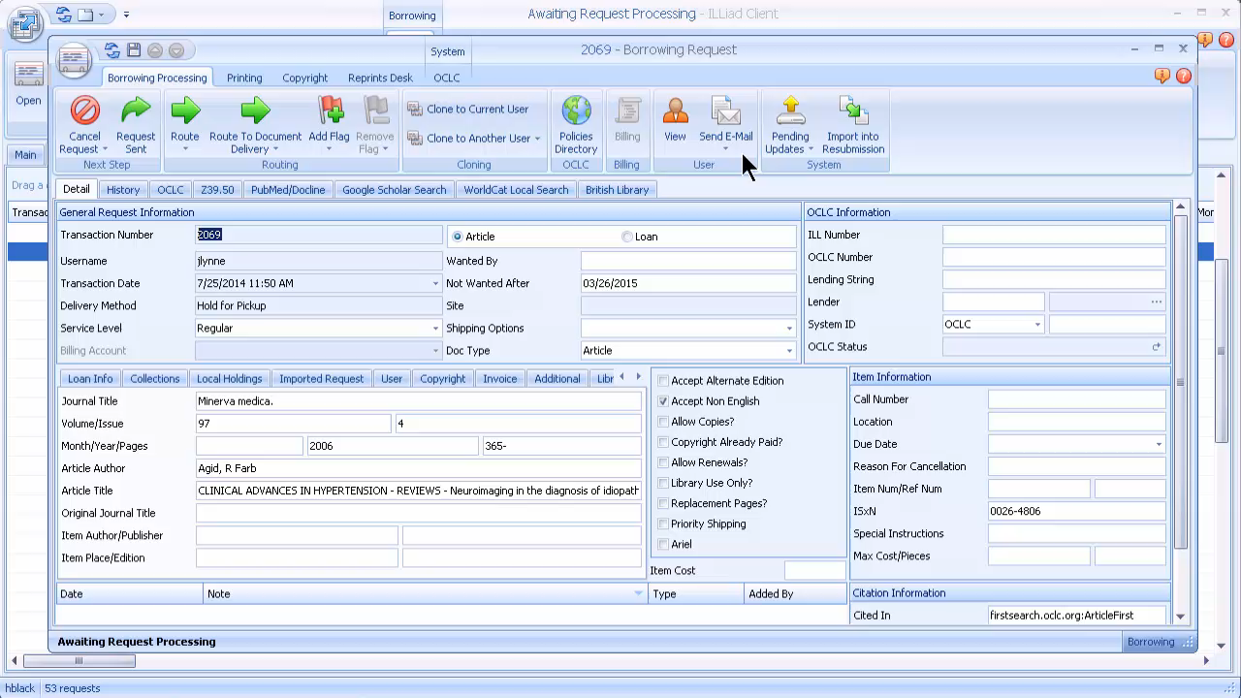

Slide 19
System Routing
Maximum ILLiad

Slide 20

Routing
Example:
Skipping return labels for libraries on your courier system
ILL Request
Update Request
Routing Rule
Awaiting
Processing
Standard or Custom
Queue

Slide 21
How DO they work?
Every transaction update runs a query
  Request data is compared to “filter” in routing rule
  Match YES
    Request auto-updated to new status
  Match NO
    Request moves to typical update status

Slide 22
Routing Rule = Filter
Process Type
Transaction Status
Match
String
Field
Value within Field

Slide 23
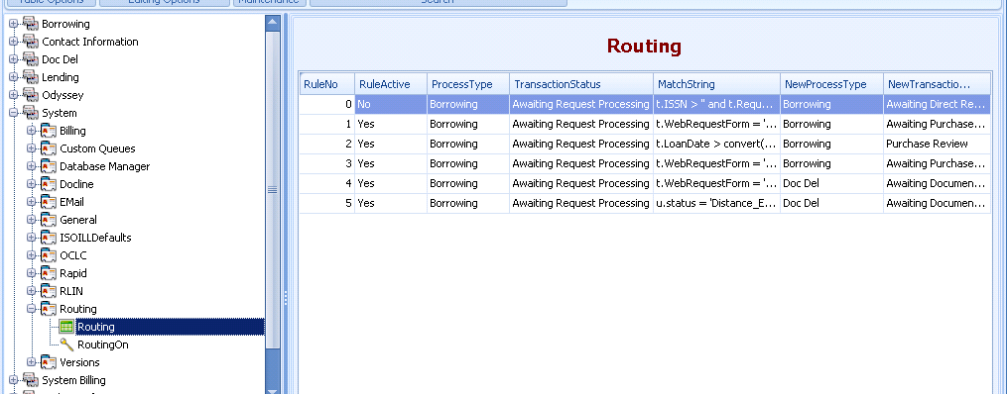
Routing Table

Slide 24
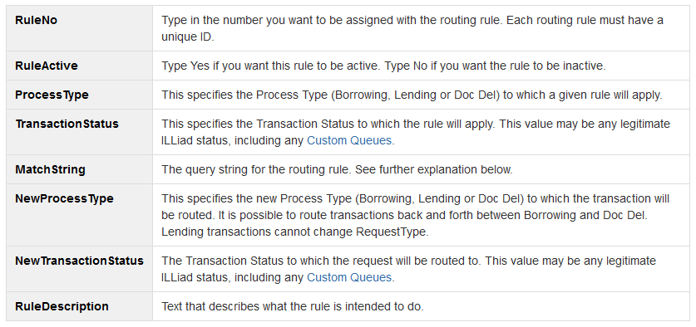
Routing Rule Values

Slide 25
Match String
Identifying table
  u. = Users table (Patron Information)
  t. = Transactions table (Request Information)
  l. = Lender Addresses table (Library Information)
Follow with field label
  Formatted as in table
Add qualification/value designated in the request
Can use combination of values
t.
t.RequestType
t.RequestType = 'Article'

Slide 26

Routing Rule Cautions
Only single quotation marks (')
  Not double quotation marks (")
No Extra Characters or Spaces
  Do not copy and paste
Rule Numbering
Mutually Exclusive
  Shared Servers must include NVTGC
Typos
Circular Routing

Slide 27
Example Routing Rule
Bypass Copyright Clearance for Older Articles
Field Name | Entry
RuleNo | 2
RuleActive | Yes
ProcessType | Borrowing
TransactionStatus | Awaiting Copyright Clearance
MatchString | t.PhotoJournalYear<‘2006’ OR t.PhotoJournalYear< convert(varchar(4), (datepart(year, getdate())-5))
NewProcessType | Borrowing
NewTransactionStatus | Awaiting Request Processing
Rule Description | Article requests older than 5 years moved directly to Awaiting Request Processing Queue

Slide 28
Examples
Route Faculty Requests to Dedicated Queue
Field Name | Entry
RuleNo | 1
RuleActive | Yes
ProcessType | Borrowing
TransactionStatus | Awaiting Request Processing
MatchString | u.Status = ‘Faculty’
NewProcessType | Borrowing
NewTransactionStatus | Awaiting Faculty Processing
Rule Description | Requests from Faculty status patrons moved to Awaiting Faculty Processing Queue
Remember to create custom queue

Slide 29
OCLC Direct Request
Maximum ILLiad

Slide 30
Direct Request Workflow
Request Submitted
Routing Rule Verifies ISBN
Updates to Awaiting Direct Request Sending
ILLiad sends to OCLC Direct Request Profile
Updates to Awaiting Direct Request Lenders
Request Sent to Lenders in Custom Holdings Path
Profile Match
No Profile Match
Updates to Request Sent
Updates to Awaiting Request Processing
ILLiad Task
OCLC Task

Slide 31
Direct Request Setup
Configure Customization Keys
Create Custom Queue
Automatic Routing
Set up a Direct Request Profile
  System | Resource Sharing Settings | Direct Request Profiles
Notes:
Configure Customization Keys
DirectRequestEnabled
SystemIDOCLCSymbol
Create Custom Queue
Awaiting Direct Request Sending
Automatic Routing
Create Routing Rule
t.ISSN > '' and t.RequestType = 'Loan' and (t.LendingString = '' or t.LendingString is NULL)

Slide 32
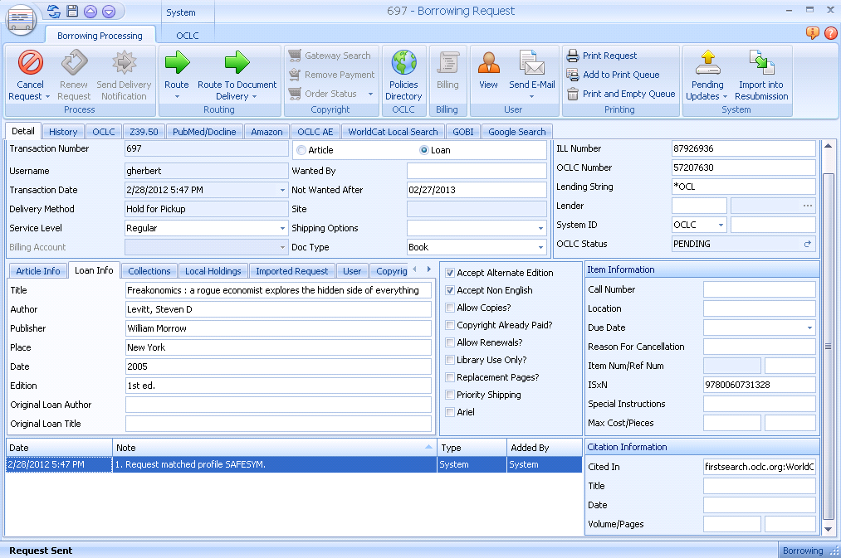
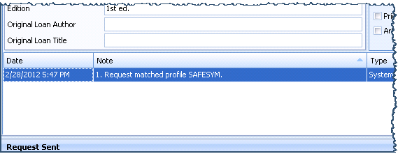
Successful Send via Direct Request

Slide 33
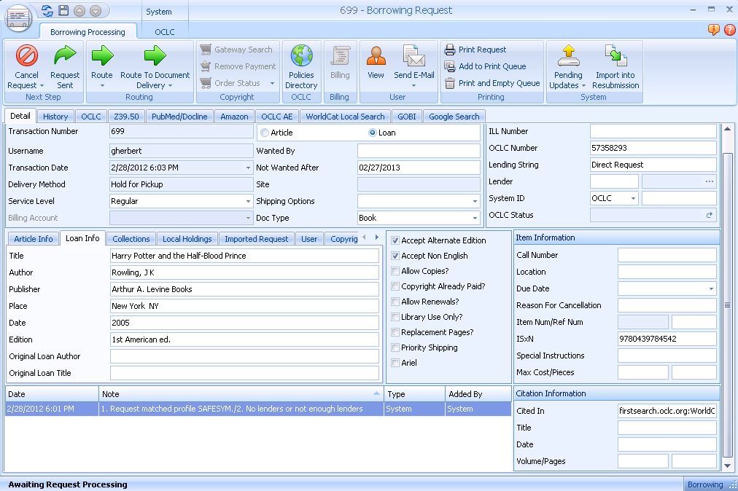
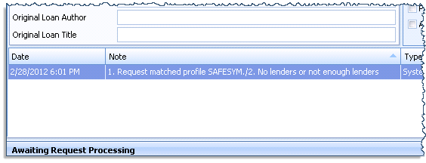
Failed Direct Request

Slide 34
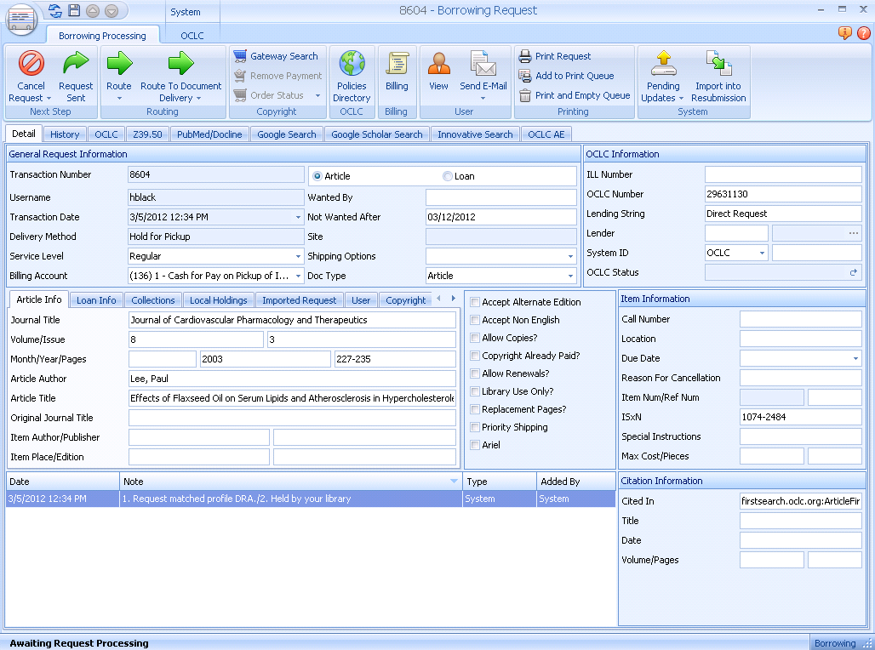
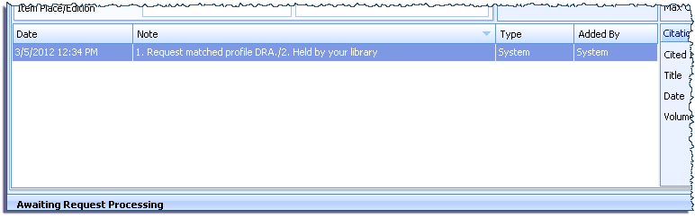
Failed Direct Request – Library Owned

Slide 35
Trusted Sender
Maximum ILLiad

Slide 36
Trusted Sender
Allows electronic document delivery to patron direct upon receipt from lending library without staff intervention
When billing is active for Borrowing, Trusted Sender functions only for customers exempt from billing
Activate for all or for individual lenders
  Trusted Sender option on Lender Address records

Slide 37
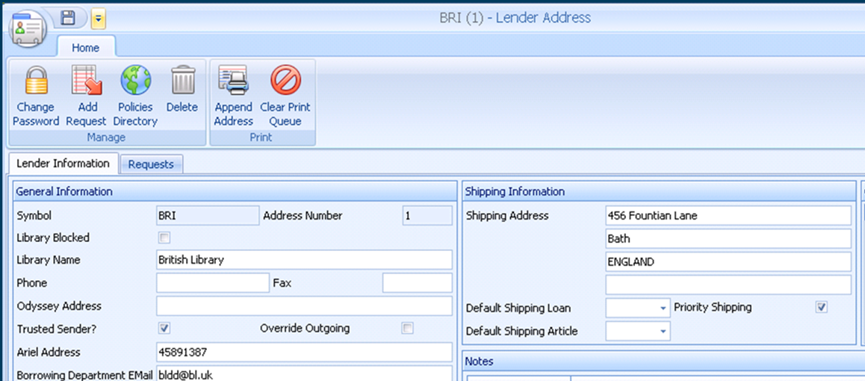

Trusted Sender Configuration
Customization Manager Setting
  Odyssey | Trusted | OdysseyAutoElecDel
    Always = All
    Never = No One
    Trusted = As set in Lender Address record
Individual Lender Address Records
  Checkbox indicator

Slide 38
Printing
Overview
Maximum
ILLiad

Slide 39

Printing Overview
3 Components of Printing
  Data Files
  Print Templates
  Print Configurations

Slide 40

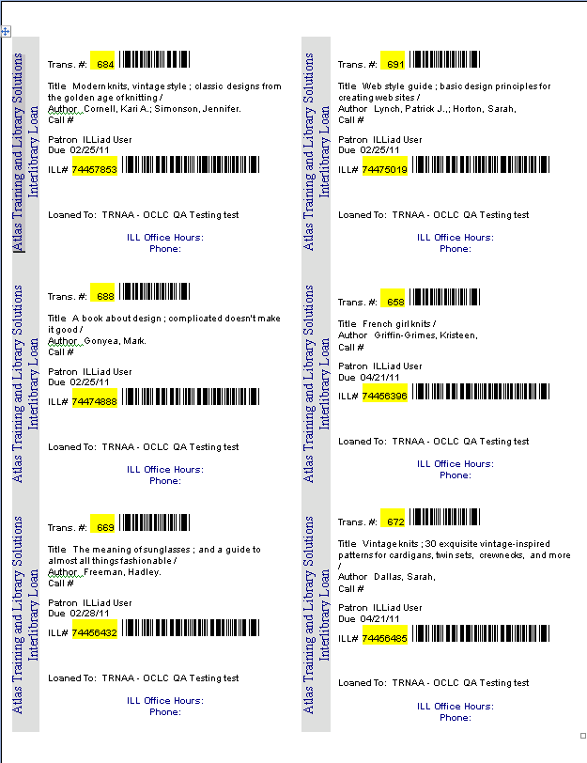
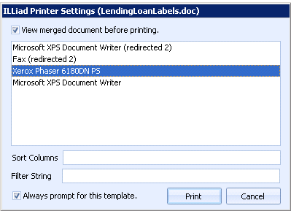
ILLiad Print Process
Data Source File in Excel
Request Data Export
ILLiad links request data with queue status
ILLiad triggers Word template according to Customization Manager Settings
Print Templates in Word
ILLiad Print Configurations

Slide 41
ILLiad Print Templates
Lending Stacks Pull Slips
Article Data
StacksP.xls
“Lending Stacks”
Article Slip
LendingArticleSlip.doc
Loan Data
StacksL.xls
“Lending Stacks”
Loan Slip
LendingLoanSlips.doc
Loan Labels
LendingLoanLabels.doc
Printing Documentation
https://prometheus.atlas-sys.com/display/illiad/Printing

Slide 42
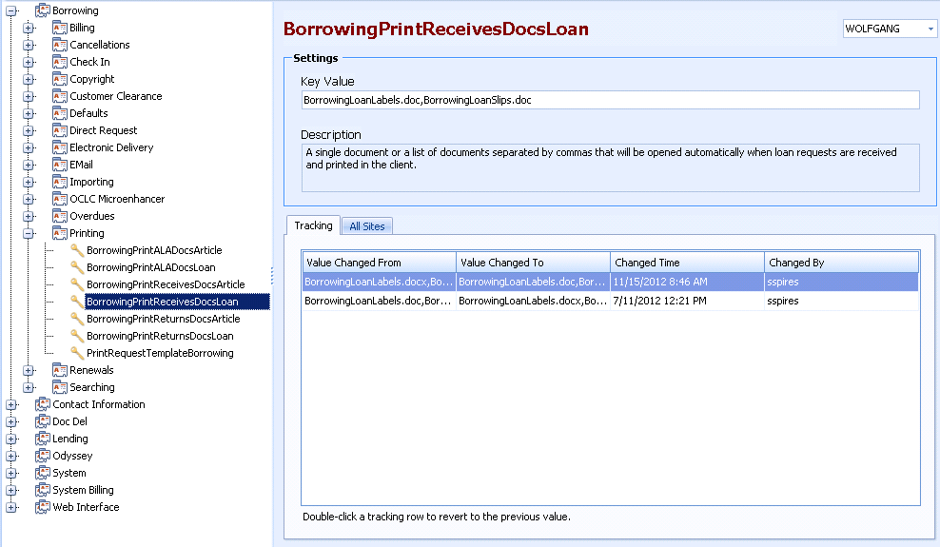
Customization Keys
Print templates for Printing Loans “Receives” in Borrowing

Slide 43
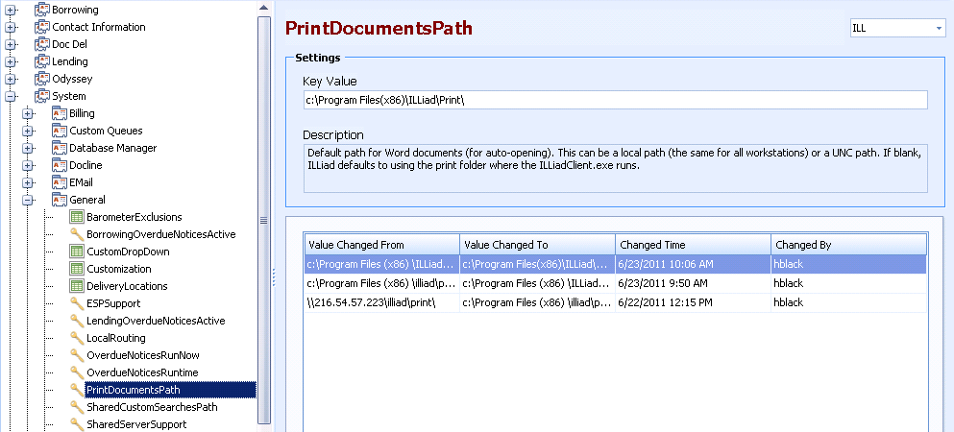
Customization Keys
Location of
Print Templates
Notes:
Print Documents Path
Tells ILLiad where to look for the email print template
Can be mapped drive as long as same from all
If not accessible it will pull defaults from program files (x86)\ILLiad\Print

Slide 44
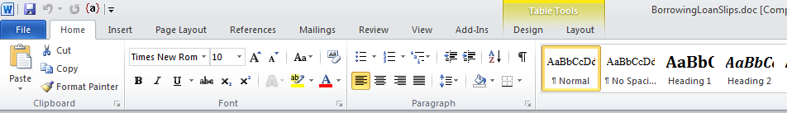
Edit Print Template
Cosmetic Changes
  Use Word document editing tools to change fonts, layout, etc.
Use Word Editing Tools for Design Changes and Cosmetic Enhancements
Notes:
Change Font and Size
Add Colors and Highlighting

Slide 45
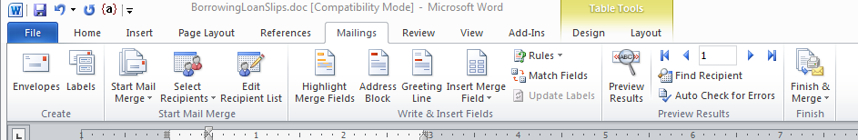
Edit Print Template
Adding new fields
  Use Word mail merge tools to add content to the print template
Use Mailings Ribbon Tools
Notes:
Legacy vs Print Data Source
Transactio = Legacy data source format
Transaction_Number = Print data source format

Slide 46
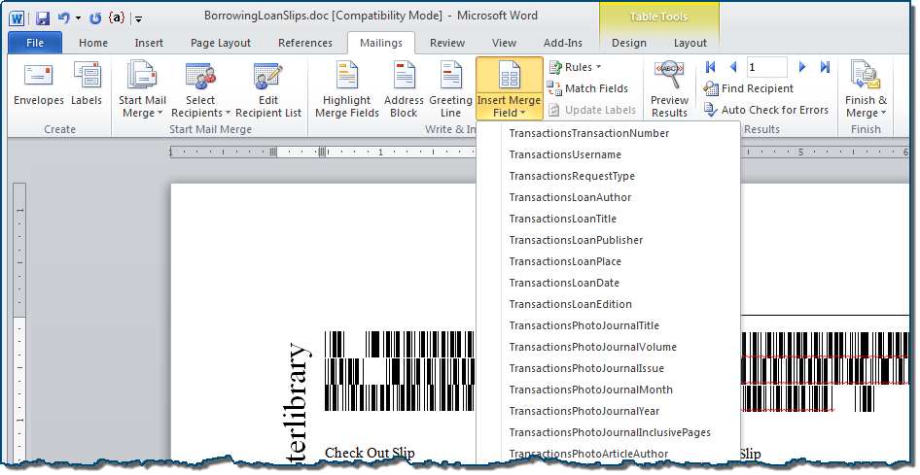
Insert Merge Field
Use Insert Merge Field button to select ILLiad to add to template

Slide 47
Thank you!
Jennifer Johns & Stephanie Spires
OCLC Resource Sharing Conference
March 14, 2018

