Slide 1
The IDS Project:
“It's the People, Not the Platform”
JENNIFER ACKER, MICQUEL LITTLE, AND BETH POSNER

Slide 2
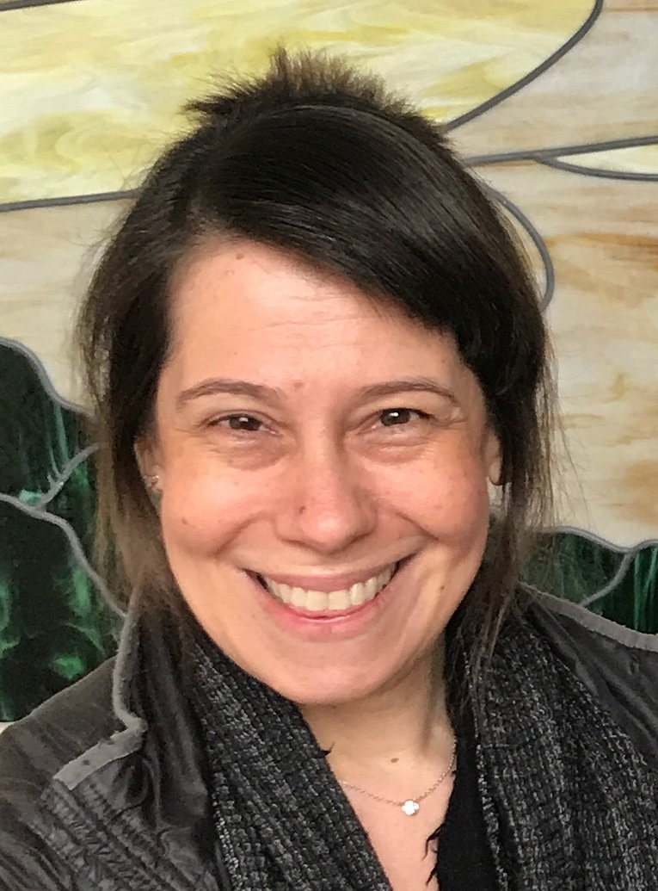
Beth Posner
Head of Library Resource Sharing
The Graduate Center, CUNY

Slide 3
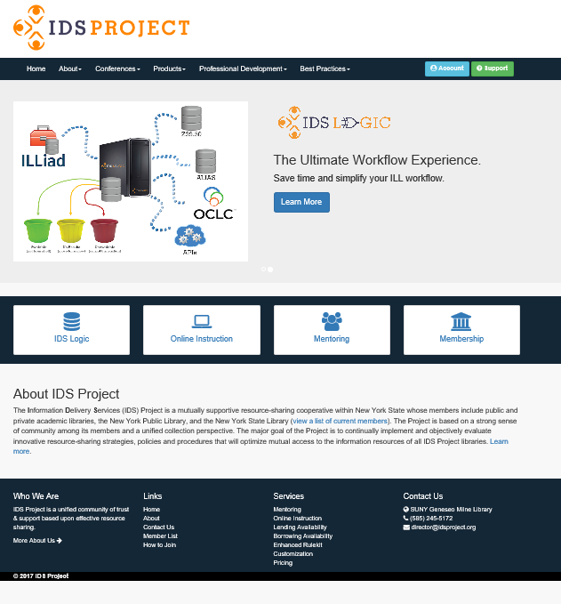
http://idsproject.org/
“A unified community of trust
and support based upon
effective resource sharing”
Notes:
Started in 2004 with 12 SUNY libraries, we now have over 100 member academic, special, and public libraries around the country
By helping each other with training and best practices (and using ILLiad and lots of innovative automation) our shared goal is to complete article transactions within 48 hours and loans within 72 hours
$1500 annual fee
Mark getting recent stats

Slide 4
IDS technology IS awesome...still...
“It’s the People
not
the Platform”
Notes:
Of course the platform and the technology we use in ILL matters a great deal...we couldn’t work as quickly or efficiently or effectively or creatively without the best tools... and that has meant using ILLiad
IDS has taken advantage of all the flexibility and customizability of ILLiad to automate workflows. Each library is unique in size, customers served, staffing, and workflows and our systems need to be flexible to allow for our uniqueness!
So, it is essential to us that all systems - ie Tipasa - enable similar user customizations so that we can continue to develop workflows that really work.
But, whatever the software, IDS will continue to support our members and the library resource sharing community with training
(and technology!)

Slide 5
Online Mentor Institute

Slide 6
IDS Mentors
Mentors are experienced specialists in ILL/IT who share their knowledge of ILL workflows, best practices and technology with IDS members
As IDS membership grows, we need more mentors
Mentor program started in 2005, the first course was developed in 2011
Notes:
Every new IDS library is assigned a mentor to help them get started and to work with them going forward...we can work through go to meeting or zoom or calls or even visit other libraries, although not Hawaii yet!

Slide 7
IDS Online Mentor Institute (OMI)
A 12 week, 6 module, online Canvas course was developed by Chris Sisak in 2014
I’ve coordinated it for three cohorts now
Online discussions, assignments, library visits and calls
Notes:
people may expect training in illiad or ids logic, but it’s really more about the IDS way of supporting each other with best
practices and ideas and finding people who can help depending on the technical issue
positive and negative aspects of using online course in general and canvas specifically
suggestions for shorter deadlines within module assignments so that the group stays together and can discuss more

Slide 8
OMI learning goals
IDS is flexible
IDS is a team
IDS is results oriented
Experience is as important as expertise
Model problem solving and working together
Notes:
IDS is flexible
if someone cannot finish an assignment or needs help in the OMI (or in their library or in helping other IDS members) the most important thing to do is to communicate and let people know so that we can figure out how to help
IDS is a team
if you need anything, someone will be able (and happy!) to help
IDS is results oriented
Even if we’re rushed and working to the last minute...even if someone need help or an extension...we will get the job done, and that’s what matters
Experience is as important as expertise
Mentors model problem solving and finding answers which is invaluable... even if mentors don’t have the answer, we want to and can and will help!
Intro Jen and RUGS
intro jennifer and RUGS

Slide 9
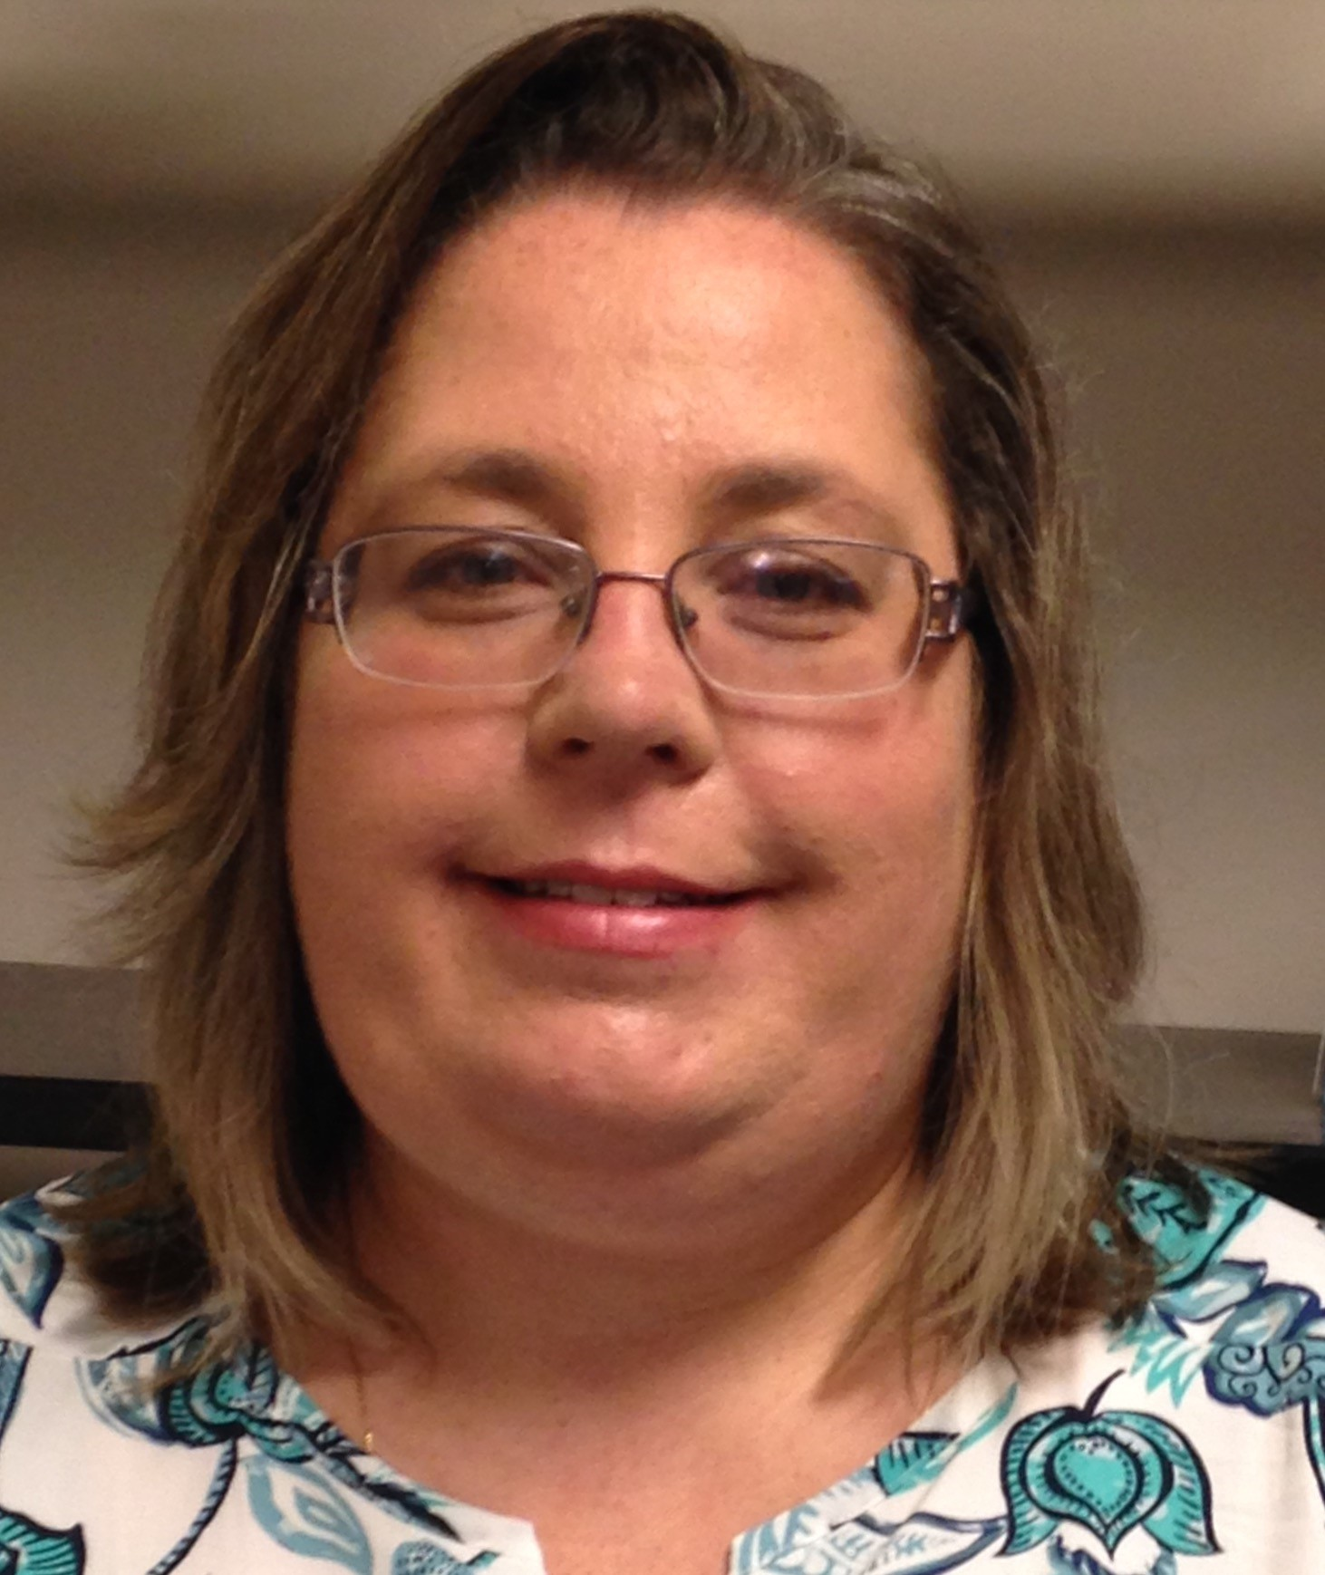
Jennifer Acker
Senior Clerk - Interlibrary Loan Hudson Valley Community College

Slide 10
Regional User Groups
Notes:
As the IDS Project membership really grew we didn’t want to lose the sense of community. Regional User Group meetings were created to foster community and create professional development opportunities for members.

Slide 11
Free Day of Learning and Sharing
Typical day starts off with updates on the IDS Project membership, statistics, and IDS technology update
Presentations range from email and print templates, hands on webpage changes, discussions about Tipasa, and short session on things like Conditionals and the Electronic Delivery Utility.
We tour the hosting library!
Lunch is a great opportunity to catch up with colleagues, connect names and faces, and share successes and trials.
Presentations are freely available on the IDS Project website
Notes:
Regional User Group Meetings are free to our members. The day starts off with an update on the project and statistics and this past fall the statistics included the most requested book titles and journal titles.
We offer a wide range of topics. We have had staff that have been on the job for 2 weeks up to staff that have been in resource sharing for 20+ years. We try to balance this by choosing everyday processes and making them short and sweet. As the RUG Coordinator I attend all the sessions and no session is ever alike but this past fall each session had some really good discussions on why staff conditional requests and how to respond.
The IDS Project pays for lunch and this is a great opportunity for our members to connect with new and familiar faces. We also make all the presentation freely available for anyone on the IDS Project website.
Image:http://www.mybighornbasin.com/2017/05/22/free-meals-for-cody-youth-this-summer/

Slide 12
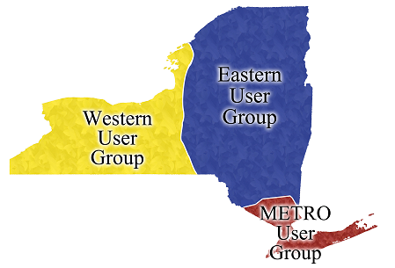
3 Regions
The state was split into 3
regions in 2013.
Each region has a Fall and
Spring meeting
One All Region meeting before
the IDS Project Conference in
late July.
Notes:
In order to enable more people to attend and build our community we divided the state into 3 regions. We meet in the fall and the spring in each of the three regions and once all together before the annual IDS Project Conference. The annual conference is open to anyone who would like to attend and this year the conference is being held at Utica College in July.

Slide 13
Coordinator of Regional User Groups
ESSENTIAL DUTIES AND RESPONSIBILITIES
General:
· Provides leadership in coordinating Regional Chairs in the organization and delivery of quarterly User Group meetings across New York State.
Mentoring:
· Cooperating with Executive Director and Administrative Team, establishes goals and priorities for Regional User Groups.
· Works with regional Chairs to organize locations, agendas, assessment, and progress of User Groups.
· Presents or participates in discussions about IDS Community Services and Technology at IDS events (Annual Conference, Regional User Groups, etc.) to keep members informed and gather feedback.
· Participates in IDS Administrative Team activities.
· Organizes the rotation of regional Chairs on an annual basis.
ADDITIONAL DUTIES AND RESPONSIBILITIES
· Support the IDS Project Administrative Team at the OCLC Resource Sharing Conference and the IDS Project Annual Conference, including representation at poster sessions and presentations.
Notes:
As I mentioned there is a RUG Coordinator and Micquel was our first RUG Coordinator when the we started in 2013. We thought we could continue without a Coordinator when Micquel moved to California. It was decided that the Coordinator plays a big role in planning the RUG meetings and I was asked to be the next Coordinator.

Slide 14
Topic Selection and Planning
IDS Project Mentors meet online several times through Go-To-Meeting
Topics come from questions mentors receive, surveys from past RUG meetings, or suggestions from mentors or chairs. At least 1 mentor from each region helps to create a presentation. Each mentor will present for their region.
We have the RUG meetings at various member libraries this Spring we will be at:
Notes:
Each RUG has an agenda and an Eventbrite registration page. We use Go-To-Meeting and Basecamp for planning. During our Go-To-Meeting sessions we come up with topics and go over planning such as food and parking! Once we select topics we ask for at least one mentor from each region to help create the presentations and then they present at their RUG meeting. Our Spring meetings will be held at HVCC, Genesee Community College, and NYPL.

Slide 15
Chair
GENERAL
Collaborates with Regional User Group Chairs and IDS Project Mentors to plan for and present at bi-annual IDS Project Regional User Group meetings.
DUTIES
Works with other Regional User Group Chairs and IDS Project Mentors to organize locations, agendas, assessment, and progress of User Groups.
Presents or participates in discussions about IDS Community Services and Technology at IDS events (Annual Conference, Regional User Groups, etc.) to keep members informed and gather feedback.
Works with Creative Technologist and IDS Project secretary to plan logistics of User Groups including food and travel.
Contact for members with any User Group Questions/Ideas/Concerns.
The chairs volunteer for one year but they can continue as the chair for more than one year. Chairs receive free registration for the IDS Project Conference.
Notes:
Each region has a Chair and the chair is a volunteer position. The chair helps with planning and is a liason for their region. If they feel comfortable they can present and as a benefit they receive help with travel costs and free registration to the IDS Project Conference at the end of the year.

Slide 16
Benefits of attending in their own words
Notes:
Here are a few quotes from our Fall 2017 survey - we asked our members to tell us the benefits of attending in their own words. 2 more are “Great for learning new ideas for the work place” and “A chance to connect with others involved in resource sharing and share knowledge.”
Now Micquel Little will talk about the Online Learning Institute

Slide 17
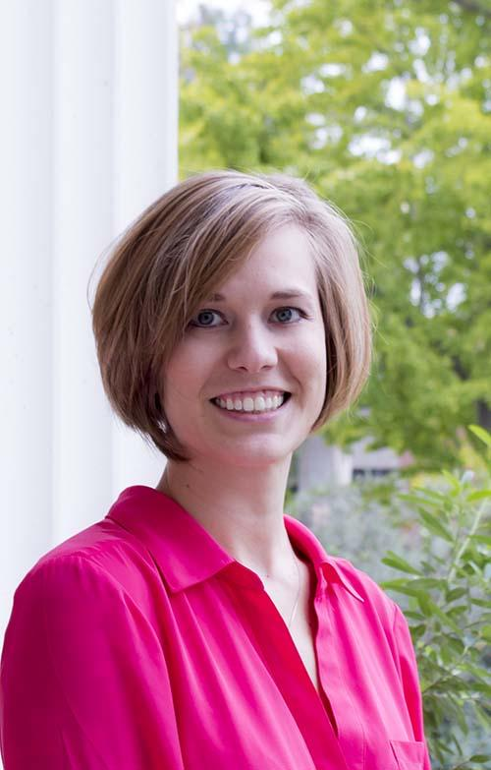
Micquel Little
Director of User Services and Resource Sharing
The Claremont Colleges Library

Slide 18
Online Learning Institute

Slide 19
IDS Project developed the Online Learning Institute in January 2014 in an effort to meet the needs of our members as well as provide nationwide support for resource sharing training and discussion. A growing number of courses include instructional videos, resource materials, discussion opportunities, and web conferences to enhance access to professionals in the field of resource sharing. Provided by a nationwide network of colleagues to encourage discussion, troubleshooting and innovation throughout the field of resource sharing.

Slide 20
Development Timeline
2014
2014
2015
2016
2017
2018
Online Learning Institute concept developed.
One course covering 8 topics designed.
First course offered over 8 weeks.
Three instructors and many guests.
Feedback: shorter courses, focused on one topic.
Additional instructors identified.
Additional instructors brought onto team through partnership with Indiana.
Foundational courses developed and offered twice.
Survey given to ask for feedback/ideas.
Survey results identified 3 additional courses to add.
101’s offered twice.
Development of 201 courses with original guests as instructors on team.
201’s offered for 1st time.
101’s offered once.
Instructor team organized assessment of courses for more engagement and retention.
Changes identified and made in courses for 2018.
101’s currently in progress.
Copyright saw changes based on assessment!
201’s and 101’s on schedule for summer/fall.

Slide 21
Courses offered
Foundational 101’s:
Borrowing
Lending
Copyright
Specialized 201’s:
Workflow Analysis
Statistics and Assessment
Purchase on Demand

Slide 22
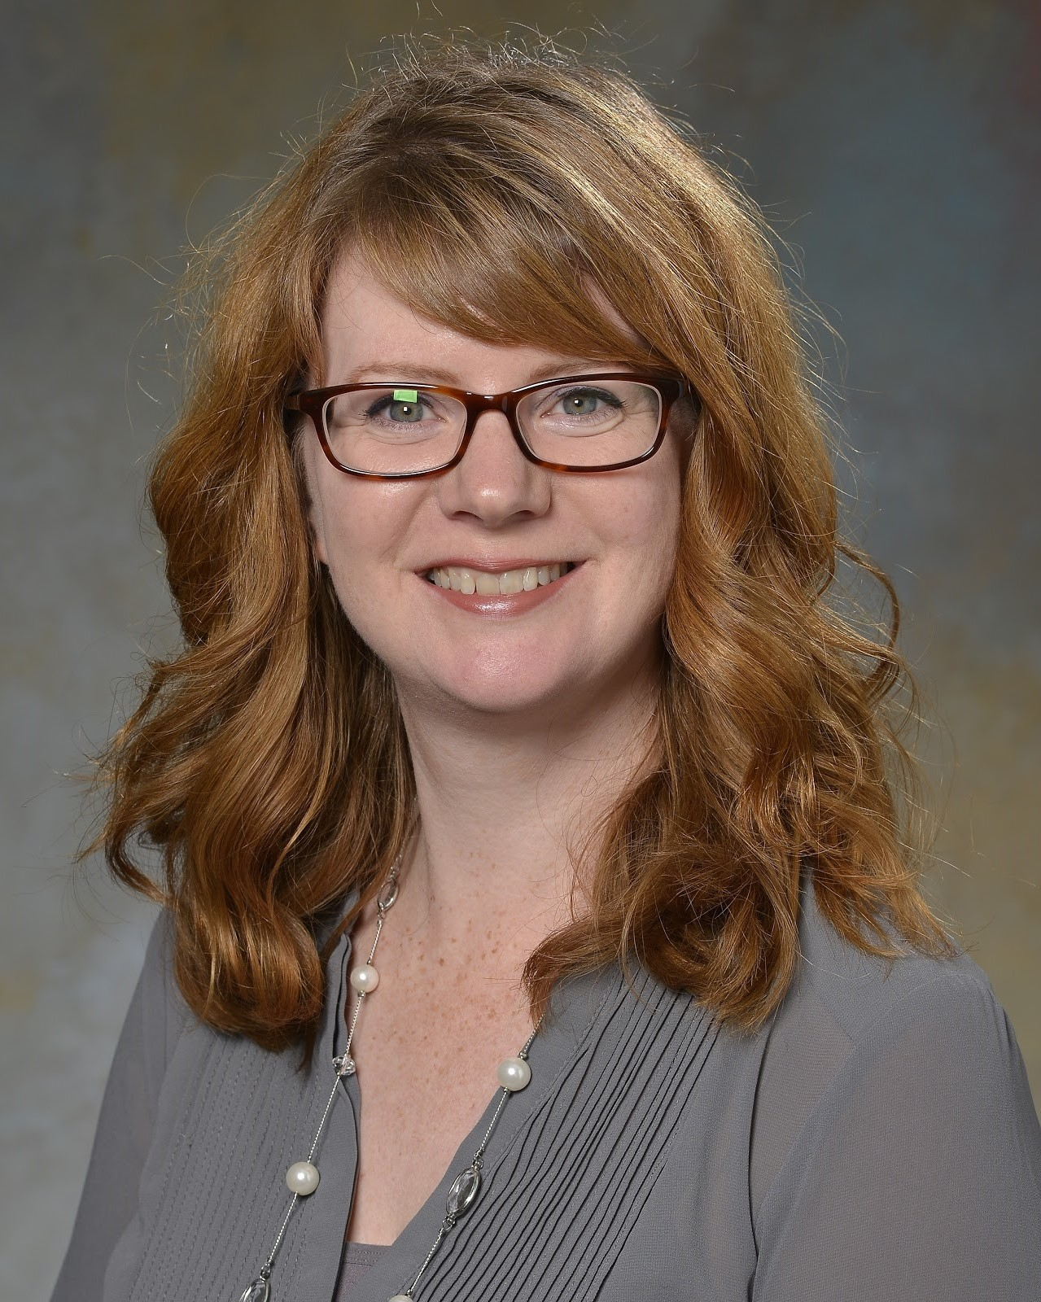
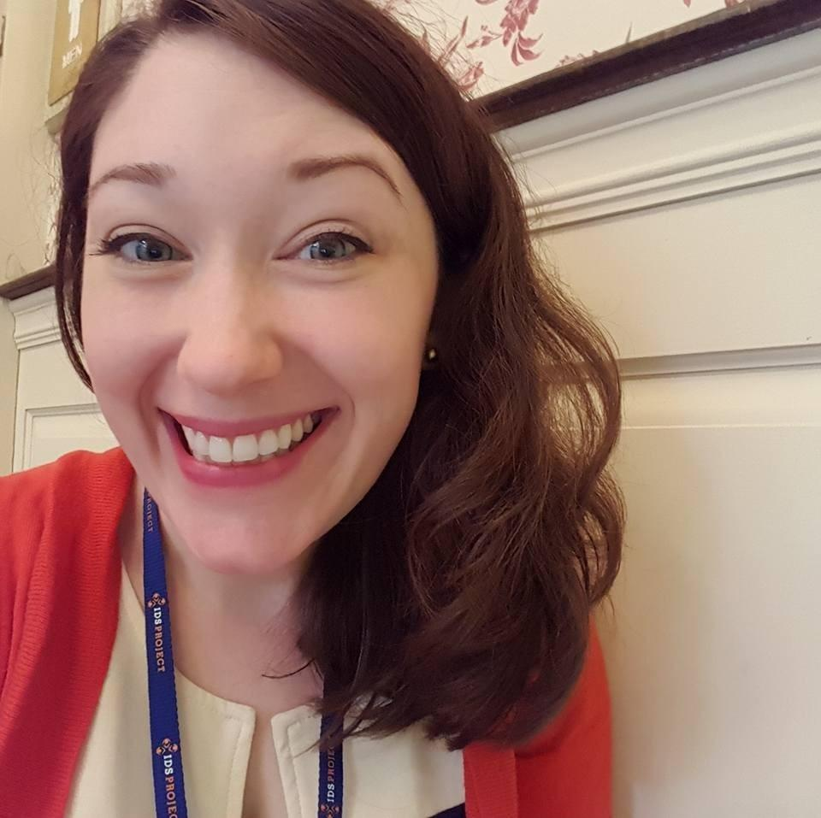
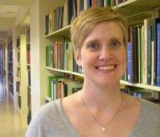
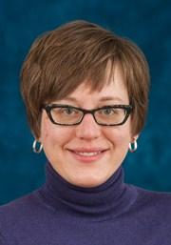
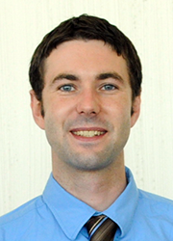
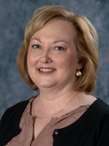
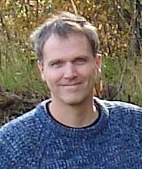
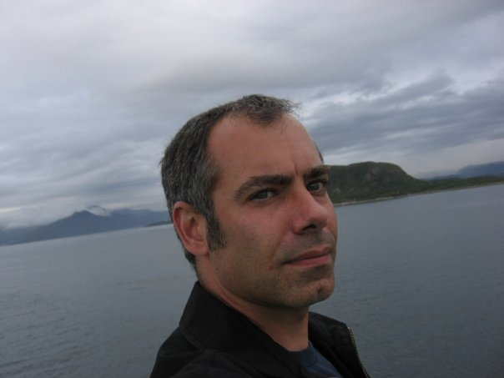
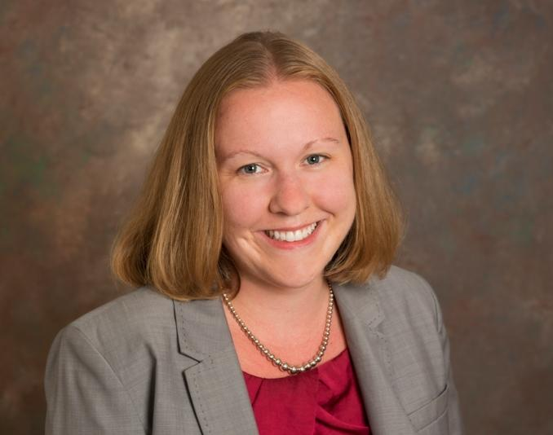
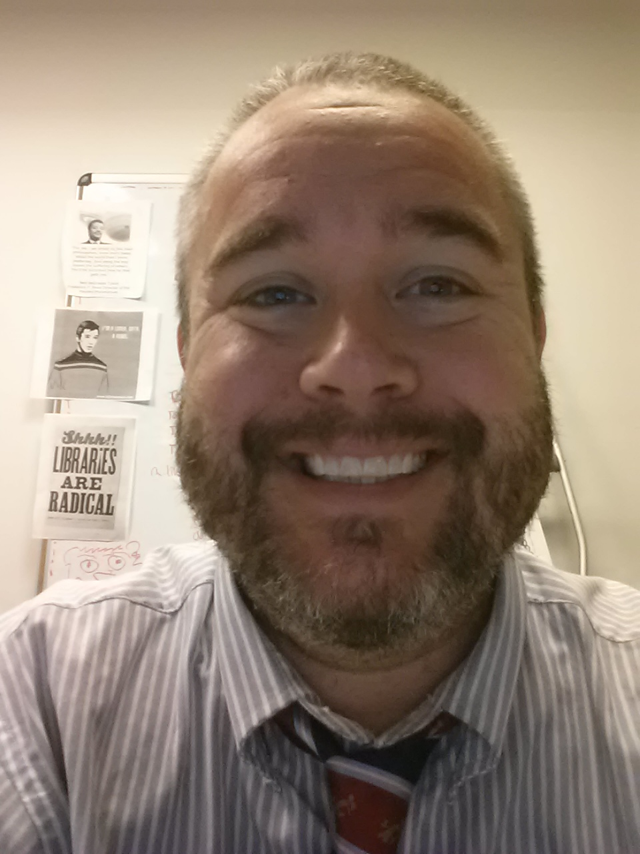
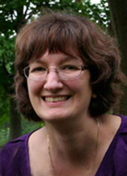
Current team of instructors
Kate Ross, St. John Fisher College | Kourtney Blackburn, St. John Fisher College | Heather Weltin, University of Wisconsin Madison | Tina Baich, IUPUI | Bill Jones, SUNY Geneseo | Cindy Kristof, Kent State | Lars Leon, University of Kansas | Kurt Munson, Northwestern University | Megan Gaffney, University of Delaware | Tom Bruno, New York University | Micquel Little, The Claremont Colleges | Chris Sisak, Nazareth College

Slide 23
Notes:
Our cohort of instructors provide a variety of perspectives on best practices as implemented at smaller private institutions all the way up to large R1s

Slide 24
Stats and Impact
Foundational Courses:
offered 6 times to 165 students
on average, courses full in 24 - 48 hours after registration opens
completion rates avg 50%
12 instructors involved over 5 years

Slide 25
Stats and Impact
Specialized Courses:
offered 1 times to 90 students
courses 80% full in 48 hours after registration opened
10 instructors involved over first 2 years

Slide 26
Next Steps
Continue building community of resources and discussion
Continue developing courses based on community needs and interests.
Increase post-course engagement and conversation.
IDS Project developed the Online Learning Institute in January 2014 in an effort to meet the needs of our members as well as provide nationwide support for resource sharing training and discussion. A growing number of courses include instructional videos, resource materials, discussion opportunities, and web conferences to enhance access to professionals in the field of resource sharing. Provided by a nationwide network of colleagues to encourage discussion, troubleshooting and innovation throughout the field of resource sharing.

Slide 27
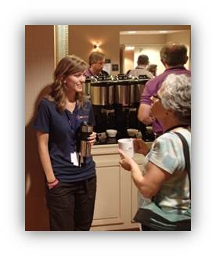
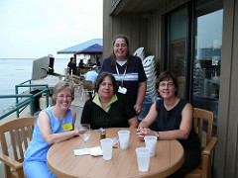
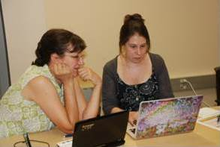
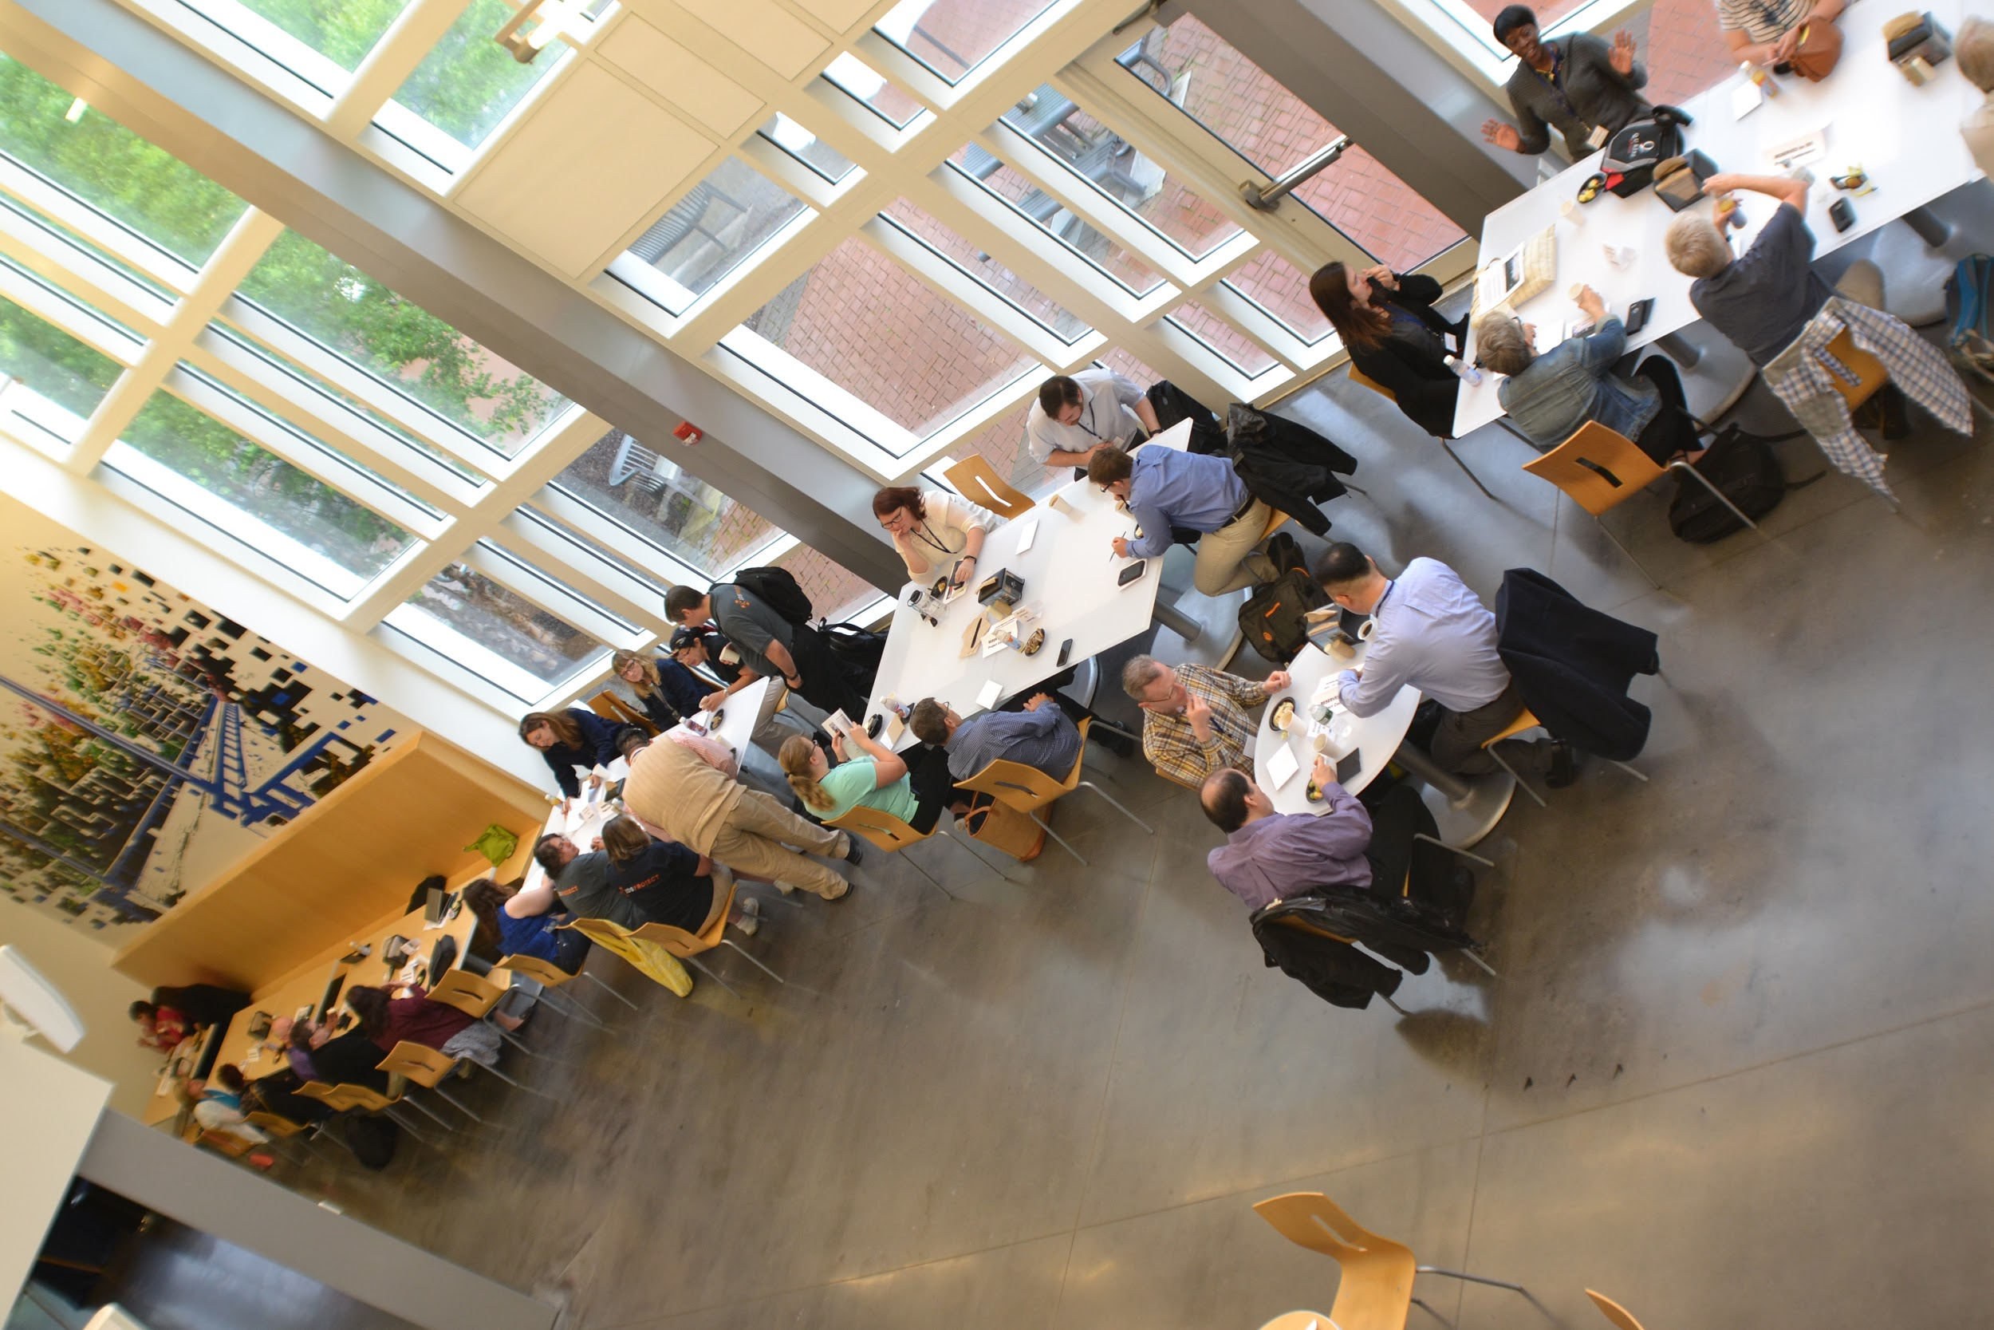
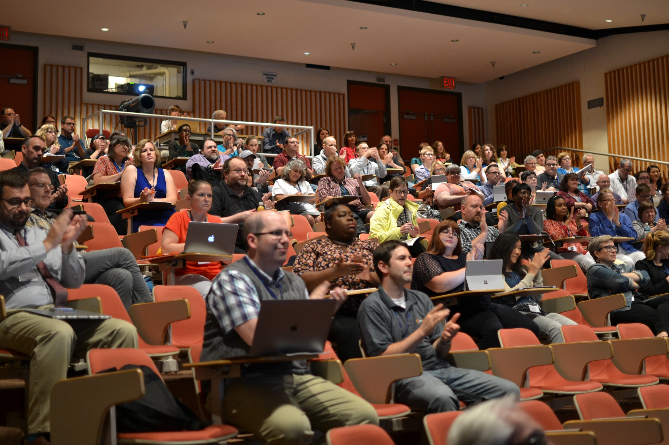
Come for the technology...
stay for the
community!
Notes:
add pics of conference fun - Can we find others?
Invite everyone to the annual conference in July or to contact any of us or IDS for more information or to join as a new IDS member

Slide 28
Jennifer Acker
Micquel Little Beth Posner
HUDSON VALLEY
COMMUNITY COLLEGE
THE CLAREMONT COLLEGES
LIBRARY
THE GRADUATE CENTER
CUNY
j.acker1@hvcc.edu
micquel.little@claremont.edu bposner@gc.cuny.edu

