Slide 1
Strategic Library Partnerships:
More than Books – Lending Biomolecular Models
Denise Gergetz, Milwaukee School of Engineering

Slide 2
Denise Gergetz
Librarian II and Archivist

Slide 3
The MSOE Model Lending Library

Slide 4
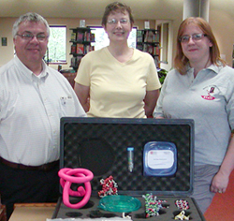
The MSOE Model Lending Library
A unique collection of models and materials loaned to classrooms through the United States.
70+ models covering 22 different areas of molecular science.

Slide 5
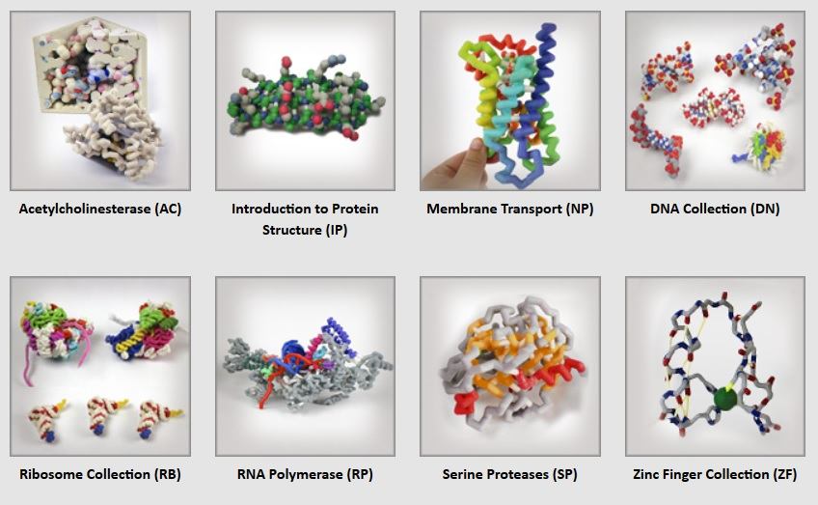
Demonstration Models

Slide 6
Classroom Sets

Slide 7
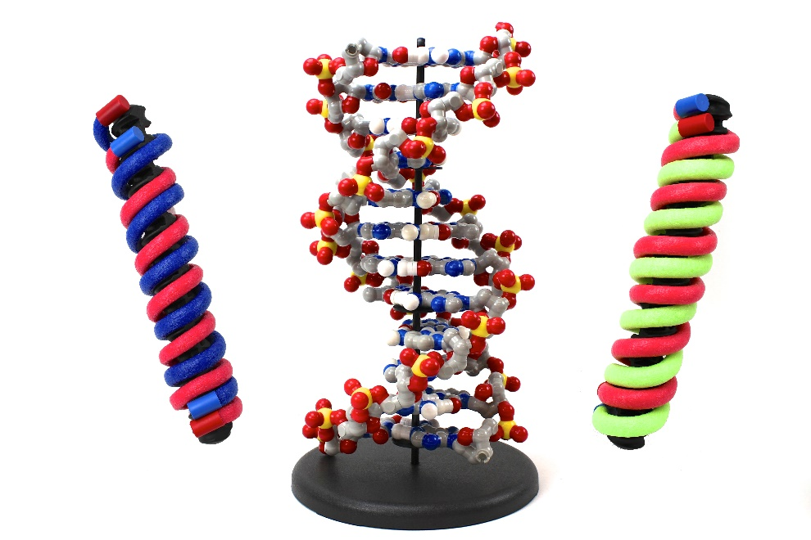
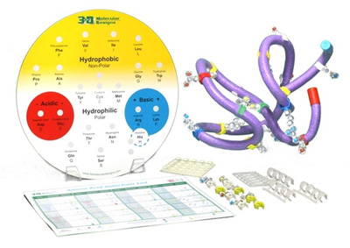
DNA Discovery Kit
Amino Acid Starter Kit

Slide 8
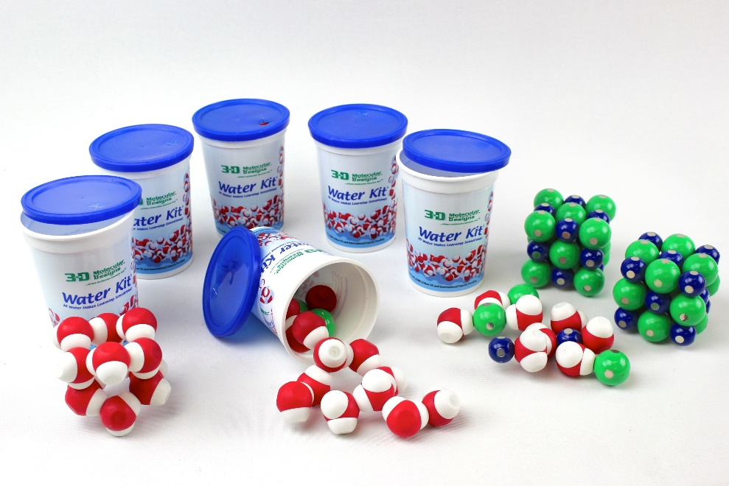
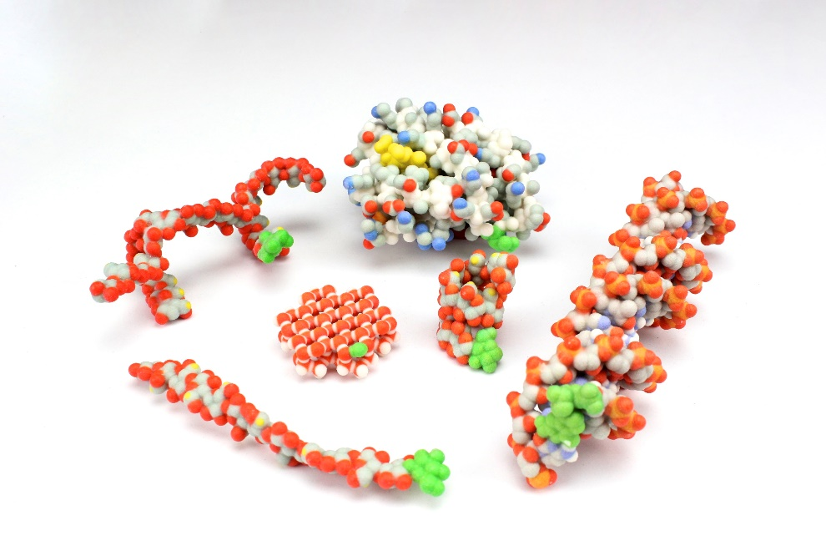
Water Kit Collection
Molecules of Life

Slide 9
Two Departments:
One Unique Partnership

Slide 10
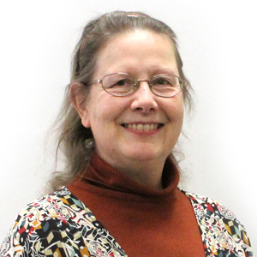
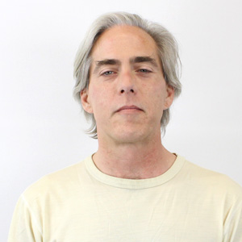
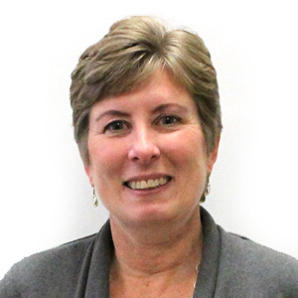
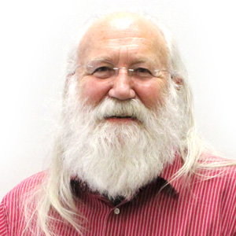
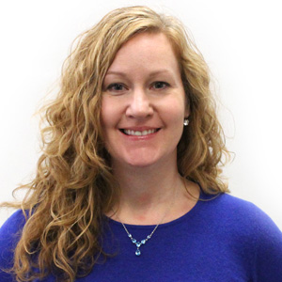
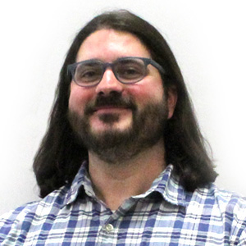
The Center for Biomolecular Modeling (CBM)
A group of teachers, scientists and artists working to create revolutionary educational materials and outreach programs that help make biosciences understandable.

Slide 11
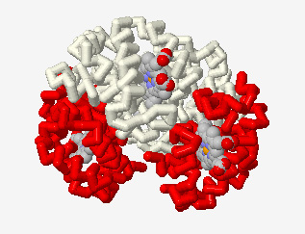
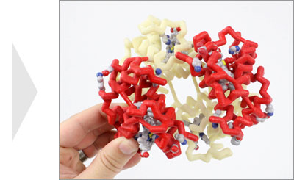
3-D Printing
Physical Models are created using molecular visualization software Jmol and then exported as 3D files.

Slide 12
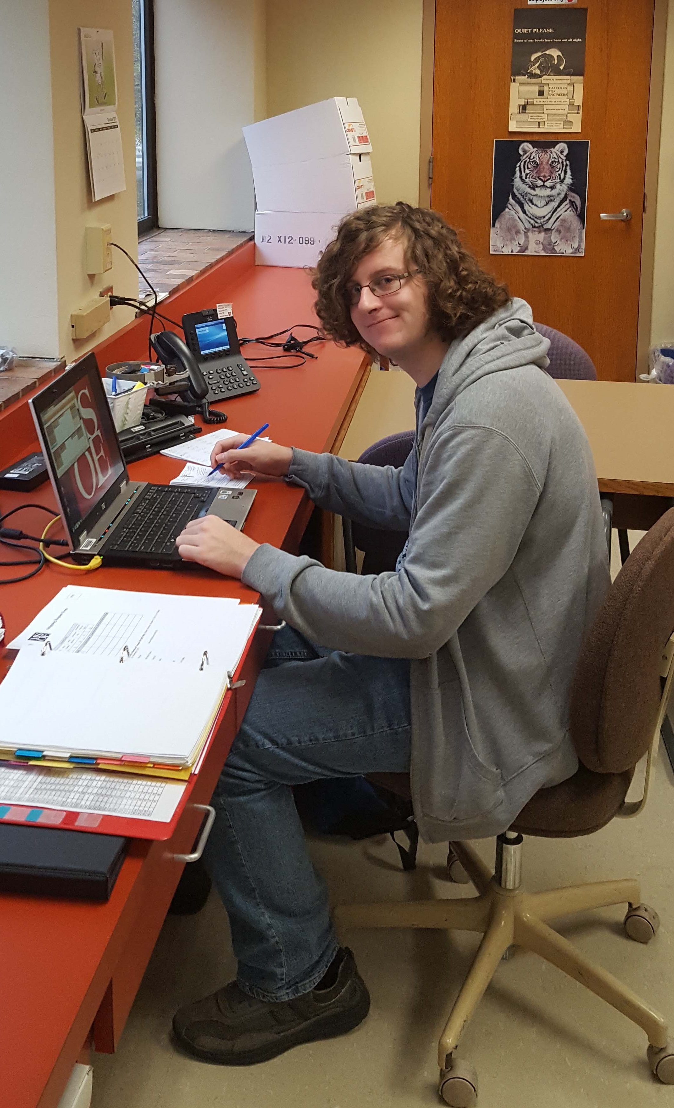
The Walter Schroeder Library
Academic Library serving about 3,000 students, faculty and staff.
The Model Lending Library is a function of our Interlibrary Loan Department.

Slide 13
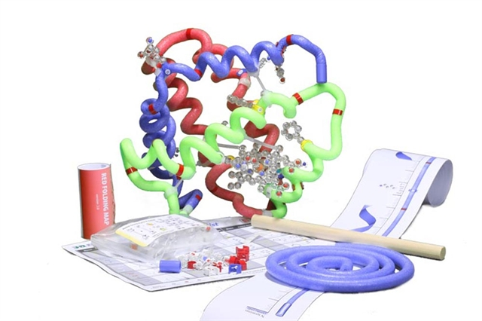
The History of the Lending Library
Tim Herman, Director of the CBM approached Gary Shimek, Director of the Library with the idea.
Officially began in September of 2003 with 5 models.
Today there are 22 types of models/kits, 75 models total

Slide 14
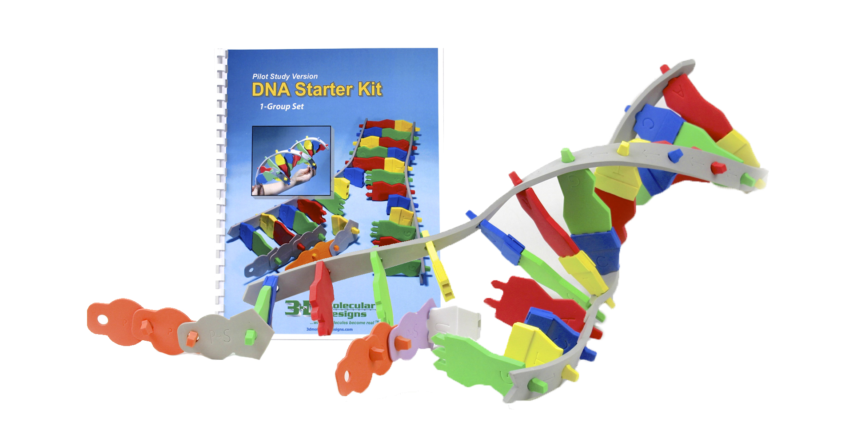
Partnership Benefits
An Efficient and Effective Lending Library
Applying library practices and methods help the lending function of the MSOE Lending Library run smoothly.
Strong Institutional Morale
This departmental collaboration further establishes a positive connection to the University as a whole.

Slide 15
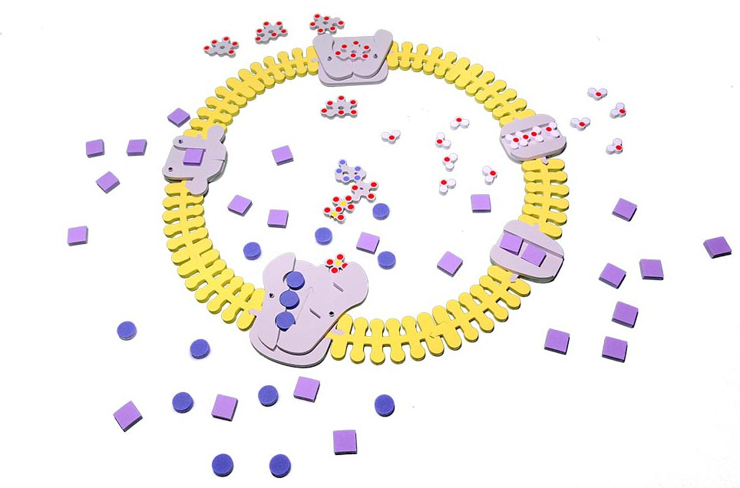
Benefits continued
Vision and Mission Fulfillment
This partnership helps us meet our mission of resource sharing for educational benefit.
This partnership allows both departments the opportunity to make strong contribution to scientific literacy and learning enhancement.

Slide 16
The Model Lending Library

Slide 17
Workflow
Patron Requests Model
We process the request and prepare the loan
We send the model to the patron
Request Form through Springshare’s LibCal Equipment Bookings
Clio Software is used to generate a lending form.
Shipping and patron data tracked with Excel.
We ship through FedEx Ground.
We cover delivery shipping the patron is responsible for return shipping.

Slide 18
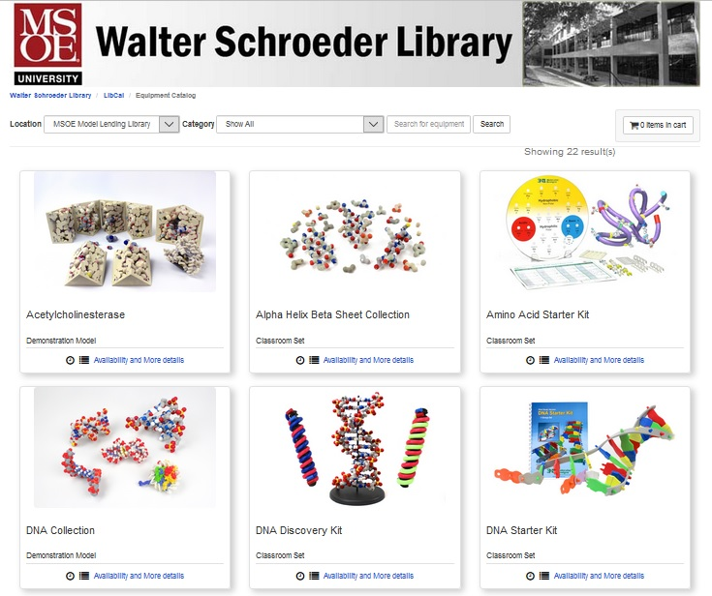

Slide 19
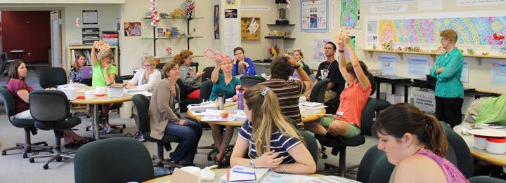
Awareness
CBM Workshops
Exhibits at Education Events
Teaching Resources
Student Programs
Online Resources
Other Educators

Slide 20
Challenges

Slide 21
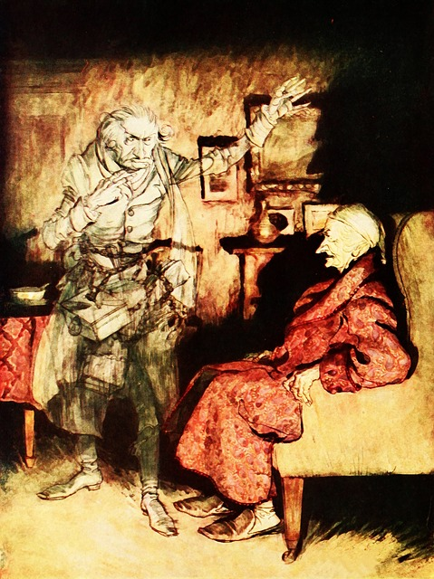
Supply and Demand
Scheduling
During the Fall many of our models are booked back-to-back.
Our scheduling includes some padding for processing time.
We recommend scheduling very early.

Slide 22
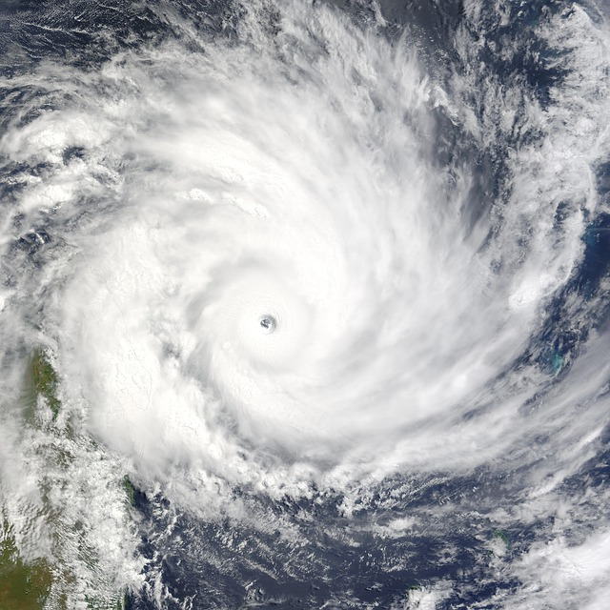
Overdue Models and Extensions
Late returns can impact our lending.
We allow 1 week extensions when possible.
Scheduling Disruptions
Transit
Life
Weather

Slide 23
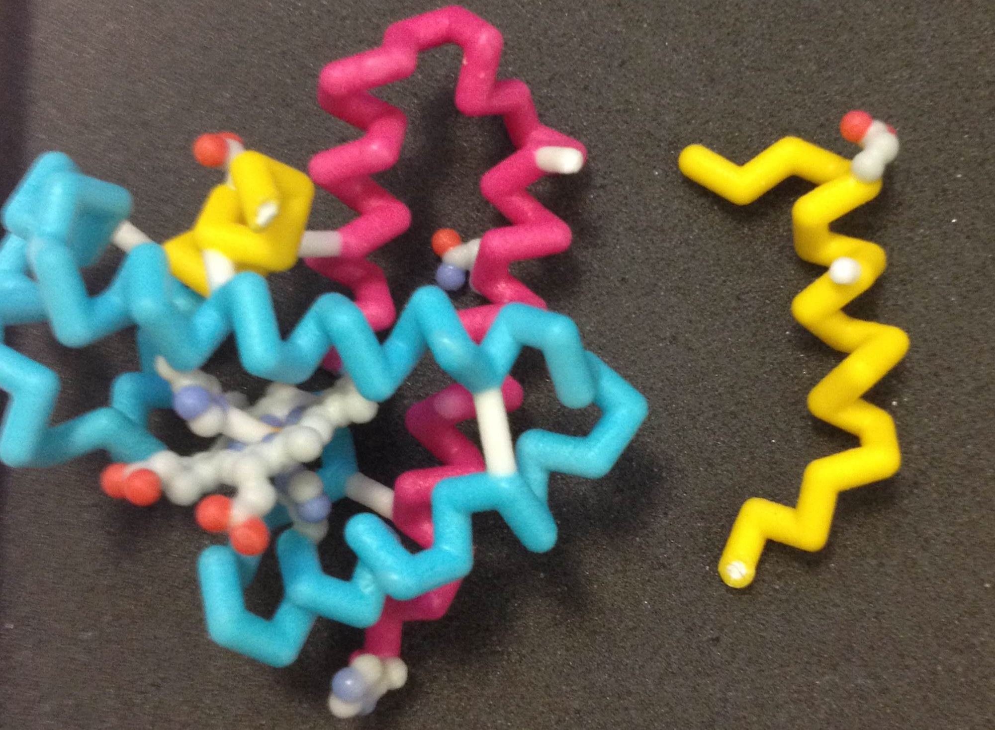
Damaged and Lost Models
Occasionally the materials do get damaged
Models lost in transit or during the loan has been fairly rare.

Slide 24
Lending Data

Slide 28
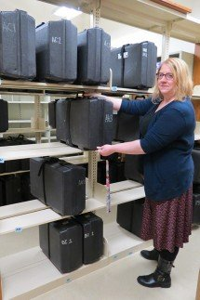
Evaluation and Growth
Loan Data
Surveys
Studies
We use this information to justify continuing the program and to assess the needs for expansion and growth.

Slide 29
Looking Ahead

Slide 30
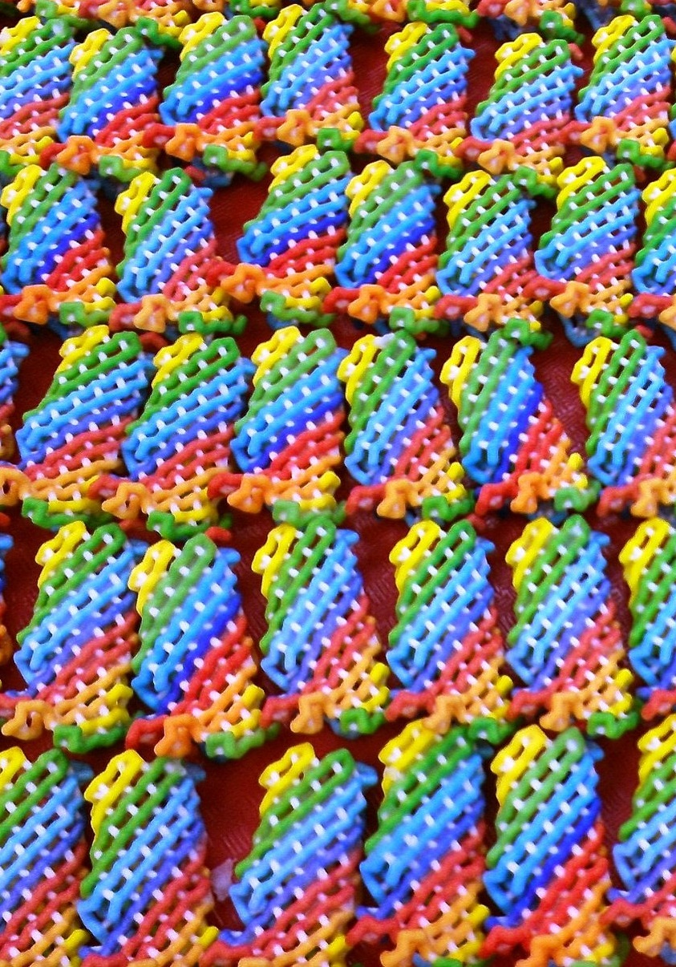
Lending Library Hub Locations
Additional model sets and new models for the Lending Library.
Grant funding to start more model lending libraries at various locations throughout the country.

Slide 31
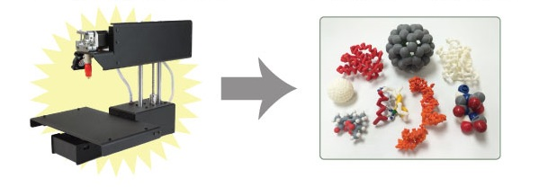
3-D Printers in Schools
With the popularity of 3-D printers and costs decreasing, it is hoped that more students will be able to benefit from these resources.

Slide 32
Denise Gergetz
Margaret Franzen
Walter Schroeder library Milwaukee School of Engineering
Center for Biomolecular Modeling
Milwaukee School of Engineering
(414) 277-7182
gergetz@msoe.edu
www.msoe.edu/library
(414) 277-2806
franzen@msoe.edu
http://cbm.msoe.edu

