Slide 1
INTERLIBRARY LOAN AND AFFILIATES OF THE HISTORY DEPARTMENT THE COLLEGE OF NEW JERSEY (TCNJ)
Perception Vs. Reality
Bethany Sewell
David Murray
Jacksonville, FL
OCLC Resource Sharing Conference, March 14, 2018
Notes:
Thank you for coming to our session. We are delighted to present the preliminary results of our recently-conducted survey on ILL use by history faculty and their capstone students at The College of New Jersey (TCNJ). We focused on History Department affiliates for two reasons. First, as a group, historians and even history capstone students typically express a greater need for resources not already held by TCNJ Library than affiliates of other departments. Second, our perception in recent years has been that history faculty demonstrated the most reservations about using local ILL services.

Slide 2
Outline
Local context
Research impetus and questions
Research methods
Preliminary findings
Local ILL use data
Preliminary conclusions
Notes:
Our presentation will cover the following…

Slide 3
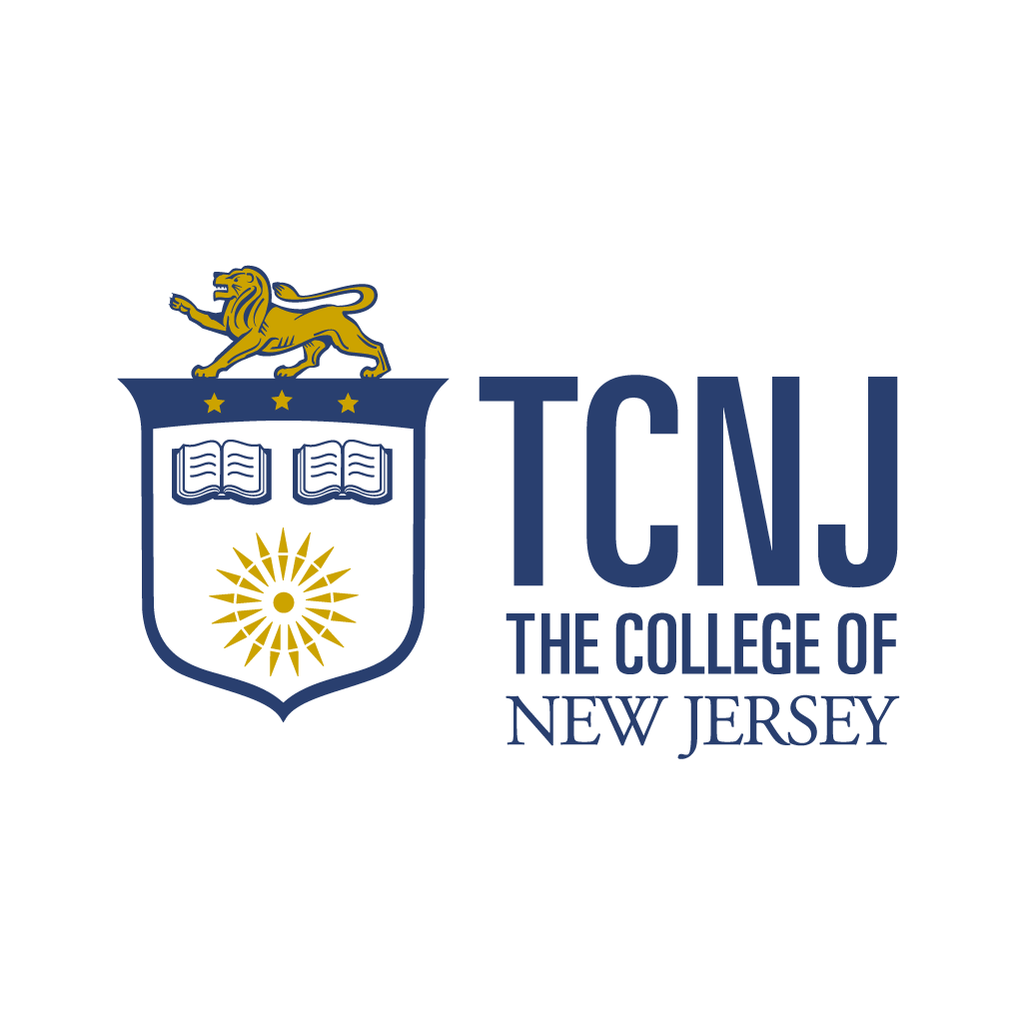
TCNJ Profile
A strong liberal arts core
6,500 full-time undergrads
95% from New Jersey
95% of freshmen live on campus
87% graduation rate

Slide 4
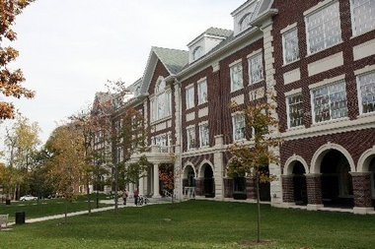
TCNJ Library Profile
The five-story, 135,000 square-foot facility
663,897 Books
8,628 Ebooks
70,347 Journals
Approx. 200 Online Databases

Slide 5
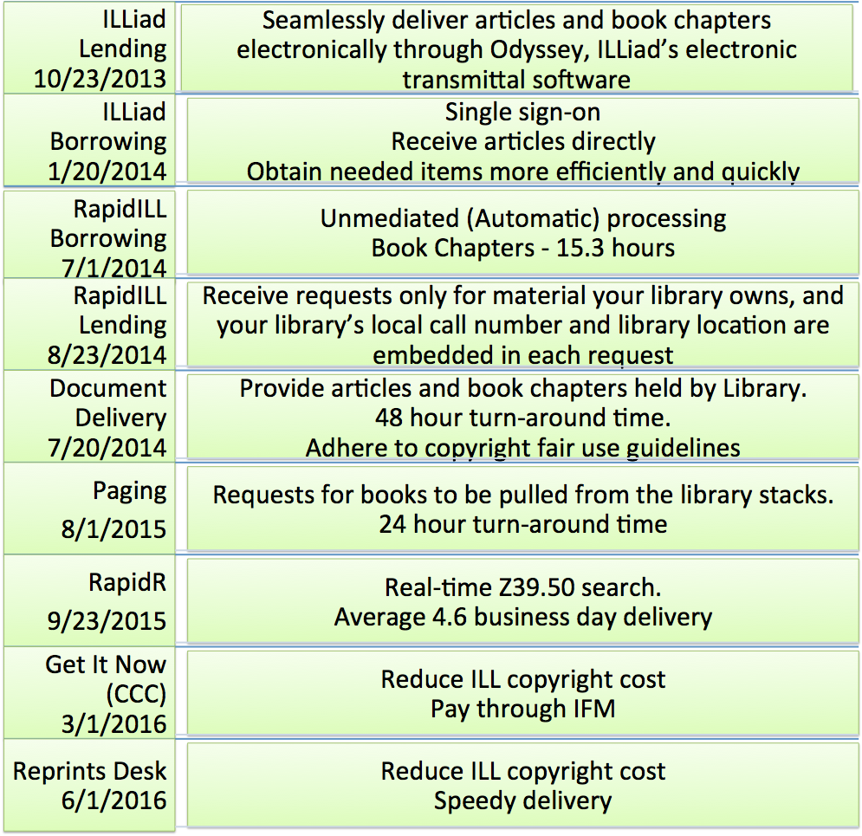
TCNJ ILL improvement timeline

Slide 6
Rapid - Unmediated requesting - returnables

Slide 7
Rapid at TCNJ (FY 2016)
2,049 returnables were requested through RapidILL
613 (30%) filled from RapidR
TAT 6.69 days (including weekends and holidays)
9,136 non-returnables
83% (7,580) of those requests were filled through RapidILL
TAT 8.7 hours
609 book chapters were requested through RapidILL
81% (495) of those requests were filled through RapidILL
TAT 15.8 hours

Slide 8
Overall user experience
User confidence leads to more use
40% increase in requests for nonreturnables
25% increase in requests for returnables.

Slide 9
Research Impetus and Questions
Impetus:
Despite demonstrable improvements in ILL promotion, turnaround times, and overall use, some historians told us that they remained reluctant to initiate ILL requests for returnables (books) or to confidently recommend ILL to their students.
Questions:
Have historians (and their capstone students) increased their use of ILL? If so, why? If not, why not? In other words, are perception and reality in sync among ILL users affiliated with the TCNJ History Department?
Notes:
[More on impetus:] Several faculty expressed concerns specifically about history majors’ ability to quickly and efficiently obtain the secondary monographs required to complete their capstone projects in a timely manner.

Slide 10
ILLiad Data
All 23 faculty affiliated with the History Department
14 tenured or on the tenure track
9 adjuncts
75 history capstone students (2017-2018)

Slide 11
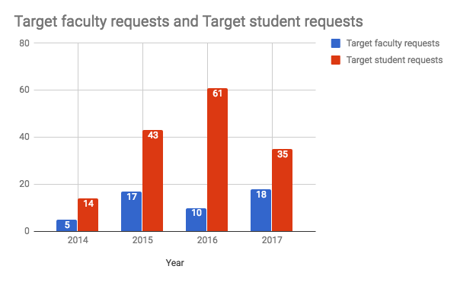
ILLiad Data - Requests made by year

Slide 12
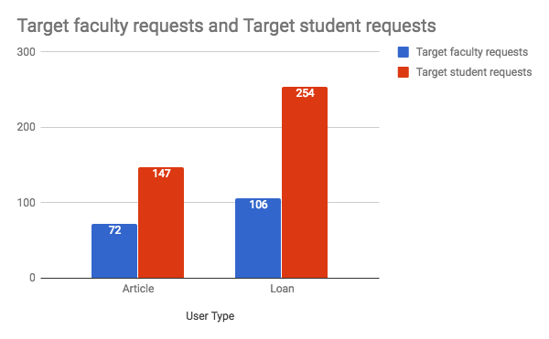
ILLiad Data - Requests made by type

Slide 13
Research Methods
Anonymous Qualtrics survey consisting of 25 questions (multiple choice + 2 open-ended); extensive use of skip, branch, and display logic
3 demographic questions (affiliation; faculty rank; employment duration)
6 faculty-only questions
3 student-only questions
13 questions for both faculty and students
Survey targets
All 23 faculty affiliated with the History Department
14 tenured or on the tenure track
9 adjuncts
75 history capstone students (2017-2018)

Slide 14
Response Rates
Status | Faculty (All) | Faculty (T/TT) | Faculty (Adjuncts) | Capstone Students
Invited (n) | 23 | 14 | 9 | 75
Response Rates (n, %) | 15 (65%) | 11 (79%) | 4 (44%) | 28 (37%)
Notes:
One faculty member did not indicate their status.

Slide 15
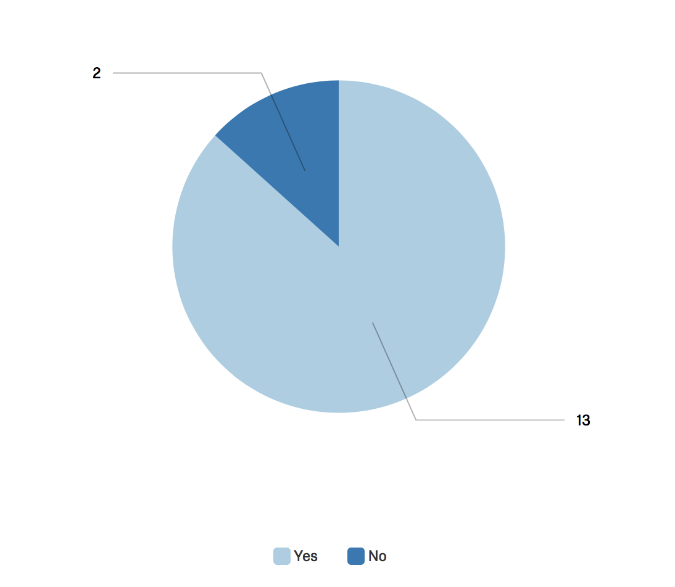
Greater Willingness to Use ILL Reported by Historians
Question: Have you found yourself more willing to use ILL to make book requests, either for your own research needs or to recommend ILL to your students, in roughly the last three years?
Notes:
QF2
The vast majority (13 or 87%) of history faculty who participated in the survey reported a greater willingness to use or recommend ILL. This suggests that progress has been made since the the Humanities Librarian received initial negative feedback about ILL in the spring of 2015. When broken out by length of employment, all of the nine faculty members with six or more years of service to the department reported a greater willingness to use or recommend ILL. We see this as a success.
Historians’ perceived the qualitative data that emerged from the two open-ended questions (Q18 and Q19). Examples:
“I recognize the cost/benefit calculation and as much as I would like a PALCI membership with 48 hour book delivery I am satisfied with the current arrangement with [sic] is substantially better than it was before.”
“Thank[s] for making such significant improvements to ILL. My students and I are using this service more because of the faster turn around. ILL is essential for us in history for both teaching and research.”
“When I compare TCNJ’s ILL services to major research institutions with ILL only, TCNJ seems similar. I appreciate this.”
“I have found ILL to be efficient and helpful.”

Slide 16
Reported Motivations for Using ILL (Historians)
Question: Which factor(s) played a role in your willingness to use TCNJ Library’s ILL service? (check all that apply)
Notes:
QF3
Of the 13 faculty who reported a greater willingness to use ILL since 2015, 11 (or 85%) indicated that their personal need for resources not held by TCNJ Library increased during that period. A slight majority (7) attributed their willingness to use ILL to improved turnaround times, while 5 (or 38%) credited ILL promotion by the Humanities Librarian. Although provided with the option, no faculty wrote in any “other” motivation.

Slide 17
Reported Motivations for Using ILL (Historians)
Question: Which factor provides or might provide the greater motivation in your desire to experience improved turnaround times for borrowing books through TCNJ Library’s ILL service?
Notes:
QF1
However, when historians were asked “Which factor provides or might provide the greater motivation in your desire to experience improved turnaround times for borrowing books through TCNJ Library’s ILL service,” two-thirds (10) indicated that their own research and their students’ research motivated them equally. Based on anecdotal conversations with historians, the Humanities Librarian hypothesized – perhaps incorrectly, as it turns out – that historians would report students’ research as the greater factor in their desire to improve turnaround times for returnables. Based on aggregate ILL use data, however, we believe this could still be the case even though faculty report both factors as equal motivators.

Slide 18
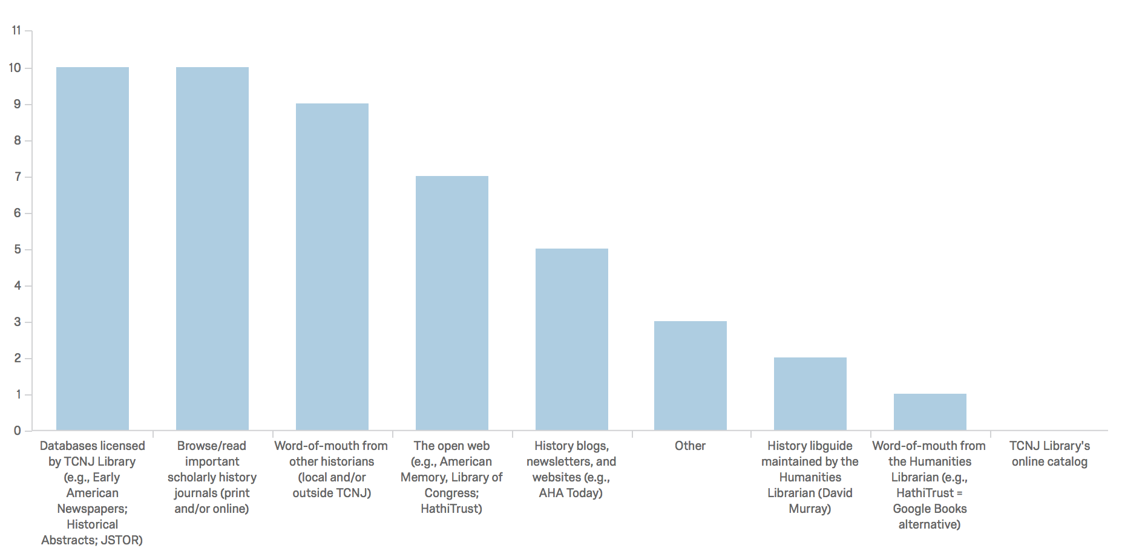
Reported Information Discovery Methods (Historians)
Question: How do you discover resources for your own research/scholarship?
(check all that apply)
Notes:
QF4
Two-thirds [10] of historians reported that they relied on licensed library databases to discover primary and secondary sources that support their own research/scholarship. The same number relied on browsing the secondary journal literature for information discovery. In line with patterns revealed in the library science literature going back decades, almost as many (9) historians indicated that they relied on word-of-mouth recommendations from other historians, whether local and/or outside TCNJ, to discover resources.
Note that local historians do not report using the catalog to discover resources for their own research, but this does not necessarily mean that they do not use the catalog. Recent research suggests that faculty across the disciplines rely heavily on catalogs to track down known items at the very least. Two of the three respondents who selected ”other” in fact indicated that they used other catalogs, namely WorldCat and Berkeley’s Hollis, for discovering resources for their own research/scholarship. The third “other” respondent relied on “bibliographies in related scholarship” (i.e., footnote chasing) to discover resources for their own research.

Slide 19
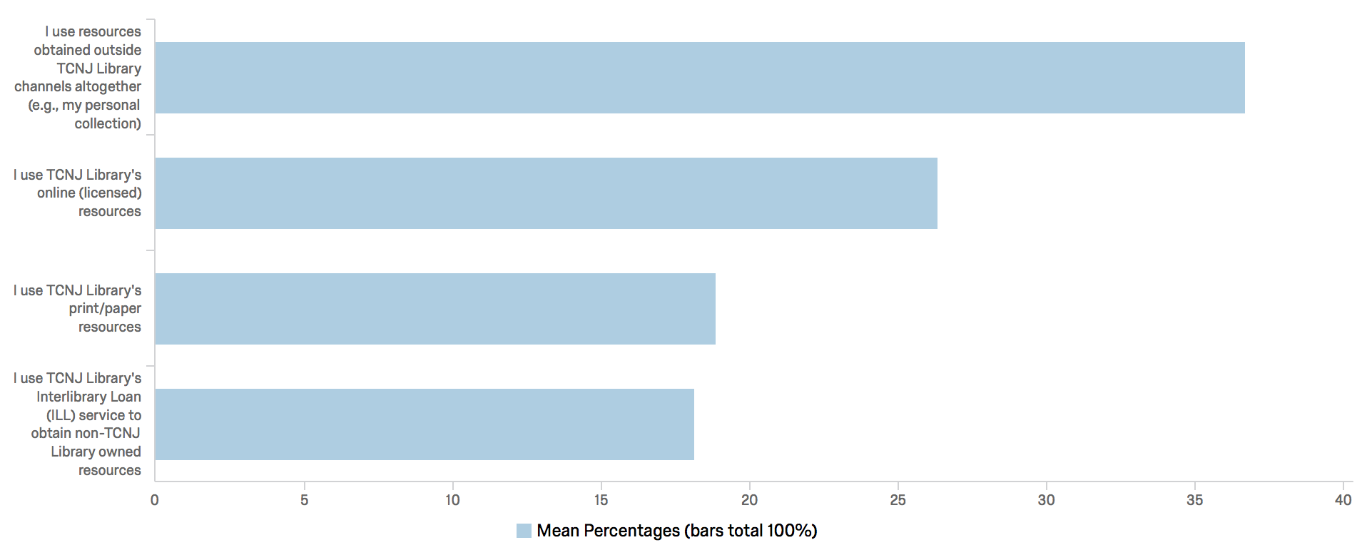
Methods for Obtaining Resources (Historians)
Question: How do you obtain resources? Indicate the approximate percentage of time that you spend using each resource for research and teaching-related purposes. Figures must total 100.
Notes:
QF5
Historians on average reported sourcing a plurality (36.67%) of their resources from outside TCNJ Library channels altogether. Next, in descending order, are local library databases (26.33%), local printed materials (18.87%), and interlibrary loan (18.13%). Regardless of faculty rank or length of employment, resources obtained outside TCNJ Library channels altogether constituted the plurality. (The single faculty participant employed with the college for 3-6 years actually spent 60% of their time procuring resources from outside TCNJ altogether.) As might be expected, the groups most reliant on ILL are tenure-track faculty (25%), tenured faculty (23.14%) and faculty who have taught at the college for fewer than 3 years (21%).
A factor exists that might, at least to a certain degree, make TCNJ historians outliers in relation historians working at other undergraduate colleges: Because our campus is located roughly between Philadelphia and New York City, it sits within perhaps the densest concentration of archives and research libraries in the United States. The closest of these libraries, Princeton’s Firestone Library, is a short 20 minute drive from campus. TCNJ Library maintains a formal arrangement with Princeton Libraries that allow our faculty and stuff ready access to Firestone’s world-class collections. What is more, many TCNJ faculty graduated from nearby research institutions (e.g., Princeton, Rutgers, and Brown) and have managed to retain remote access to the resources of some of those institutions.

Slide 20
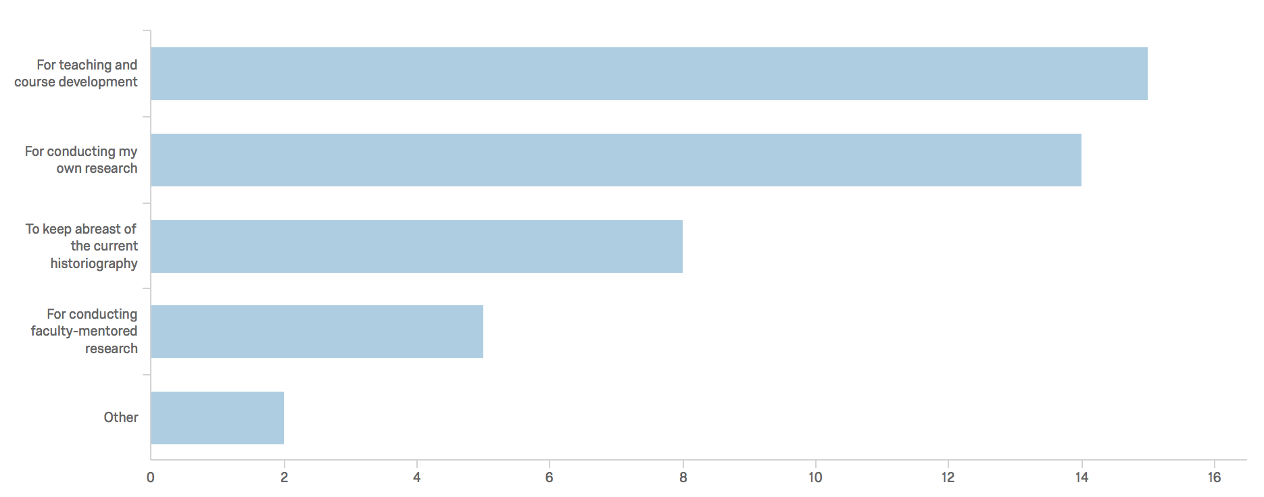
Why Do Historians Access Library Resources?
Question: For what purposes do you access the library’s resources?
(check all that apply)
Notes:
QF6
Reinforcing the pattern that emerged in QF1, nearly as many local historians reported accessing library resources “for conducting my own research” (14) as ”for teaching and course development” (15 or 100%).
Other:
“I use ILL services for my own research and some teaching; I use the TCNJ print collection for teaching.”
“Reading for pleasure, sometimes.”

Slide 21
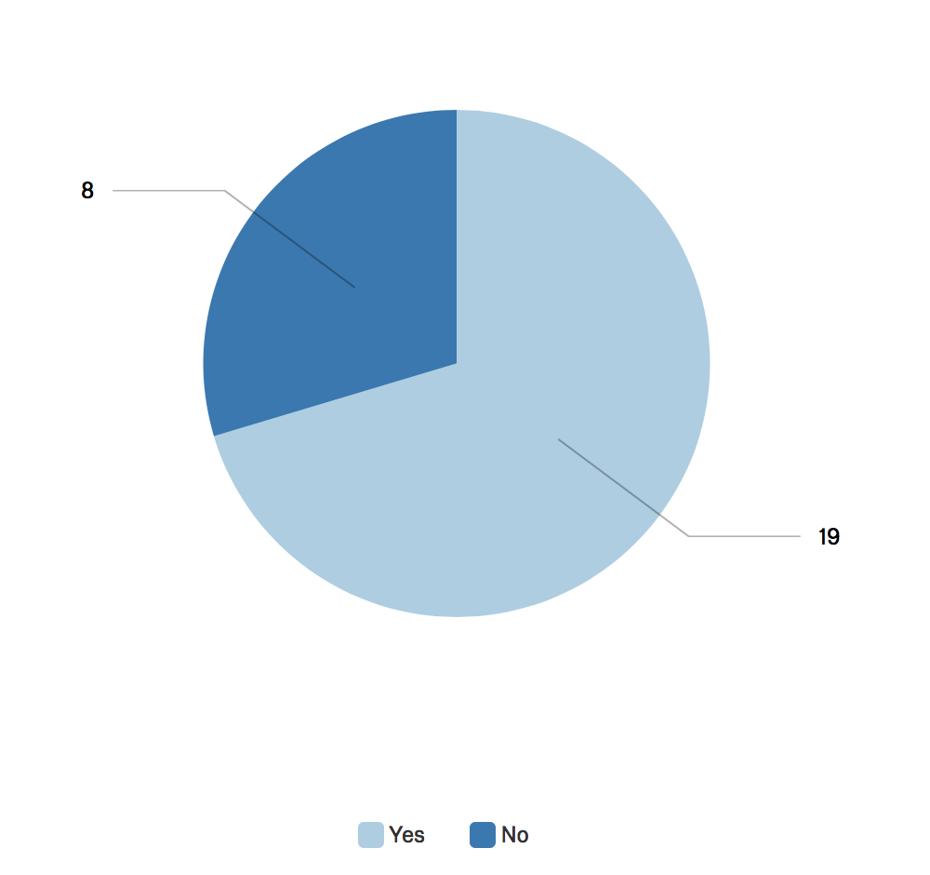
ILL Use (History Capstone Students)
Question: Have you ever used TCNJ Library’s Interlibrary Loan (ILL) service to request a history book from another library?
Notes:
QS1
Of the 27 capstone students who answered this question (one left it blank), 19 (or 70%) indicated that they had used TCNJ Library’s ILL service.
Twelve history capstone students (or 44%) reported using ILL service 10 or more times (Q9).
Seventeen students (or 63%) reported using ILL at least once per semester (Q11).
Nearly three-quarters combined (20 students, or 74%) reported requesting mostly “books” (12) or “books and articles equally” (8) (Q12).
Roughly the same number of students reported waiting ”a few days” (8) as reported waiting “a week” (9) for the last book requested via ILL (Q14). These figures are very much in line with our statistics that show turnaround times for whole books have been reduced, on average, to 5 days.
Most significantly, three-quarters combined (20 or 74%) reported being “very satisfied” (13 or 48%) or “satisfied” (7 or %26) with their overall ILL experience. No students reported being “somewhat dissatisfied,” “dissatisfied,” or “very dissatisfied”.

Slide 22
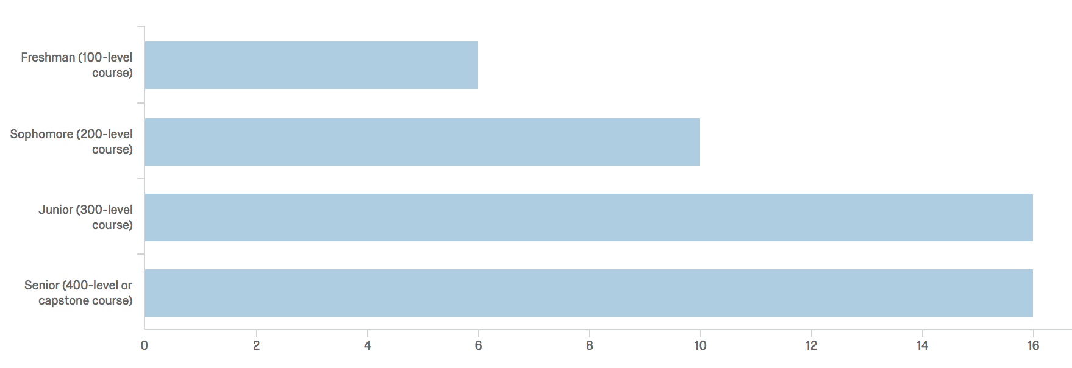
ILL Use by Course Level (History Capstone Students)
Question: If yes, for which level history course(s)?
(check all that apply)
Notes:
QS2
As might be expected, history capstone students reported increased use of ILL as they moved through the history curriculum. The six students (or 22%) who reported using ILL for a 100-level course is mildly surprising.

Slide 23
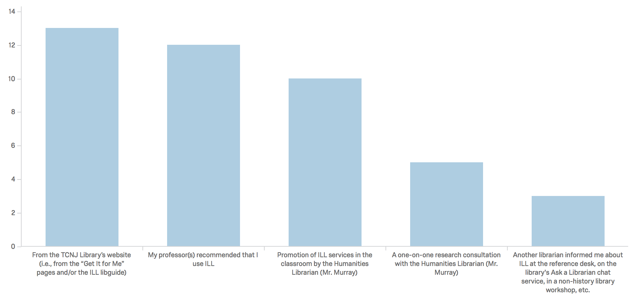
ILL Discovery (History Capstone Students)
Question: If yes, which factor(s) had an impact on your knowledge of and/or willingness to use TCNJ Library’s ILL service, if any?
(check all that apply)
Notes:
QS3
Of significance, even if expected, the recommendations of students’ professors positively impacted 12 (44%) students’ knowledge of and/or willingness to use ILL, ranking just behind the library’s website (13 or 48%). ILL promotion by the Humanities Librarian and other librarians also had a positive impact.

Slide 24
Preliminary Conclusions (1)
Historians (85%) reported a greater willingness to initiate or recommend ILL book requests in the last three years.
Use data suggests that this willingness is tied to concerns about students’ ability to use ILL to good effect. Indeed, historians themselves reported spending 37% of their time obtaining resources from outside TCNJ Library channels altogether.
We conclude preliminarily that initial (2015) faculty expressions of concern about poor turnaround times resulted from observations that their students (not them) lacked timely access to returnables.
History capstone students are using ILL and benefitting from it.
Notes:
Contrary to our expectations, which were based on anecdotal communication with local faculty, the vast majority of TCNJ historians (85%) reported that they are more willing to initiate ILL book requests since 2015. This phenomenon, they reported, is tied first and foremost to increased needs as teachers and scholars for resources not held by TCNJ Library. Formal curricular outcomes, for example, now require that students incorporate primary sources into research projects in 400 or capstone level courses, as they always have, but also now in 300 and even 200-level courses. Students taking 100-level Craft of History courses work mostly with secondary materials.
Aggregate use data suggests that the greater motivation among local historians for improved ILL turnaround times lies in students’ ability to make good use of ILL to quickly gain access to monographs. Aside from one “super user” and three moderate users, most local historians initiated few if any personal ILL requests since 2015. Indeed, on average the historians who participated in the survey reported spending 37% of their time obtaining resources for teaching and research purposes from outside TCNJ Library channels altogether. They spent on average about half that amount of time (18%) obtaining resources through ILL.
We therefore conclude preliminarily that initial (2015) faculty expressions of concern about poor turnaround times resulted from first-hand observations that students (not themselves) lacked timely access to history monographs (returnables). We believe this to be the case even though two-thirds (10) of historians reported that their own personal research needs motivated them equally (Slide 9). Except for one heavy and three moderate ILL users, aggregate use data simply do not support the notion that local historians require improved turnaround times to support their own research needs. Rather, any concerns in this direction must be speculative or hypothetical since most TCNJ historians do not make personal use of the library’s ILL services.

Slide 25
Questions?
sewellb@tcnj.edu
murrayd@tcnj.edu

