Slide 1
Library consortia & how they participate in resource sharing
OCLC Resource Sharing Conference
Jacksonville, Florida
March 14, 2018

Slide 2
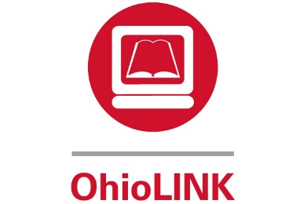
Bethany Sewell
The College of New Jersey
Lori Smith
Colorado State Library
Myra Justus
Cincinnati State Technical and Community College
Notes:
Brief Description of each consortia

Slide 3
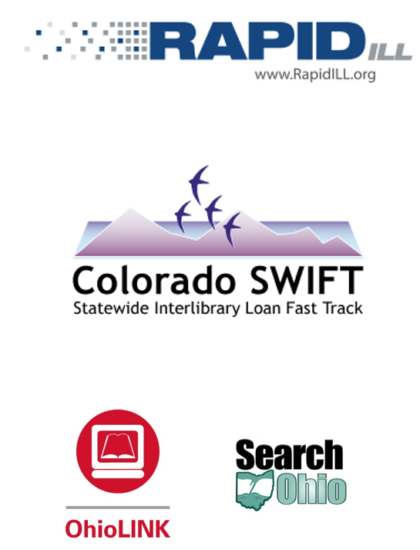
Membership Information
Notes:
Rapid
Pods
Membership Requirements
Colorado
335 SWIFT libraries
Public, School, Academic, Correctional, Special
Ohio
~120 academic libraries (OhioLINK-Ohio Library and Information Network)
~30 public libraries and ~ 100 public library branches (Search Ohio).
Membership Requirements

Slide 4
Policy Information
Notes:
Rapid
Cost
24-hour turnaround time by filling or updating to unfilled
Insure receipt by the borrowing library within 4 business days
At least 8 weeks for the loan period.
Colorado
Libraries do not charge each other for requests
Lenders determine loan periods, renewals, overdues, and lost
No charge for membership – software, training, support
Ohio
No Charge for requests
Fines/Fees/lost items due to borrowing library
Statewide Standardized loan rules

Slide 5
Shipping Information
Notes:
Rapid
Benefits
Cost
Real Time Avaliability
Colorado
Pay for the shipment of items
Courier – statewide (1 million subsidy from the state) – per item cost?
Ohio
Priority
Shipping System

Slide 6
Consortia Software & Technology
RapidILL/RapidR
VDX
D2D
Zportal & Z39.50
ILLiad
Innovative Integrated Library System
Millennium/Sierra
INN-REACH
Various other ILS
Notes:
Colorado
VDX (standing for Virtual Document eXchange) is a software product for interlibrary loan (ILL) and document request management. ^{[1]} VDX was developed by UK company Fretwell-Downing Informatics, a company which in 2005 was taken over by OCLC PICA, itself wholly acquired by OCLC Online Computer Library Center in 2007.^{[1]}
Web based software
Some libraries use NCIP and ISO ILL to streamline workflow
Various ILS – not a union catalog – Z39.50 servers
(Innovative, Polaris, SirsiDynix, TLC, Koha, OCLC, EOSi, Follett, Insignia, Cybertools, Auto-Graphics, Book Systems)
Positive – real time holdings and availability checking
Negative – slow searches and quality of bibliographic records
ZPortal – some use for patron initiated
VDX going away
Relais staff
Software development
Uses Z39.50, include our member libraries with current ILS
NCIP
Others experience with D2D?
3 groups using III & INN reach (Prospector, Marmot & Flatirons)
Challenge – dozen different ILS
API & DCB
Create new group
Others experience with III?

Slide 7
Looking Toward the Future
Notes:
Colorado
VDX going away
Was version of OCLC Worldshare
OCLC acquired Relais
D2D now replacement
Still exploring all solutions
Concentrate on two
Need to consider resource sharing environment in CO

Slide 8
Thank you!

