Slide 1
Stretching the Elastic: Since One Size Does NOT Fit All
AMY GREENBERG
ANNE E. MCKEE
CAROL NELSON

Slide 2
GWLA
Scholars Portal
Minitex

Slide 3
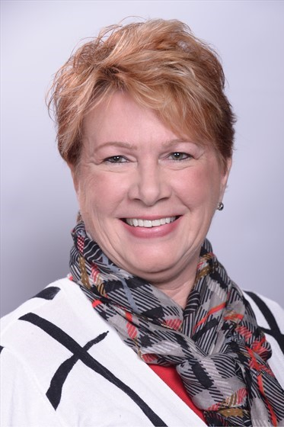
Anne E. McKee, MLS
Greater Western Library Alliance (GWLA) Program Officer for Resource Sharing

Slide 4
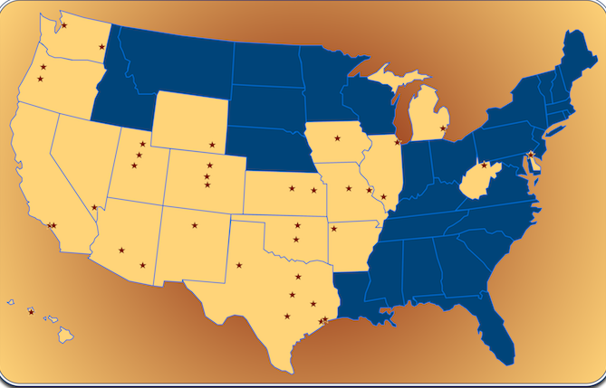
The Pond!

Slide 5
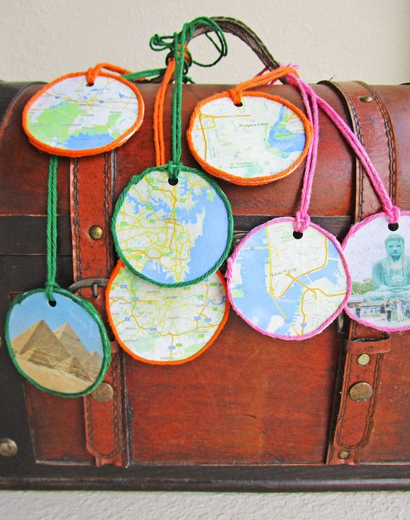
Have laptop-will travel!
Littlepassports.com

Slide 6
Greater Western=West of the Pond☺
38 Members
Origins back in 1980’s; 5 name changes (!)
100% funded by member dues
GWLA Institutions Strong: Even Stronger together
Membership Process: http://www.gwla.org/about-gwla/GWLA-Bylaws
GWLA Members:
*APLU *ARL *AAU
Notes:
*19 States : Delaware to Hawai’i; Washington State to Texas
*Originally centered around Big 12 5 name changes: 2001 for GWLA,

Slide 7
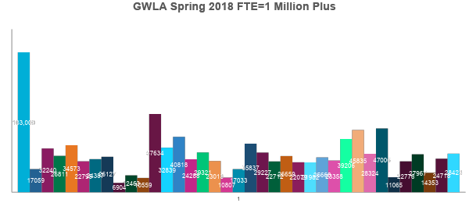
GWLA FTE
Notes:
ASU the largest, Rice the smallest in terms of fte

Slide 8
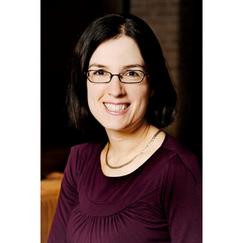
Amy Greenberg
Scholars Portal, Ontario Council of University Libraries

Slide 9
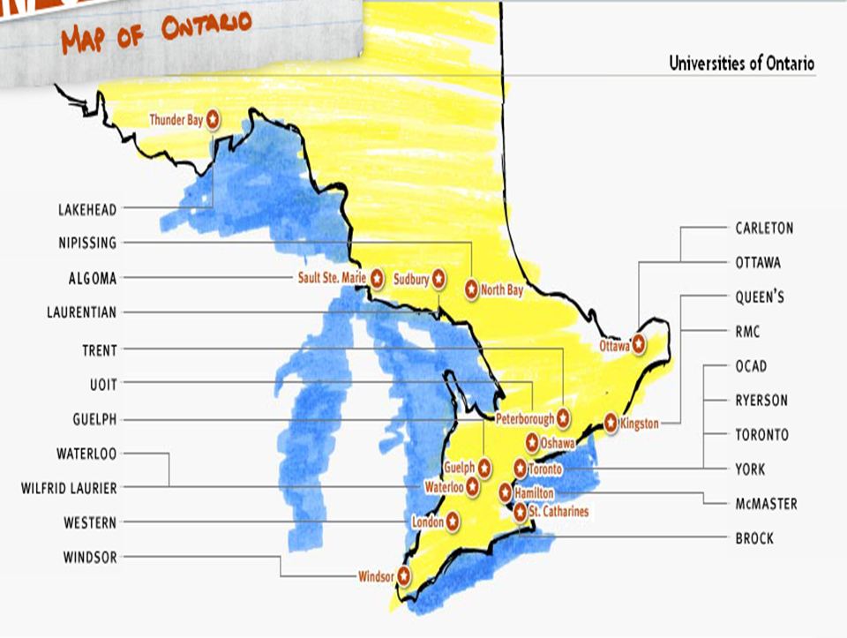
Notes:
OCUL, or the Ontario Council of University Libraries is a consortium of libraries at the 21 universities in Ontario.
Have existed as a Council since 1967, with libraries joining as new universities were created
OCUL is not a legal entity on its own – we are an affiliate of the Council of Ontario Universities (COU). So it is very much an academic library consortium.
Here is a map of the province of Ontario with the Great Lakes - Most of the universities are in the more populated areas of southern Ontario but we have schools spread across the province and also in the north.

Slide 10
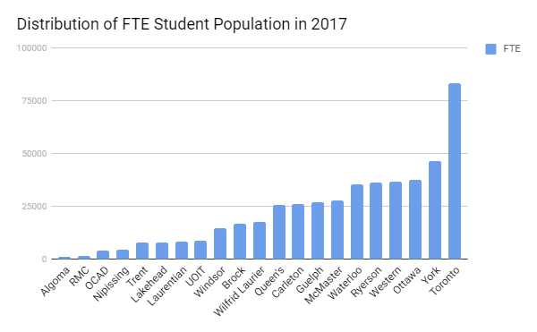
Notes:
To give you a sense of the population we serve - The total university student population in Ontario is over 466,000 – this is about 1/3 of all the university students in Canada.
The population at the Ontario universities varies considerably, with the smallest and newest university, Algoma, having only about 1,400 and the largest, Toronto, at more than 83,000. Toronto is the largest by a considerable margin - the next largest is York with about 47,000 FTE.
Other factors also vary among schools such as the demographic makeup and the programs that they offer. So there is a diversity of needs for our members and their communities. We have several 4-year undergraduate schools as well as several research intensive schools, plus some specialized institutions such as a military college (RMC) and a Fine Arts university (OCADU).

Slide 11
OCUL – who we are and what we do
Commitment to work together to maximize our collective expertise and resources
Enhance information services in Ontario and beyond through
collective purchasing
shared digital information infrastructure
collaborative planning
advocacy
assessment
research
partnerships
communications, and
professional development
Notes:
OCUL is a member-driven organization. We have a longstanding commitment to work together to maximize our collective expertise and resources. We see ourselves as collaborating to support Canada’s knowledge economy by providing the information tools and access essential for high quality education and research in Ontario’s universities.
We are funded directly by membership contributions from the libraries; there is a fairly complicated costing formula to calculate each member’s portion. Some services have been expanded beyond the scope of the consortium to other provinces in Canada, so there is a bit of revenue generated from those as well.
OCUL is continually building on an established record of leadership in the shared development of innovative digital library services and collections. We have received several national and provincial grants to develop infrastructure and shared services, which have since been folded into the ongoing services provided to members.

Slide 12
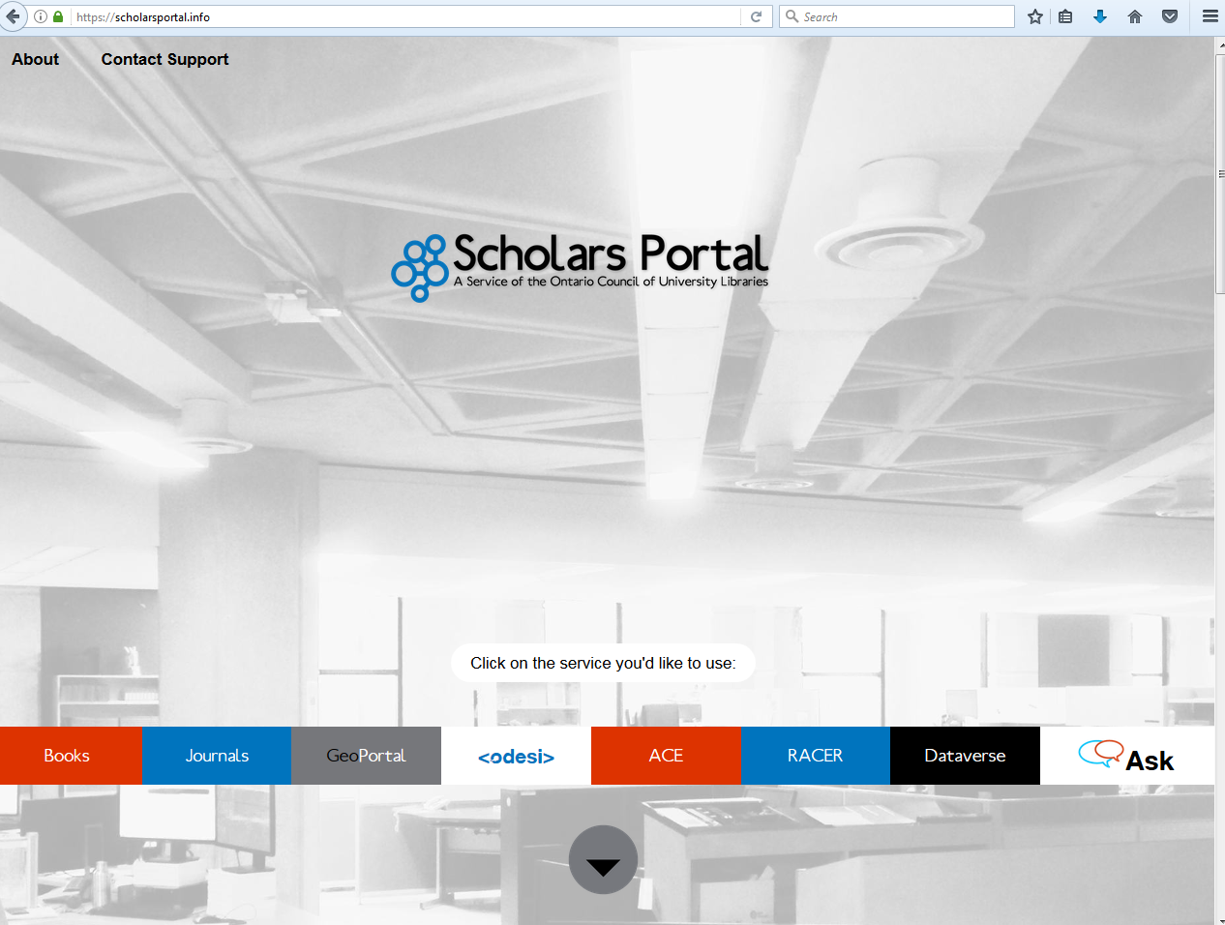
Scholars Portal
Notes:
Scholars Portal is the service arm of OCUL and it is basically the group of services that make up the shared digital infrastructure mentioned earlier. It was established in 2002 as a way to implement OCUL’s planning and direction.
This is a screen shot of our current website (under revision). The background is a photo of part of our office at the University of Toronto.
SP staff include librarians, programmers, and systems/network admins. The team are employees of one of the OCUL member libraries, University of Toronto. UTL acts as the service provider; they pay into OCUL membership like the other 20 schools, but a portion of the fees goes back to them to pay for staff salaries and HR expenses.

Slide 13
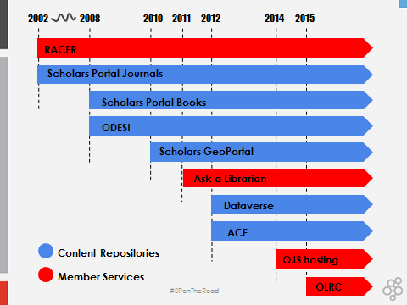
Notes:
SP provides a wide variety of services to students, librarians, faculty and staff at OCUL member institutions. Services are broadly characterized in 2 types - content repositories and member services.
Timeline slide, to highlight RACER (our ILL service) - very well-known and well-used service – it was the first service of Scholars Portal, launched in 2002 and went live to users in 2003.

Slide 14
OCUL Communities
Accessibility Quality Assurance
Assessment Resource Sharing
Data Video
Digital Curation
Geo
Government Information
Information Technology
Public Service Renewal
Publishing/Hosting
Notes:
One additional benefit to the membership is joining a community. Membership in the OCUL Communities is open to anyone within an OCUL institution
These communities are often where people first become involved with OCUL and are where they are able to contribute to and maintain interest in a topic they are either directly responsible for at the schools, or one they have a keen interest in.
Membership in the OCUL Communities is open to anyone within an OCUL institution. Currently we have over 200 staff at the libraries who are community members. Communities are provided with communication tools from the OCUL office, and are asked to submit a short annual report, but actual activities vary widely.
Resource sharing community is the longest standing and also one of the largest, since it represents a service that exists at every library. The membership is a mix of frontline staff and managers but tends to be more manager-level and discussions are more overarching, looking at future opportunities or ways to revamp service, not focused on daily user issues. We have a separate listserv which is operations-focused.
So, all of this to say that ILL services in our consortium exist as part of a wide variety of other services and benefits that member university libraries have access to.

Slide 15
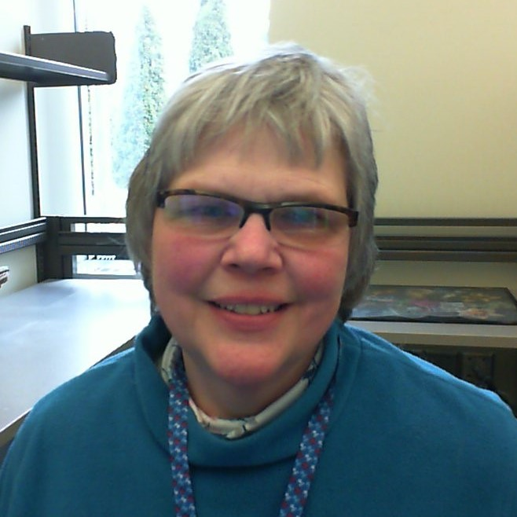
Carol Nelson
Minitex – Resource Sharing Manager

Slide 16
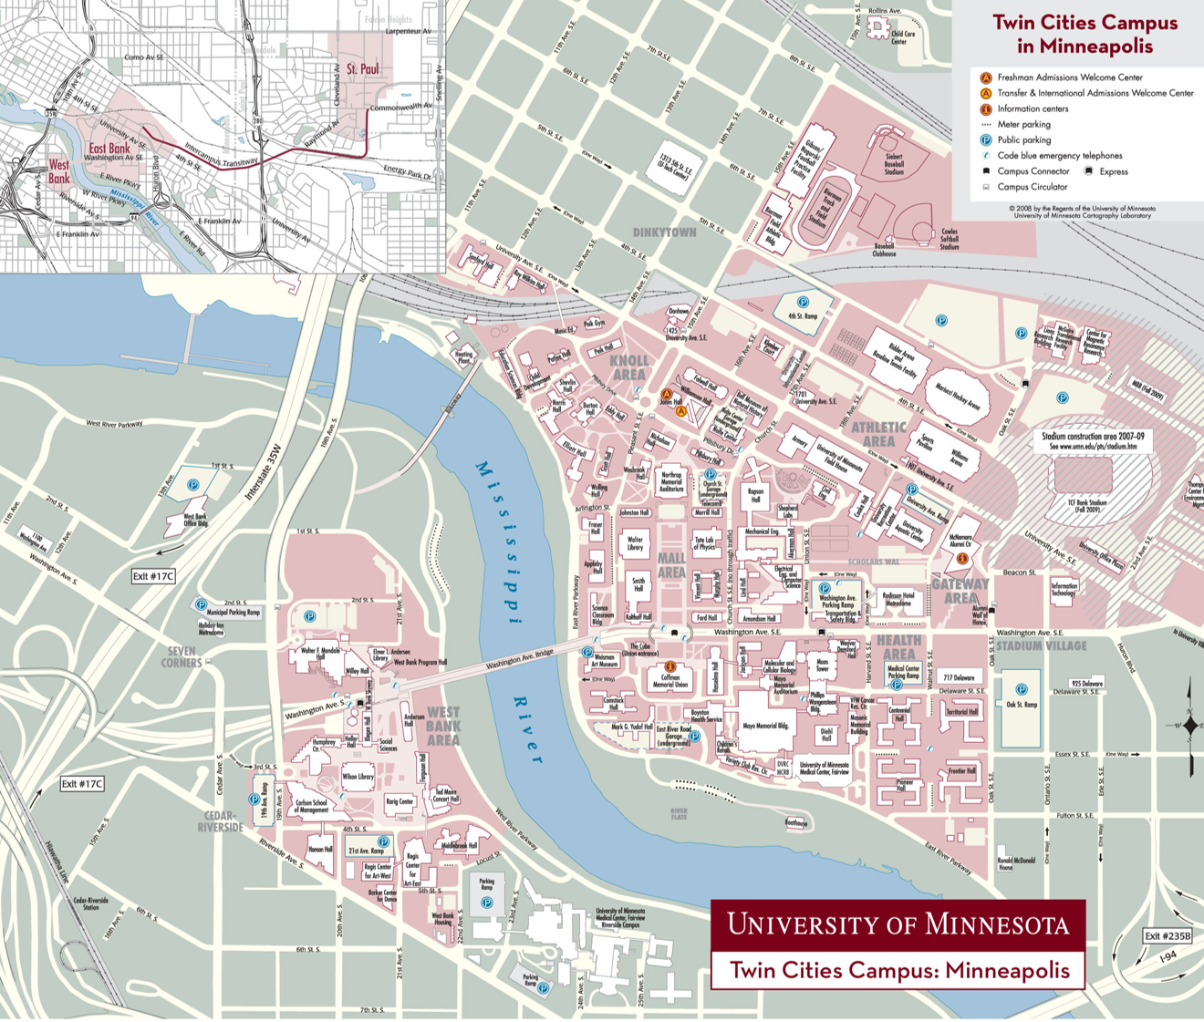
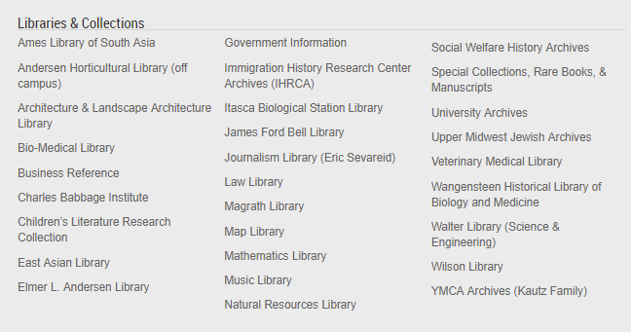
University of Minnesota Libraries
29 Libraries, collections and offsite storage
5 miles from main office to the most remote library
Notes:
Minitex is a consortium based at the University of Minnesota in Minneapolis. It started as a pilot project in 1969. In the 1960s, interlibrary loan was actually pretty rare - there wasn’t an OCLC database telling us where an item was owned. With few exceptions, ILL was reserved for academics, which usually meant faculty or graduate students. Interlibrary loan was cumbersome, often being arranged between librarians over the phone and sometimes required a patron to physically go to the lending library in person to use the item. Librarians were beginning to realize that sharing knowledge needed to be more accessible. ALA was encouraging libraries to share local information resources more broadly. Many Consortia developed around this time to assist libraries with creating sustainable ways to share their collections.

Slide 17
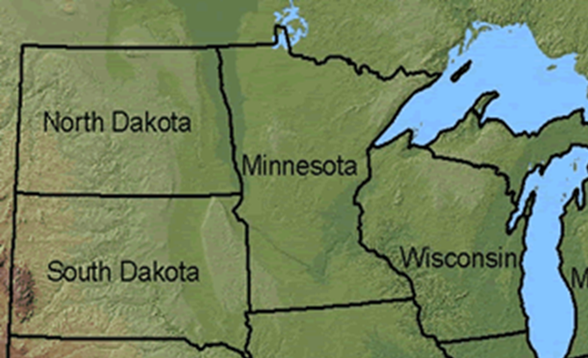
Notes:
Minitex is funded by the Minnesota state legislature and includes 376 libraries - there are no fees for borrowing or lending. We do also have contracts and work closely with North Dakota and South Dakota libraries, and we have a sharing agreement with Wisconsin libraries as well.

Slide 18
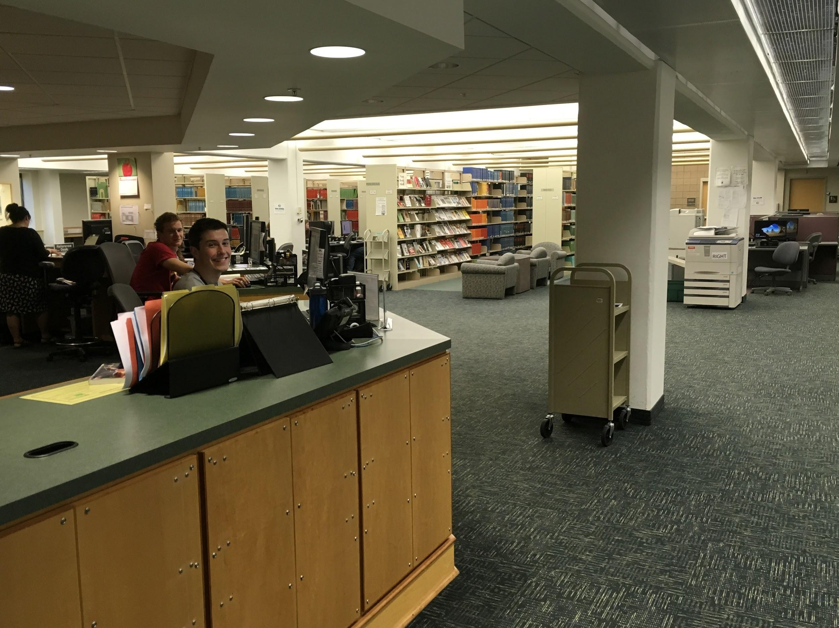
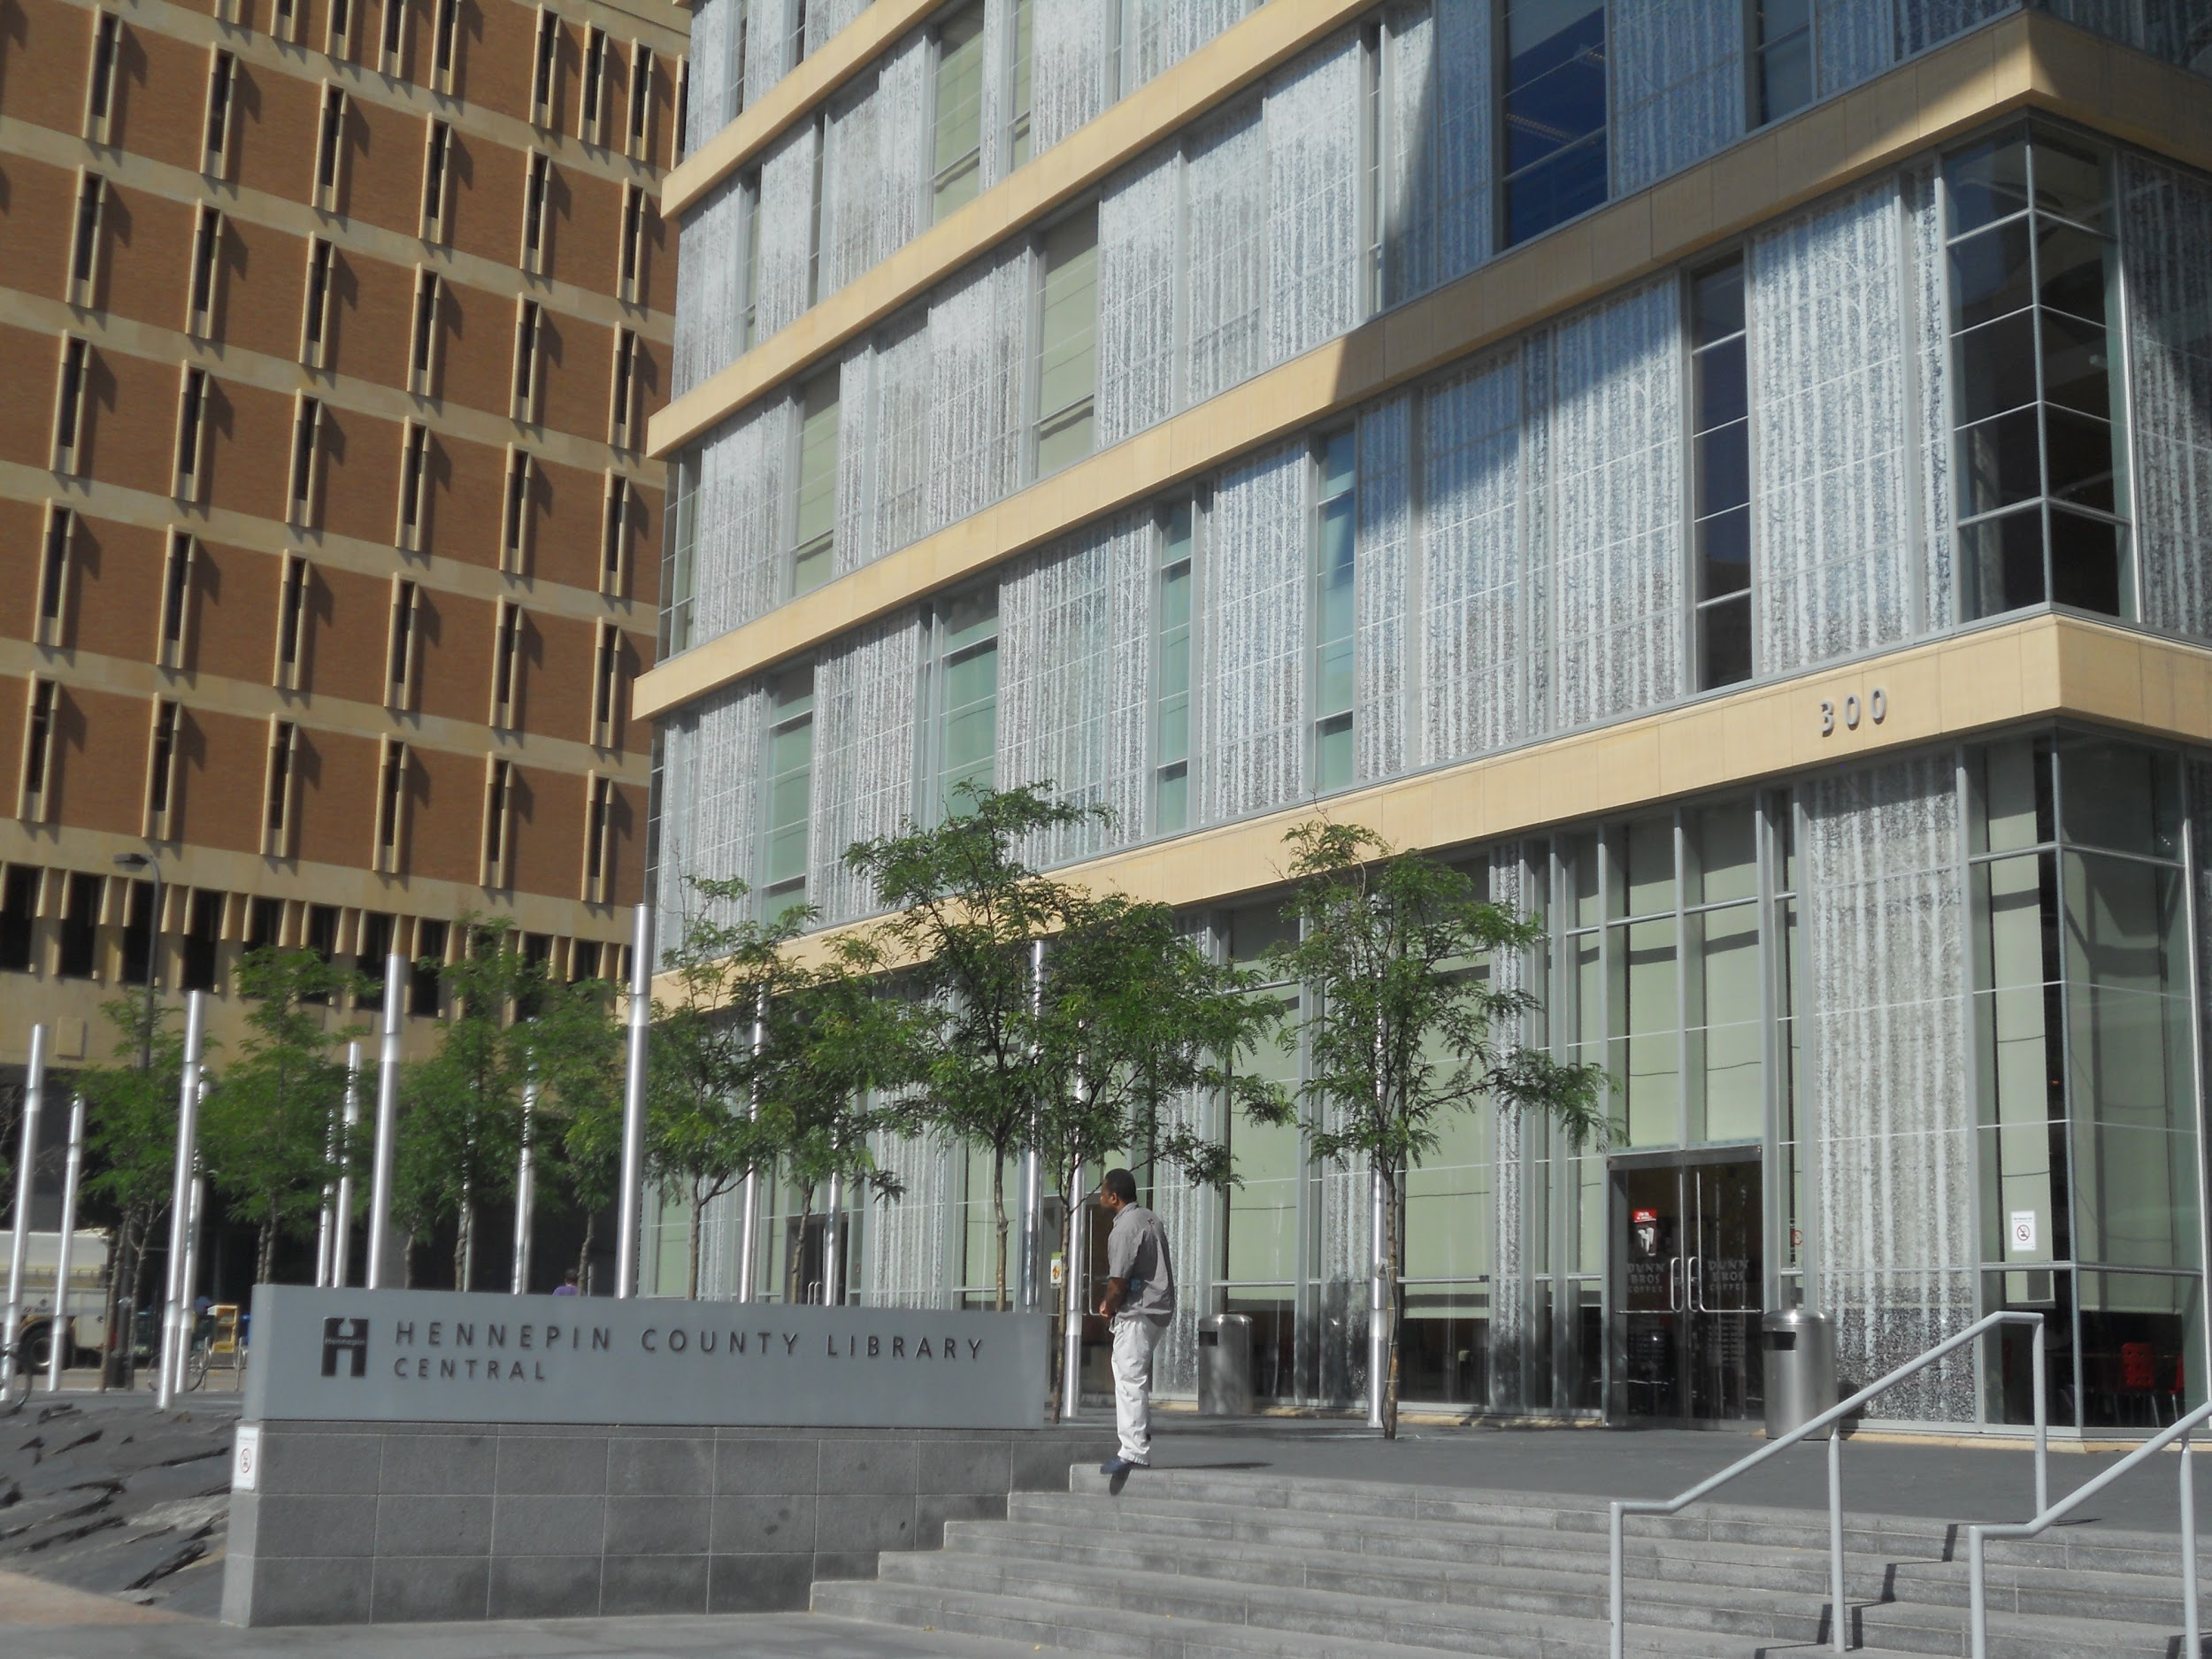
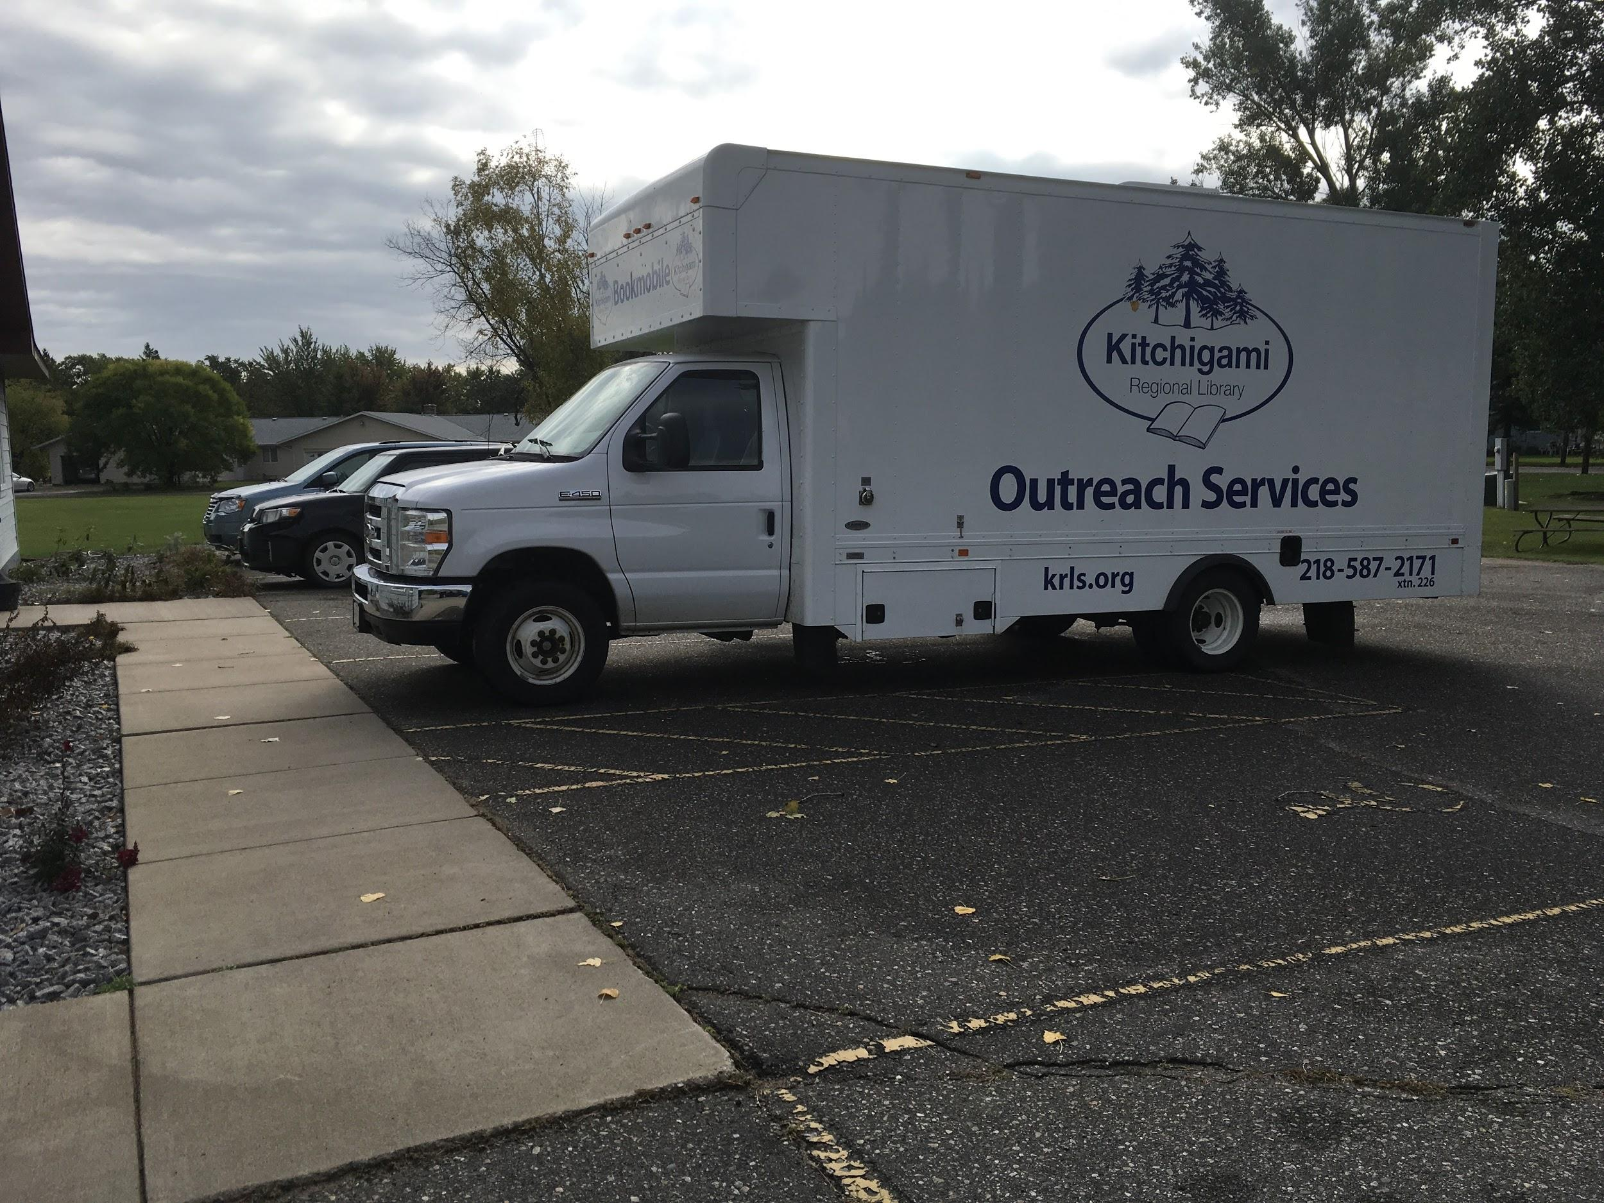
Notes:
Participating libraries must have a shareable collection and be staffed by a librarian.Libraries include academic, public, state agency, high school and hospital libraries, but no corporate or for profit libraries.

Slide 19
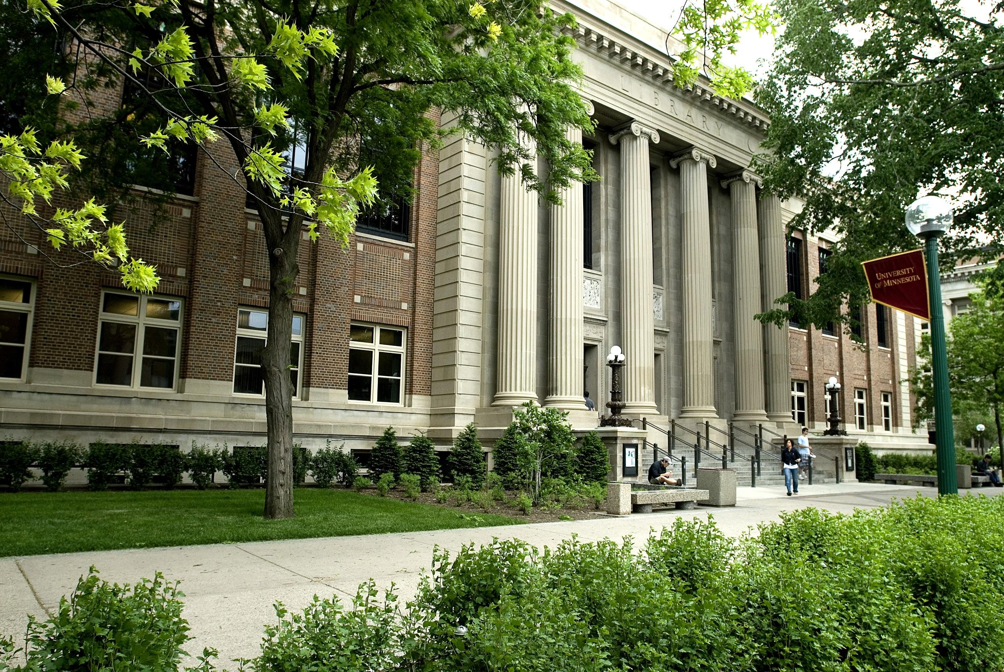
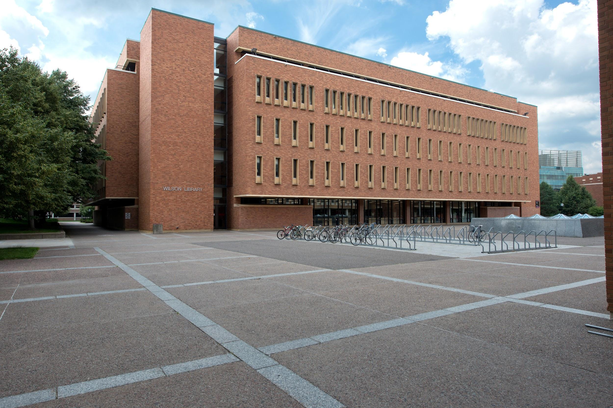
Notes:
Having a headquarters at the University of Minnesota campus allows us access to a major research library’s collection. That is significant because we search over 80,000 requests a year at campus libraries. In addition to the physical collection, last year, we were able to fill over 40,000 requests using licensed electronic resources of the University libraries.

Slide 20
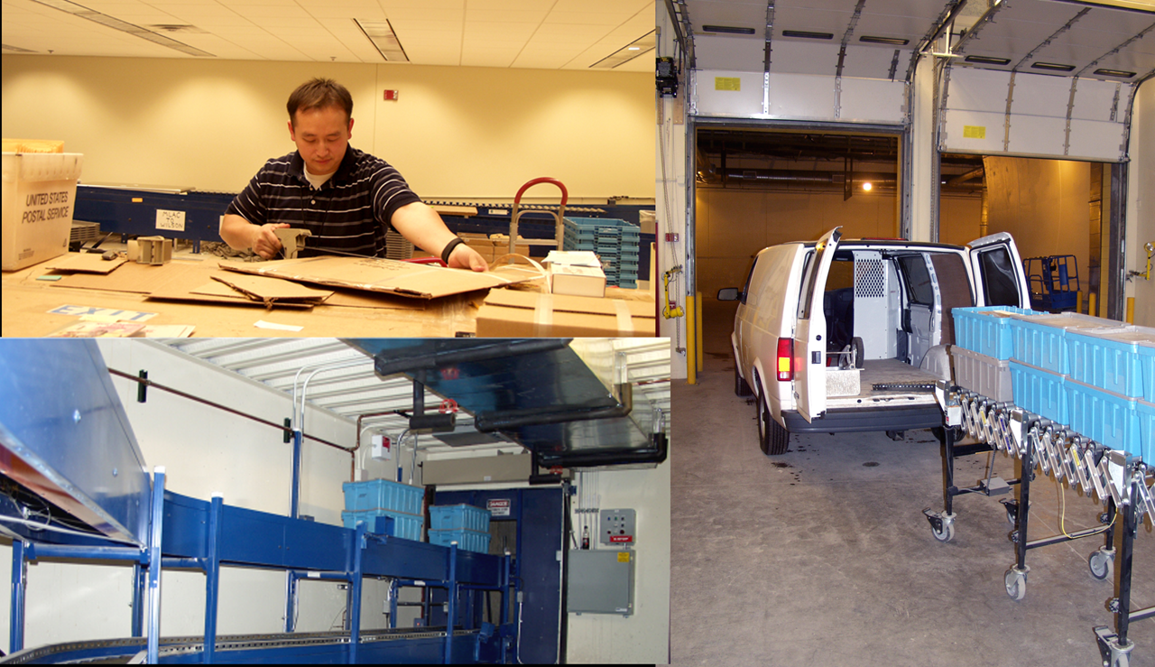
Notes:
As part of the ILL service, Minitex runs a centralized overnight delivery service. The building where delivery is housed was specially designed to handle the massive amounts of materials moving through our delivery hub every day. We have staff processing materials from 7am to 11pm, Monday - Friday and limited processing on Saturday. There is a secure underground loading dock that can be accessed by our couriers 24 hours a day. Last year, our delivery staff shipped over 942,000 items.

Slide 21
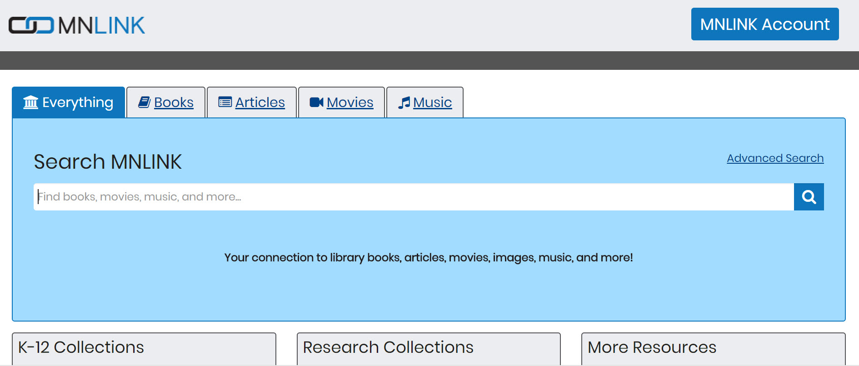
Notes:
MNLINK was launched in 2004 has discovery and interlibrary loan. It is available to anyone in the state of Minnesota with a public library card.
MNLINK combines a set of unique features:
It has a patron focused discovery system
It includes the catalogs of public, academic and other library types in the Minitex region
It allows any patron with a public library card to place interlibrary loan requests.
Last year, MNLINK patrons requested 517,509 items through interlibrary loan.

Slide 22
Minitex - other services
Cooperative purchasing of libraries supplies and electronic databases
Digital Initiatives and Metadata Education
Minnesota Library Access Center
Reference services and continuing education
Ebooks Minnesota
Minnesota Library Publishing Project
Notes:
Minitex has grown beyond interlibrary loan over the years, and now offers a number of other services to members.

Slide 23
Nuts and Bolts
Notes:
Software used for ILL
integration or communication with other library systems
Annual ILL volume
Returnables
Non-returnables
Process for making policy decisions

Slide 24
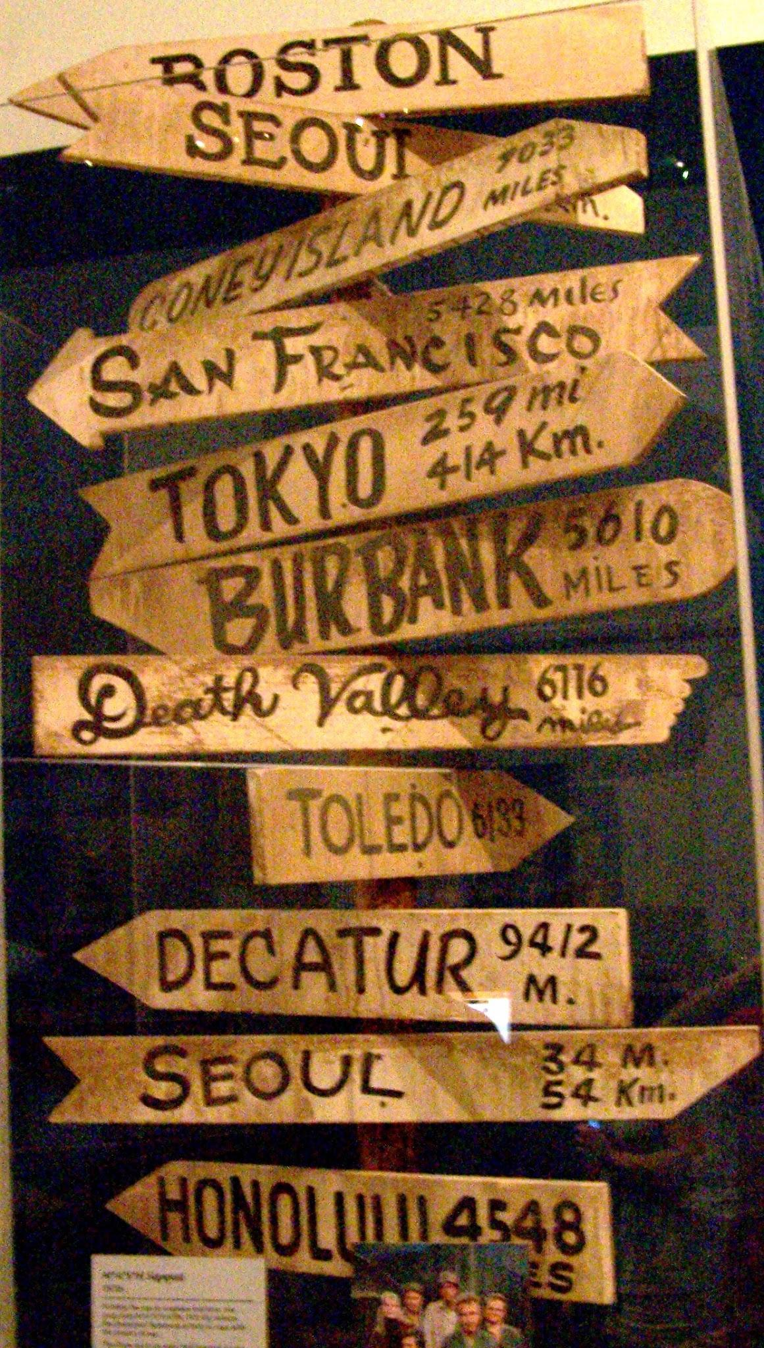
Trends we are seeing
Notes:
Offsite storage and challenges in handling those items.
Electronic Resource Negotiation for databases and ensuring language is good for interlibrary loan
Move to using consortia for cost savings - either through delivery or good terms for ILL fees and costs.
Increase or decrease in ILL over the years?
Change in percentage of returnables vs non-returnables?
New aspects of service (integration with Acquisitions, purchase on demand, licensing information...?)
Maybe mention DOCLINE
Using reciprocal agreements over paying for ILL
License info

Slide 25
What do you like most about your consortia?
Scott Betts

Slide 26
Aspen Tech
Notes:
maybe we could insert some cute graphic here about working with diverse membership, since that seemed to be a theme when we discussed this! (Amy)

Slide 27
Questions?

Slide 28
Anne E. McKee
Amy Greenberg Carol Nelson
Greater Western Library Alliance (GWLA)
Ontario Council of University Libraries (OCUL)
Minitex
anne@gwla.org
amy@scholarsportal.info c-nels@umn.edu

