Slide 1
Comparing Apples to Oranges: An Investigation into the Validity of Interlibrary Loan Statistics
Amie Freeman, University of south Carolina
Megan palmer, university of south carolina

Slide 2
Overview
Background
Development and implementation of survey
Results
Key takeaways
Future directions
Questions

Slide 3
Background
2016 ILLiad International Conference conversations
Questions emerged:
What are our roles as ILL practitioners?
What statistics are reported?
To whom?
How are particular statistics counted and classified by institutions?

Slide 4
ILL Roles
Provide access to information by:
Filling requests
Providing information through other means
Provide information literacy instruction by:
Patron interactions
Filling requests with additional instructions
Email templates and customized messages
Cancellation messages

Slide 5
Every number has a story.
What stories are we telling?

Slide 6
Three objectives:
Discover how Interlibrary Loan librarians classify completed and cancelled requests.
Understand how information is transferred to patrons through the ILL system.
Determine if Interlibrary Loan statistics are reliable and standardized.

Slide 7
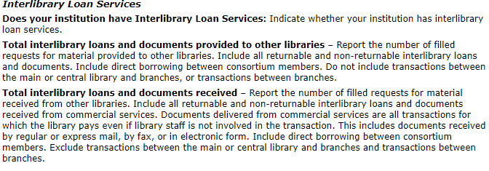
ARL
IPEDS
ACRL
Internal reports to administrators

Slide 8
Shaped survey around questions:
What items are considered filled or cancelled internally?
What items are reported filled or cancelled externally?
How are these messages provided to patrons?
Are ILL statistics reliable, standard, and uniform?

Slide 9
Development of survey
Decided to focus on large research institutions
Selected ARL libraries as focus group
Sample size 116
Designed survey based on ILLiad classifications regarding items filled or cancelled through non-traditional ILL means, including:
Items filled through library collections
Items available online (digitized, open access, freely-available)
Items (books or articles) purchased for patrons

Slide 10
Survey implementation
Compiled list of ARL libraries
Searched institutional webpages for contact information
Emailed all 116 libraries requesting survey completion
Received 50 responses, a 44% response rate

Slide 11
Results
goo.gl/Y9VZjJ

Slide 12
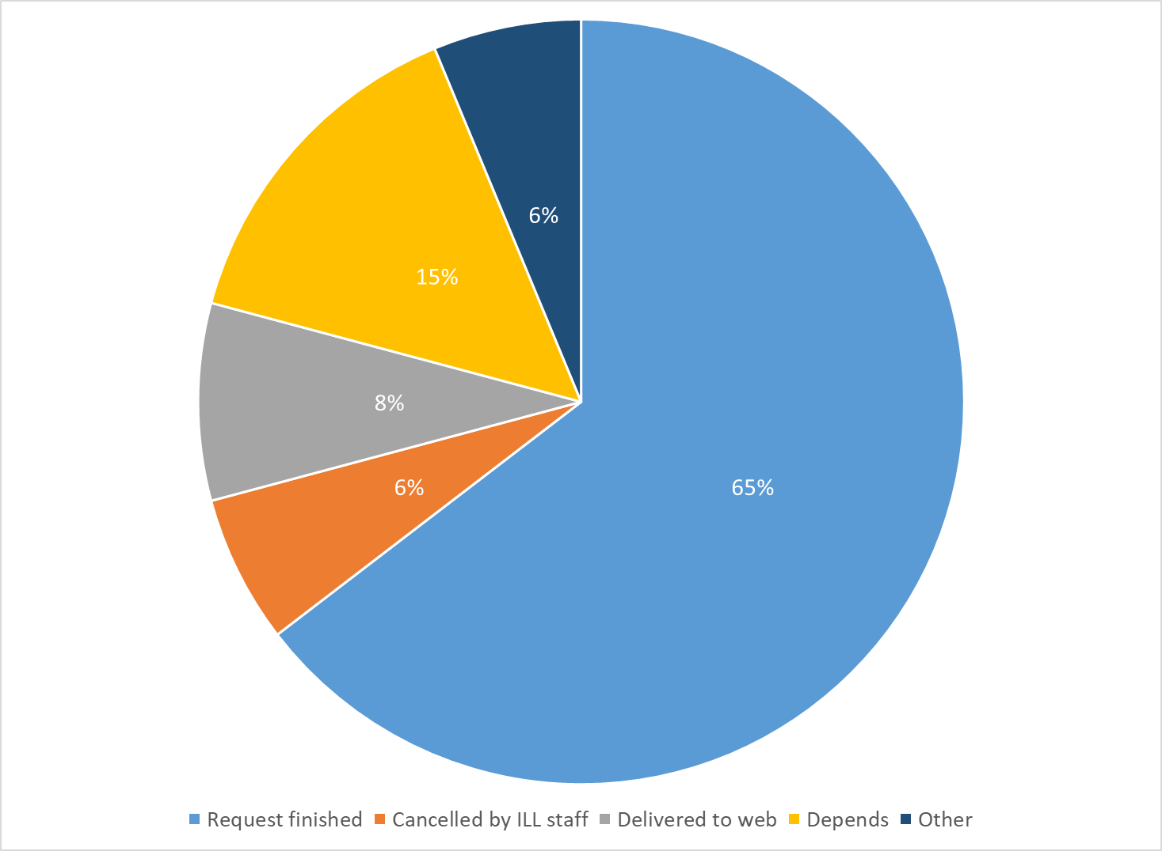
Question 1: When you fill a request through a method other than traditional ILL means (library to library), in what status is the finished request placed?

Slide 13
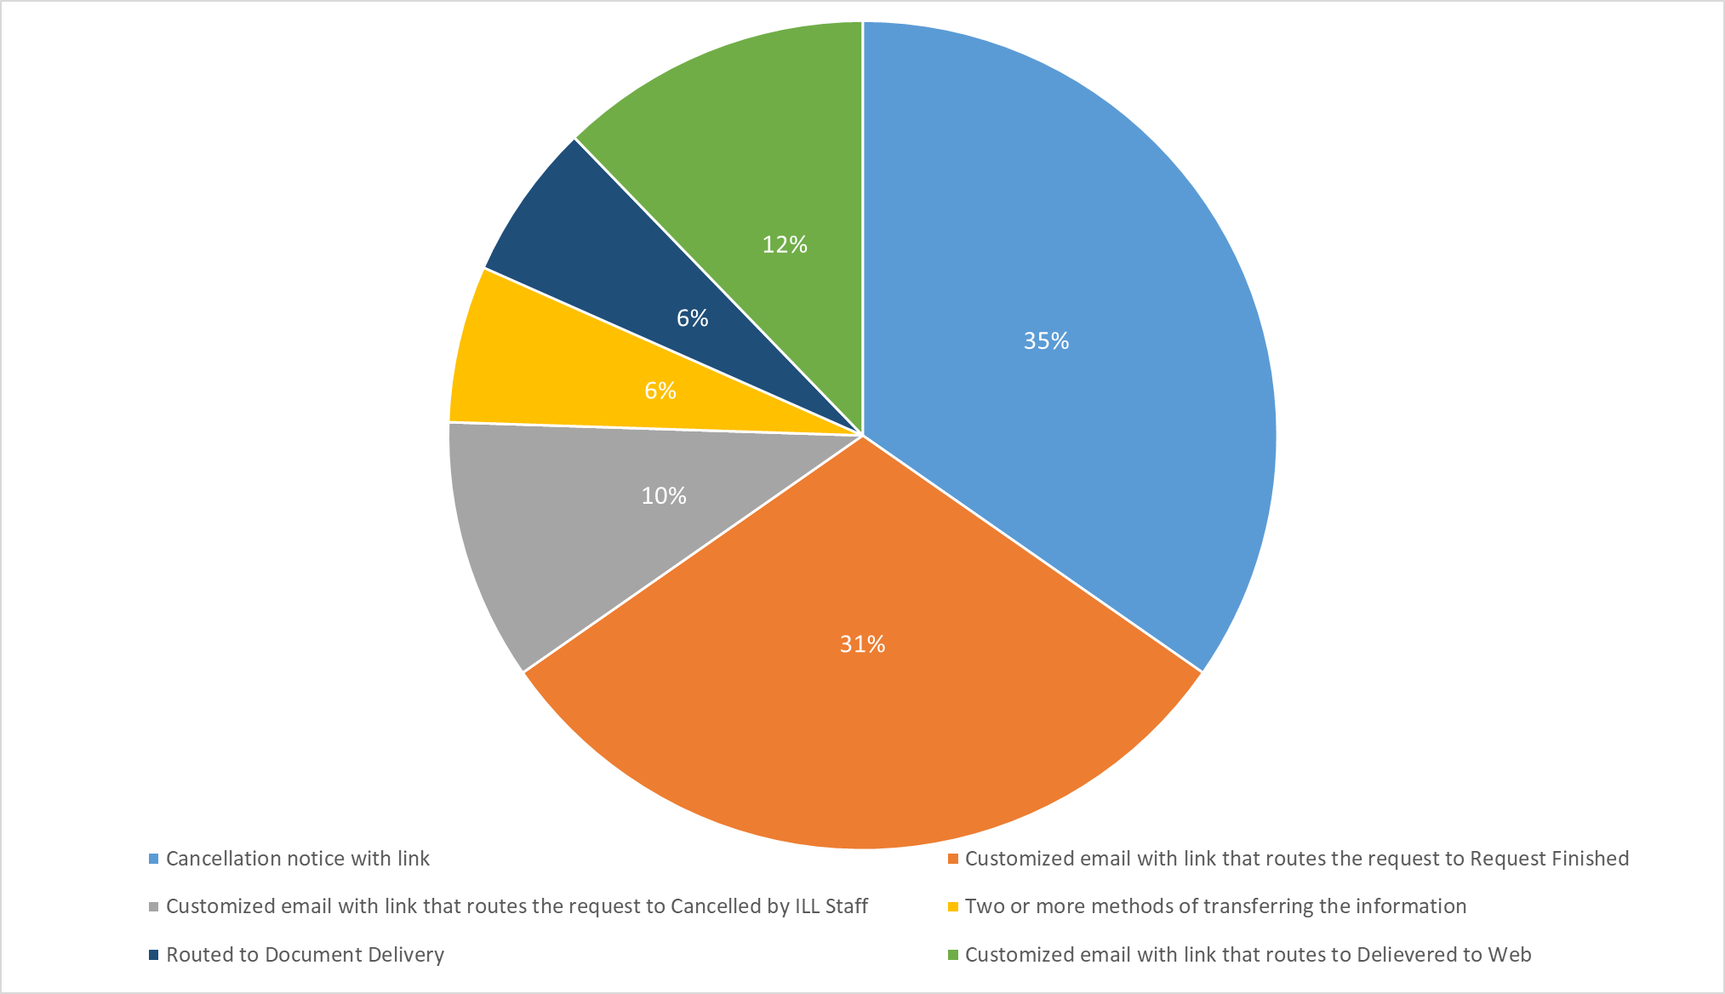
Question 2: When you discover an item that a patron has requested is freely available on the internet (such as a digitized item or open access journal), how do you transfer the information to the patron?

Slide 14
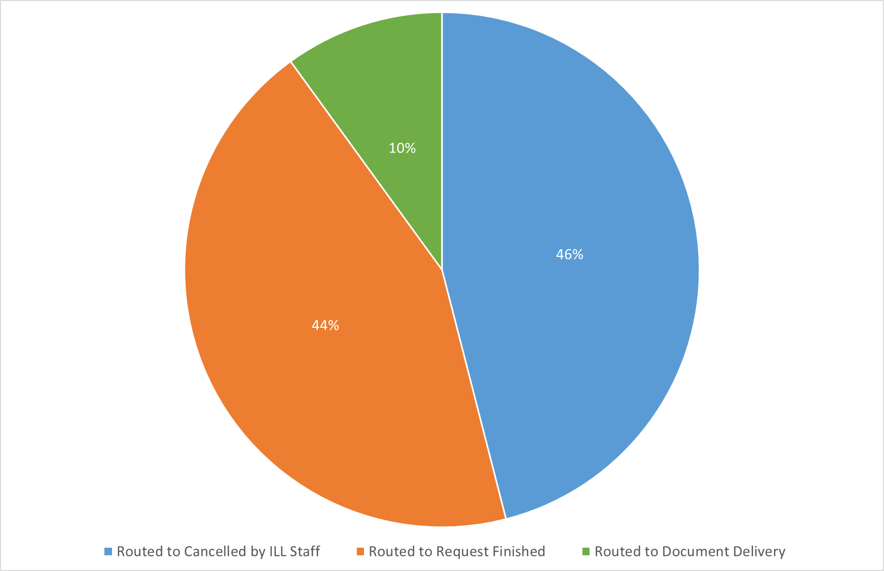
Question 2: When you discover an item that a patron has requested is freely available on the internet (such as a digitized item or open access journal), how do you transfer the information to the patron?

Slide 15
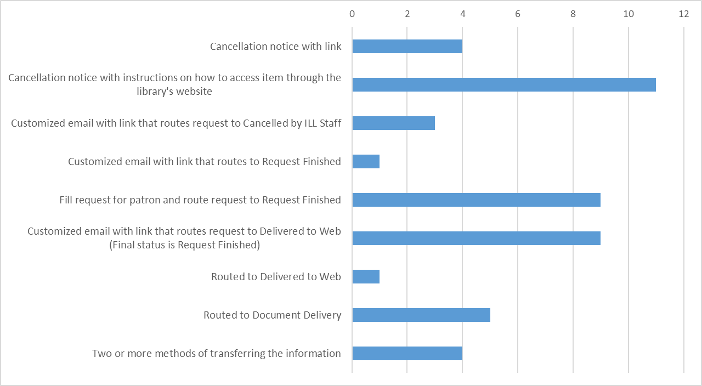
Question 3: When a patron requests an item that is available electronically through your library, how do you transfer the information to the patron?

Slide 16
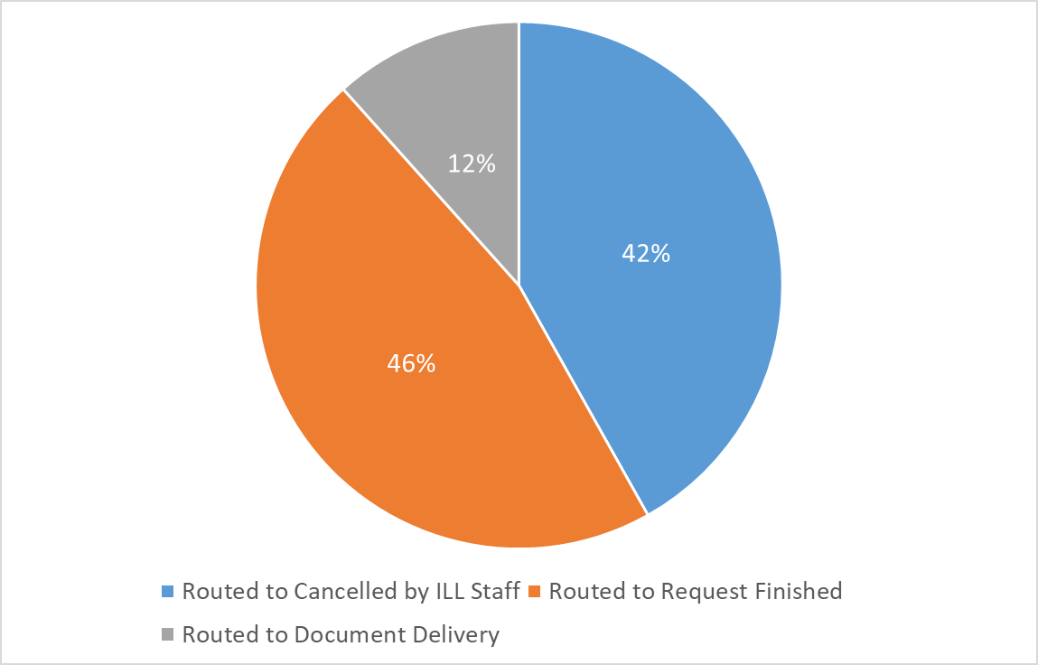
Question 3: When a patron requests an item that is available electronically through your library, how do you transfer the information to the patron?

Slide 17
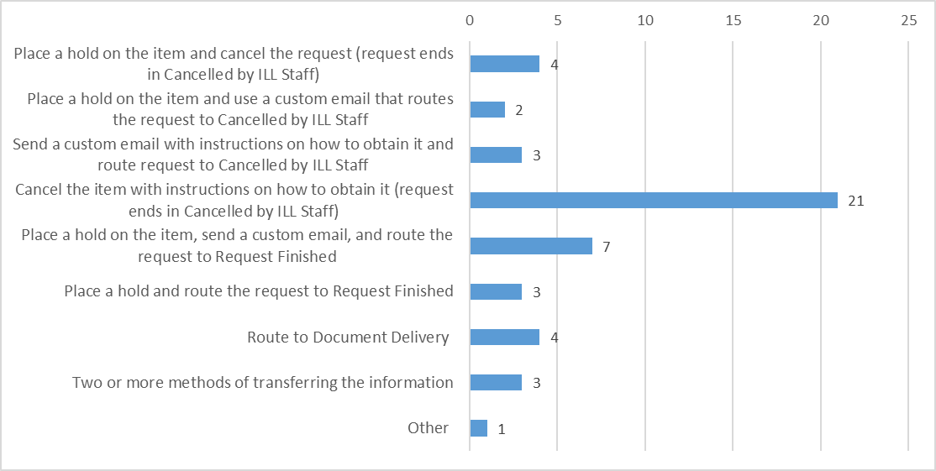
Question 4: When a patron requests an item that is held physically in your library system, how do you transfer the information or item to the patron?

Slide 18
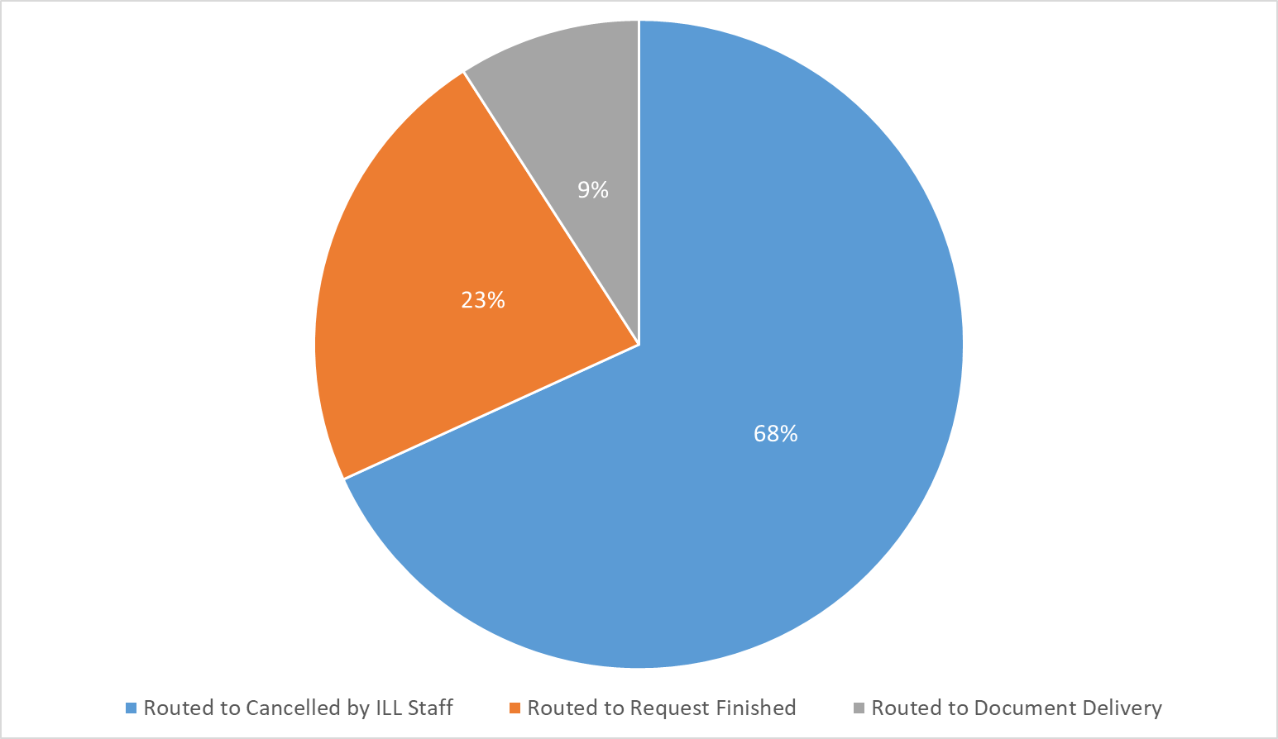
Question 4: When a patron requests an item that is held physically in your library system, how do you transfer the information or item to the patron?

Slide 19
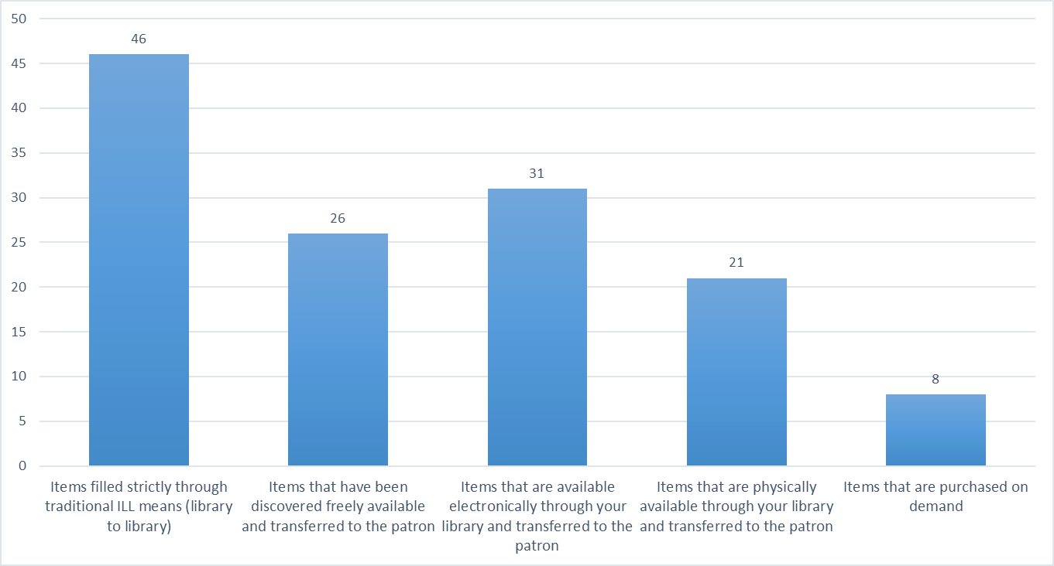
Question 5: When submitting statistics to internal library administrators, what items do you include as “filled” in your numbers? (more than one answer can be selected)

Slide 20
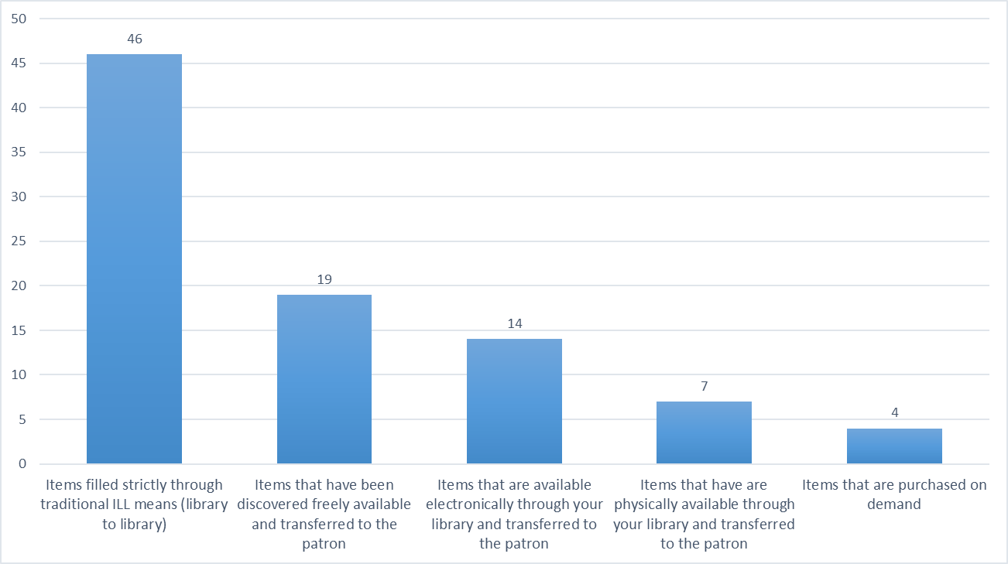
Question 6: When submitting statistics to outside reporting bodies (such as ARL, ACRL, and IPEDS), what items do you include as “filled” in your numbers? (more than one answer can be selected)

Slide 21
Sample of Comments
We moved away from trying to teach patrons how to request our materials on their own to doing the work for them and making the book or article available without them having to start all over again. Initial resistance from a few staff to this as somehow letting patrons "cheat" but that was isolated.
We report anything filled for patrons even if local. We want to show staff work on behalf of patrons. A patron's failure to find something is not their fault, it is likely an issue of discovery or lack of knowledge how to do something because the library systems are so separate. Our system is broken not the user.

Slide 22
Sample of Comments
Have consistency with statistics for all ILLiad users.
Outside reporting bodies need to decide where to represent consortial direct borrowing. Since these are materials from other libraries, should we count them as ILL fills? They appear in our regular circulation numbers.
We try to fill all requests regardless of where we source the material. In order to get accurate statistics, we route to Document Delivery anything filled from local collections, web resources, or library e-resources.

Slide 23
Takeaways: answers and more questions
Patrons receive information and instruction in numerous ways from varying libraries.
Additional research is needed to determine which technique is most effective.
Differences in categorization and reporting present an inaccurate statistical picture across the ILL community. These differences can have implications on:
Benchmarking
Budgeting
Staffing

Slide 24
Methodology implications
Questions need more clarity
Additional options not realized during the development stage of study
Need to survey beyond large academic institutions
Photo by Matthew Henry from Burst

Slide 25
Future directions
Reevaluate traditional roles assigned to resource sharing
Continue community conversations and studies
Investigate best practices to formulate guidelines
Add direction to the ILL code

Slide 26
Questions?

Slide 27
Amie Freeman
Megan Palmer
University of south Carolina
University of south Carolina
dillarda@mailbox.sc.edu
palmerm3@mailbox.sc.edu
For survey results, visit https://tinyurl.com/surveyILL

