Slide 1
WebDewey Number Building Music examples
November 2012

Slide 2
Overall workflow
Find starting number/span with add instruction, else find base number
Click Start/Add
System displays notation specified by add instruction or displays Table 1 (in final step)
As needed, user navigates to next number/span with add instruction or base number
Number building complete?
No
Yes
Verify the number is correct, click Save
User term box appears, select user terms
Edit term, click Update
User term needs to be changed?
Yes
Additional term needed?
No
No
Yes
Create additional term, click Add
Select term to set as caption
Save as institutional or personal visibility
Verify presence in the hierarchy
Contribute to Dewey Editors (optional)
If not contributed to Dewey Editors, new number visible only to institution or person

Slide 3
Process of building 785.7198 String octets
Navigate to this number/span | Click | Number built so far | Caption of last number/notation added
785.7 | Start | 785.7 | String ensembles
785.2-785.9:19 | Add | 785.719 | Size of ensemble
785.18 | Add | 785.7198 | Octets

Slide 4
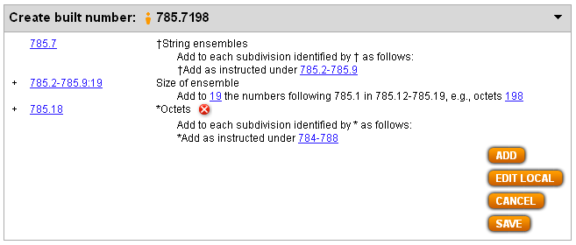
Results of process of building 785.7198 String octets

Slide 5
Process of building 782.421643092 Blues singers
Navigate to this number/span | Click | Number built so far | Caption of last number/notation added
782.42 | Start | 782.42 | Songs
782.1-782.4:11-17 | Add | 782.421 | General principles
781.643 | Add | 782.421643 | Blues
T1—092 | Add | 782.421643092 | Biography

Slide 6
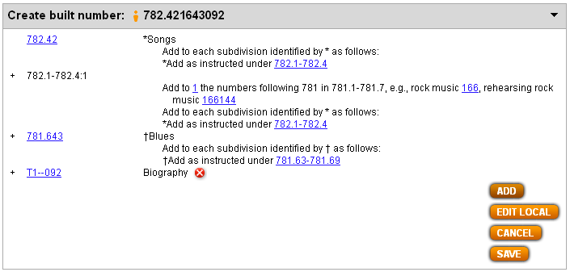
Results of process of building 782.421643092 Blues singers

Slide 7
Process of building 781.625104578 Italian folk music in Calabria
Navigate to this number/span | Click | Number built so far | Caption of last number/notation added
781.621-781.629 | Start | 781.62 | Folk music of . . .
T5—51 | Add | 781.6251 | Italians
781.621-781.629:03-09 | Add | 781.62510 | Specific . . . localities
T2—4578 | Add | 781.625104578 | Calabria region

Slide 8
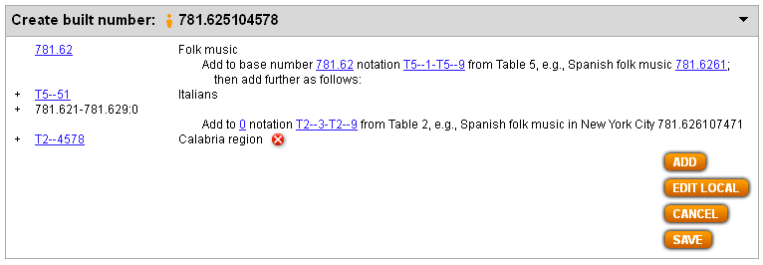
Results of process of building 781.625104578 Italian folk music in Calabria

