Slide 1
From modelling to visualization of topic relationships in classification schemes
Rebecca Green, OCLC
Diane Vizine-Goetz, OCLC
Marcia Lei Zeng, Kent State University
Maja Žumer, University of Ljubljana
Classification & Visualization: Interfaces to Knowledge
International UDC Seminar 2013, 25 October 2013

Slide 2
Application of visualization techniques to DDC
Modelling topic relationships in the DDC
[Data format revision for topic relationships]
[Use scenarios]
Visualization of topic relationships in the DDC

Slide 3

DDC in FRSAD, so far
Each DDC class corresponds to a thema
Notation associated with the class is the nomen
Thema is the full category description of the class
Nomen is the symbol (or surrogate) used to represent the full category description:
dewey.info URI
hierarchically contextualized caption
Relative Index (RI) terms corresponding to functionally equivalent topics
Data modeling – FRSAD – 1

Slide 4
Extensions, set 1: All topics, Relative Index terms included
All topics are themas
All RI terms are nomens
Topics can be related to:
Classes (thema-to-thema relationship)
Other topics (thema-to-thema relationship)
RI terms (thema-to-nomen relationship)
RI terms can be related to each other (nomen-to-nomen relationship)
Data modeling – FRSAD – 2
Notes:
All topics are themas (but only functionally equivalent topics correspond to a class)

Slide 5
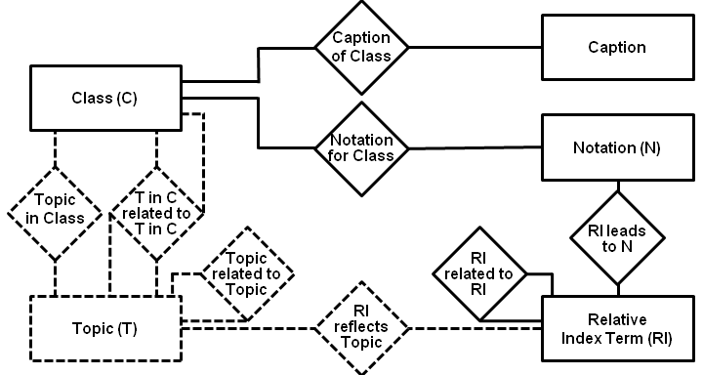
Topic-enhanced view
themas on left nomens on right
only portions in solid lines now systematically captured in DDC database
Data modeling – FRSAD – 3

Slide 6
Extensions, set 2: Filling out the picture
Topic-to-class relationship attribute: equivalence status
Topic-reflecting text in class descriptions as parallel set of nomens (note: this is not a fully controlled vocabulary)
Nomen-to-nomen equivalence relationships
Between two synonymous RI terms
Between an RI term and textual expression
Data modeling – FRSAD – 4
Notes:
Further complexity in modeling thema-to-thema topic relationships in classification schemes arises from notes that send the classifier from one class to another class. The DDC has class-elsewhere notes, and see and see also references that perform this function. These depend on standard semantic relationships between topics in the referring and referred-to classes, although often it is only the topic in the referred-to class that is explicit.

Slide 7
Topics and their interrelationships (1)
Data model, topic-to-topic

Slide 8
Topics and their interrelationships (2)
Diabetes, comprehensive works
Diabetes mellitus
Type 1 diabetes
Type 2 diabetes
Gestational diabetes
Diabetes insipidus
Data model, topic-to-topic

Slide 9
Topics and their interrelationships (3)
[Disciplinary contexts]
Medicine,
610
Pediatrics
Obstetrics
Cooking,
641.5
Adolescent medicine
Social services,
361-365
Therapy
Diet therapy
Data model, topic-to-topic

Slide 10
Relative Index (RI) terms and their interrelationships (1)
Data model, RI-to-RI

Slide 11
Relative Index (RI) terms and their interrelationships (2)
Diabetes Diabetes mellitus | Type 1 diabetes Diabetes mellitus (Type 1) Insulin-dependent diabetes
Type 2 diabetes Diabetes mellitus (Type 2) Non-insulin-dependent diabetes Noninsulin-dependent diabetes | Gestational diabetes Diabetes mellitus – pregnancy complications – obstetrics
Data model, RI-to-RI
Notes:
Equivalence classes

Slide 12
Notation for / Caption of Class (1)
Core thema-nomen relationship

Slide 13
Notation for / Caption of Class (2)
Notation | Hierarchically-contextualized caption
362.196462 | Social problems of and services to groups of people / People with physical illnesses / Medical services / Diabetes
616.462 | Medicine / Specific diseases / Diseases of endocrine system / Diabetes mellitus
616.46206 | . . . / Diabetes mellitus / Treatment
618.3646 | Medicine / Gynecology and obstetrics / Diseases and complications of pregnancy / Diabetes
618.92462 | Medicine / Pediatrics / Diabetes mellitus
641.56314 | Cooking for people with medical conditions / People with diabetes
Core thema-nomen relationship
Notes:
Captions must be given in context of hierarchical chain to be unique. Because of space constraints, captions are included at only those levels required for understanding.
Note: some numbers are built numbers and do not (yet) have preferred captions designated for them.

Slide 14
Relative Index (RI) terms reflect Topics (1)
Data model, topic-to-RI
Notes:
Topics are known only through words, so the RI-reflects-topic relationship is assumed to be obvious/intuitive.
But it’s worth mention that the RI does not operate entirely like a thesaurus, in that the RI makes a distinction between preferred and non-preferred terms, not between authorized and non-authorized terms. Therefore, the relationship between Topic and RI is not 1-to-1, but 1-to-N.
On same grounds, instantiation of Topic-in-Class relationship also not shown.

Slide 15
Topics in Classes
Data model, topic-in-class

Slide 16
Topic-in-class related to Topic-in-class (1)
Data model, recursive topic-in-class

Slide 17
Topic-in-class related to Topic-in-class (2)
616.462 *Diabetes mellitus
Class here comprehensive works on diabetes
Class diabetic nephropathies in 616.61
For diabetes insipidus, see 616.47
616.61 *Diseases of kidneys and ureters
Class here diabetic nephropathies, nephrology
Data model, recursive topic-in-class
Notes:
616.1–616.9 Specific diseases
Class a work treating all the complications of a disease with the disease, e.g., all the complications of diabetes mellitus 616.462; class a work that focuses on one specific complication with the complication, e.g., peripheral nerve disorders associated with diabetes mellitus 616.856

Slide 18
Relative Index (RI) term leads to Class
Data model, RI-to-class

Slide 19
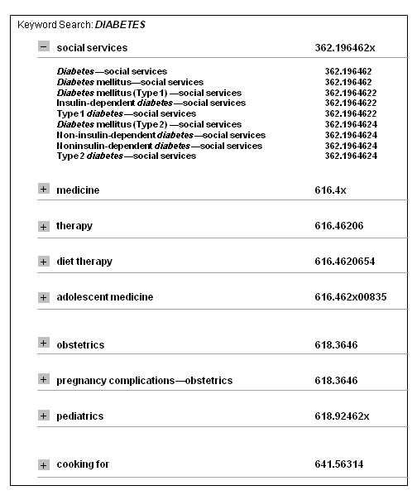
Searching against authority data . . .
Click on heading to access authority record
Headings presented in context of classes / subheadings
Related topics accessed
through reference fields in record
Subheading can be expanded / collapsed
Visualization – class-and-subheading-based arrangement

Slide 20
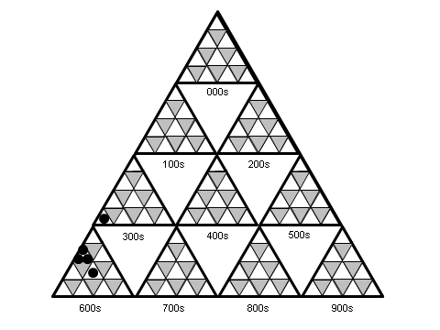
Visual overview of diabetes across the DDC (1)
Visualization – class-based arrangement – pyramid view

Slide 21
Visual overview of diabetes across the DDC (2)
Visualization – class-based arrangement – pyramid view

Slide 22
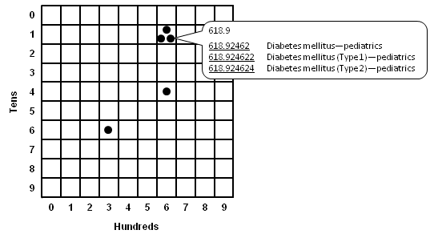
Alternative view of diabetes across the DDC
Visualization – class-based arrangement – matrix view (1)

Slide 23
Drilling down from 616.462 (1)
Visualization – class-based arrangement – matrix view (2)

Slide 24
Drilling down from 616.462 (2)
Visualization – class-based arrangement – matrix view (2)

Slide 25
Representative authority record
LDR nz###n## ​
001 och00127208 ​
003 OCoLC-D ​
005 20110322091736.0 ​
008 100206|||a|z||||||##########||#a||#####d ​
040 ## $a OCoLC-D $b eng $c OCoLC-D $d OCoLC-D $f ddcri ​
083 04 $a 362.1964622 $0 (OCoLC-D)ocd00139591 $2 23 $5 OCoLC-D $9 as=AP $9 ps=PE $9 cts=2011-03-22T09:17:36Z-Rebecca Green ​
150 ## $a Type 1 diabetes ​ ​
550 ## $w g $a Endocrine diseases $x humans $0 (OCoLC-D)och00043296 $2 23 $9 ra=AP $9 rv=PE $9 cts=2010-11-17T19:30:18Z-Joan Mitchell $9 uts=2011-03-02T20:40:30Z-Rebecca Green ​
670 ## $a LCSH. $b Type 1 diabetes $0 (DLC)sh 85037456 $9 450
983 0# $2 23

Slide 26
Conclusion
Topics play key role in:
DDC data model
Uses of DDC, e.g.,
End-user discovery
Editorial maintenance
Topic relationships are many + varied = complex
Visualization techniques address need to control topics to support use of DDC

Slide 27
Questions?

