Slide 1
The Voice of Members in the Americas
Event, Date
OCLC Americas Regional Council:
Presenter
E-mail: regionalcouncil.americas@oclc.org
Twitter: #oclc

Slide 2
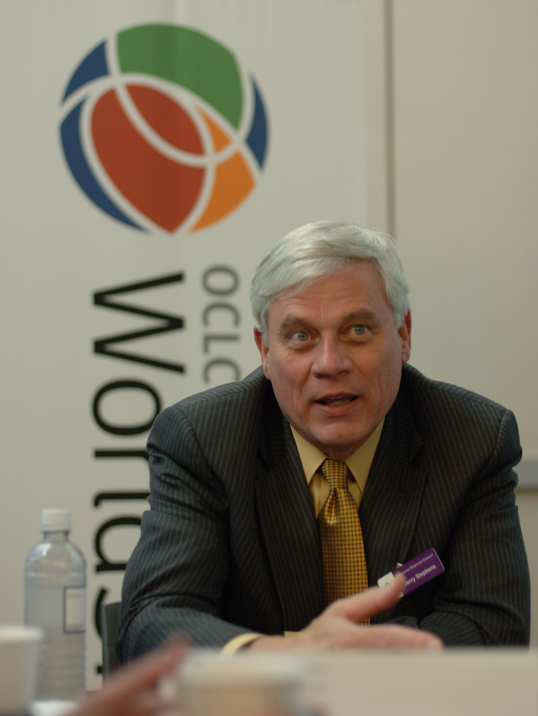
OCLC Americas Regional Council
Every member has
a voice
Opportunities to participate
Stronger members’ cooperative

Slide 3
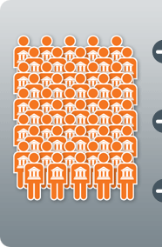
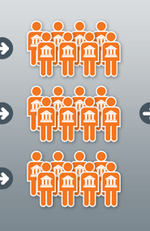
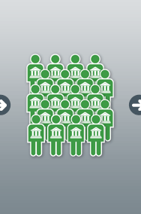

OCLC Governance
Members
Regional
Councils
Global
Council
Board of
Trustees
Notes:
The OCLC cooperative’s governance structure:
A member of the OCLC cooperative is any library, archive or museum that contractually agrees to contribute intellectual content to the OCLC cooperative or share resources with it.
Staff of OCLC members can participate in governance of the OCLC cooperative through one of three Regional Councils: Asia Pacific; Europe, the Middle East and Africa (EMEA); or the Americas.
The members of the Regional Councils elect delegates to represent members in their respective regions to OCLC Global Council. Global Council delegates in turn elect six members of the OCLC Board of Trustees.

Slide 4
OCLC member representation
Regional Councils
Americas Regional Council (ARC)
Asia Pacific Regional Council (APRC)
Europe, Middle East and Africa Regional Council (EMEARC)
OCLC Global Council
Global Council ratifies amendments to OCLC governing documents, discusses key issues in the industry, provides direction to OCLC management, and elects six members to the OCLC Board of Trustees.
OCLC Board of Trustees
The Board works to align OCLC’s product, research and advocacy strategies with OCLC’s mission, encouraging a culture of cooperation and rigorous debate.

Slide 5
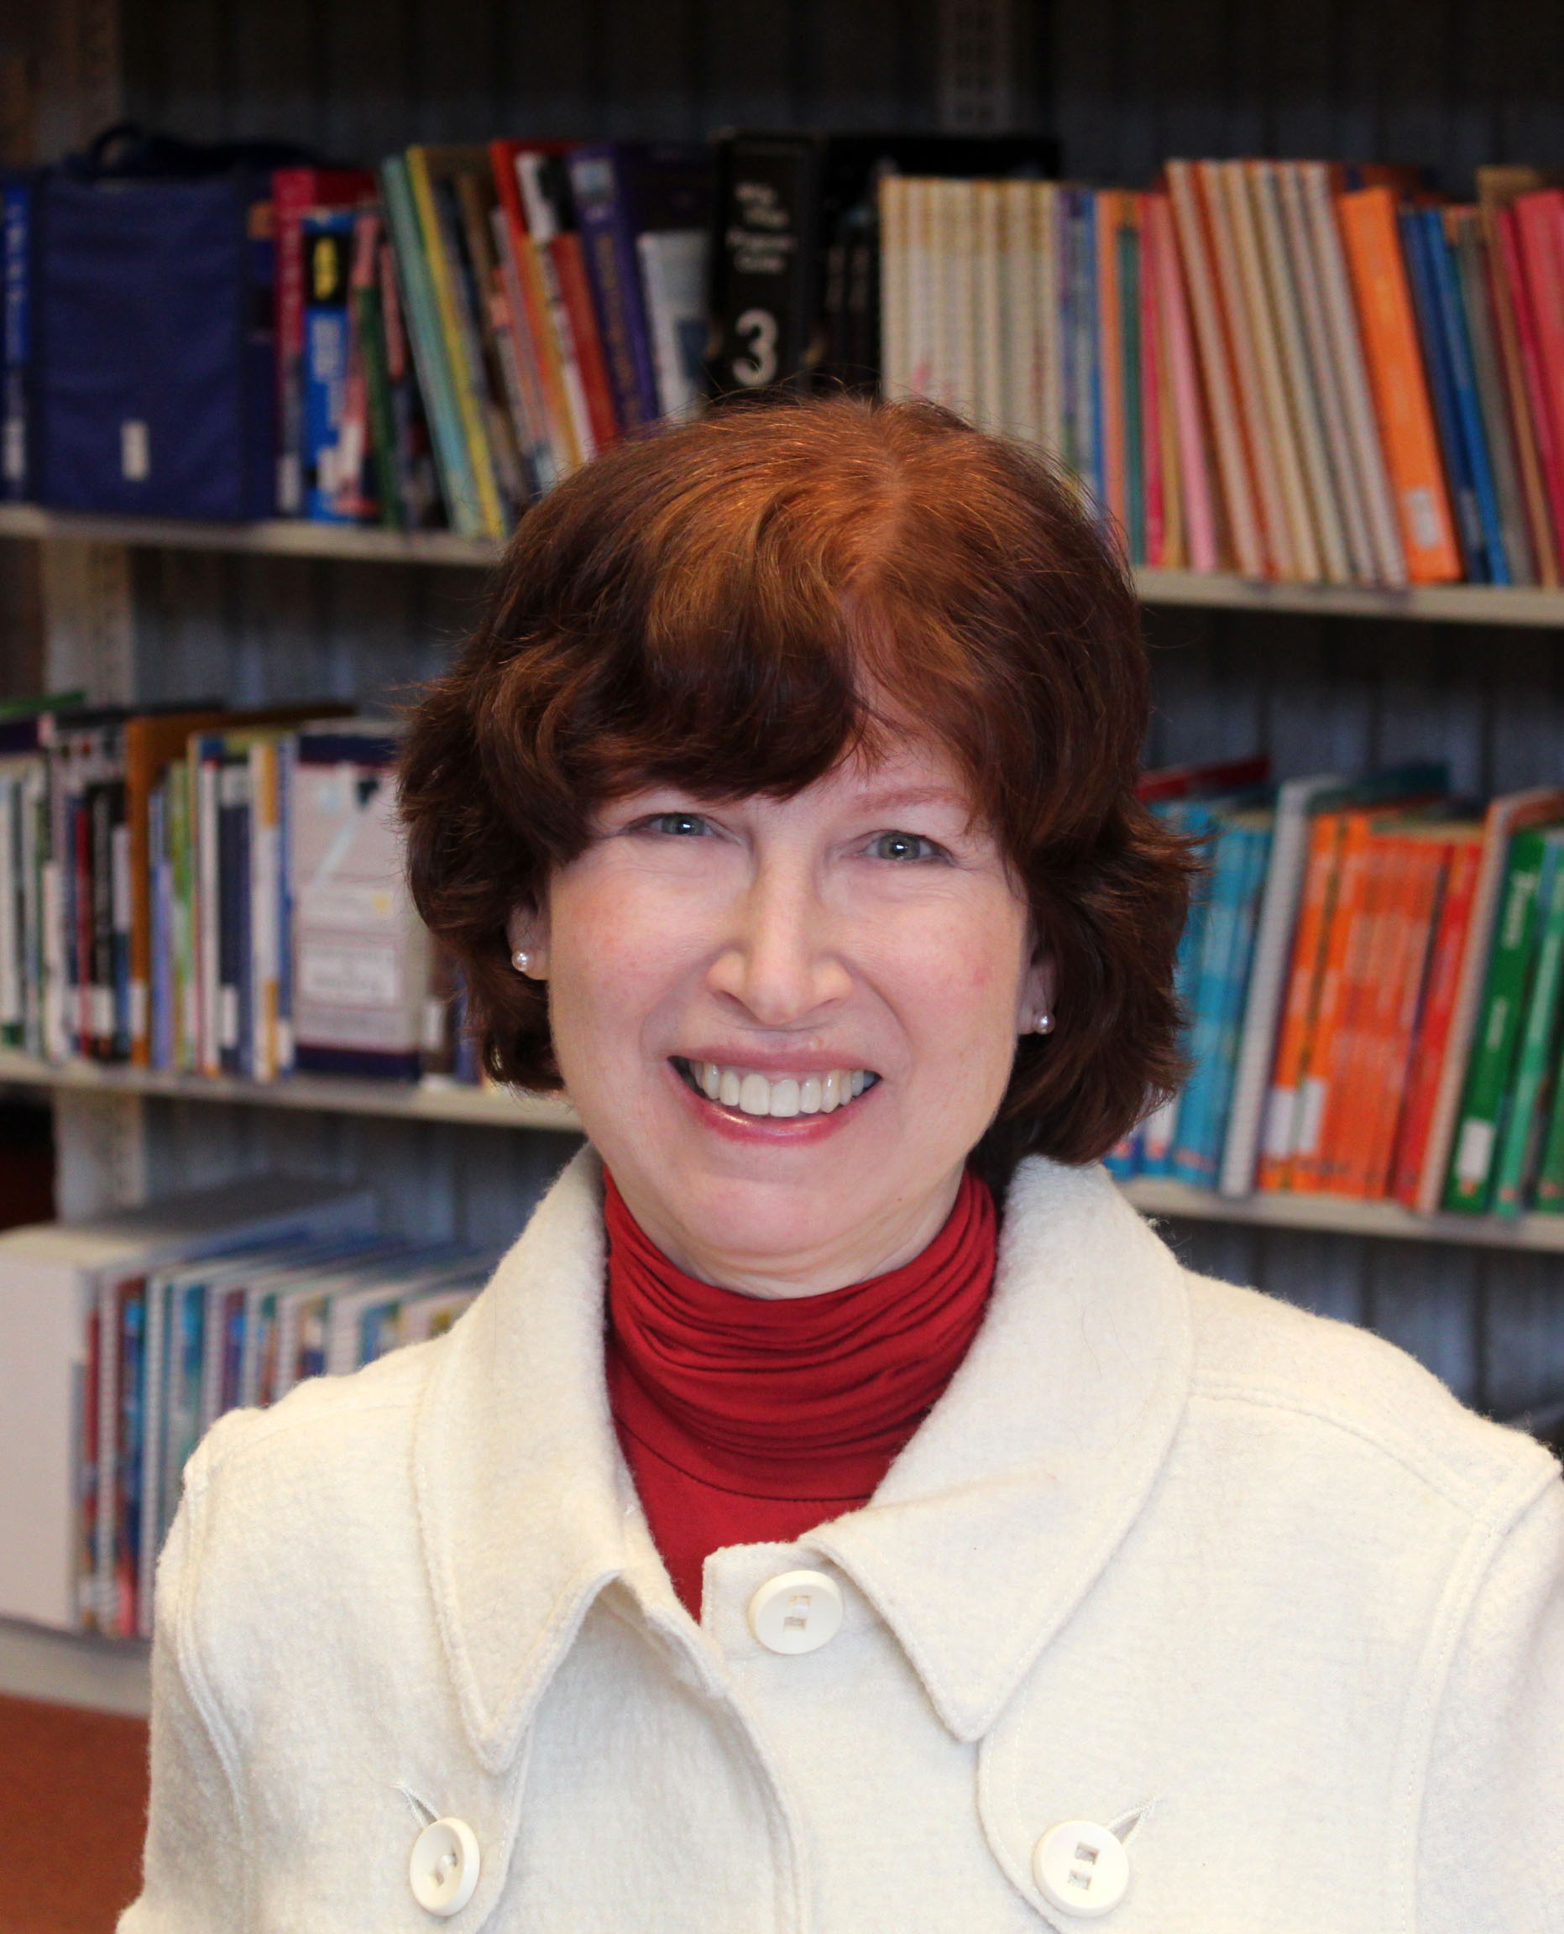
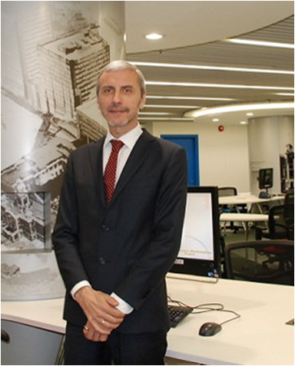
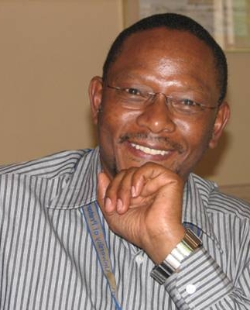
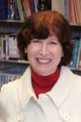
OCLC Regional Councils
Jane Treadwell
Chair, Americas
Regional Council
Peter Sidorko
Chair, Asia Pacific
Regional Council
Robert Moropa
Chair, EMEA
Regional Council

Slide 6
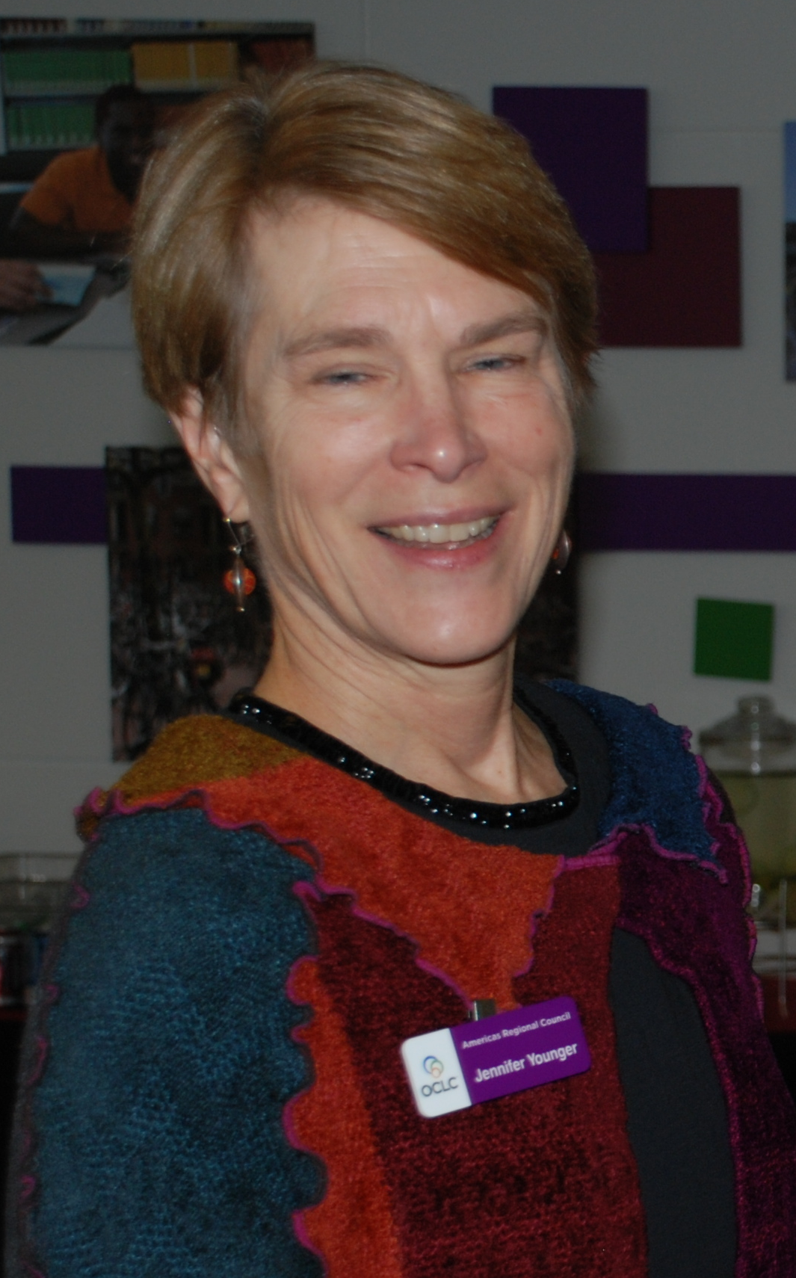
The role of the Americas Regional Council
“Reaching out to connect with other members, fulfilling organizational aspirations, inspiring others by sharing and innovating together, communicating with Global Council delegates and OCLC leadership—there are countless ways members can leverage the power of the cooperative.”
Jennifer younger,
OCLC Global Council president
2010 – 2011
“Reaching out to
connect with other members, fulfilling organizational aspirations, inspiring others by sharing and innovating together, communicating with Global Council delegates and OCLC leadership—there are countless ways members can
leverage the power of the cooperative.”
Jennifer younger,
OCLC Global Council president
2010–2011; Member, OCLC Board of Trustees 2012–present

Slide 7
The role of the
Americas Regional Council
Direct representation of member libraries in the Americas to the OCLC cooperative
Provide feedback and direction to OCLC management and staff at regional council meetings
Discuss ideas and strategies related to issues of importance to the cooperative and the profession through participation in regional interest groups
Elect an executive committee for ARC to provide overall direction for the region
Elect member delegates to OCLC Global Council

Slide 8
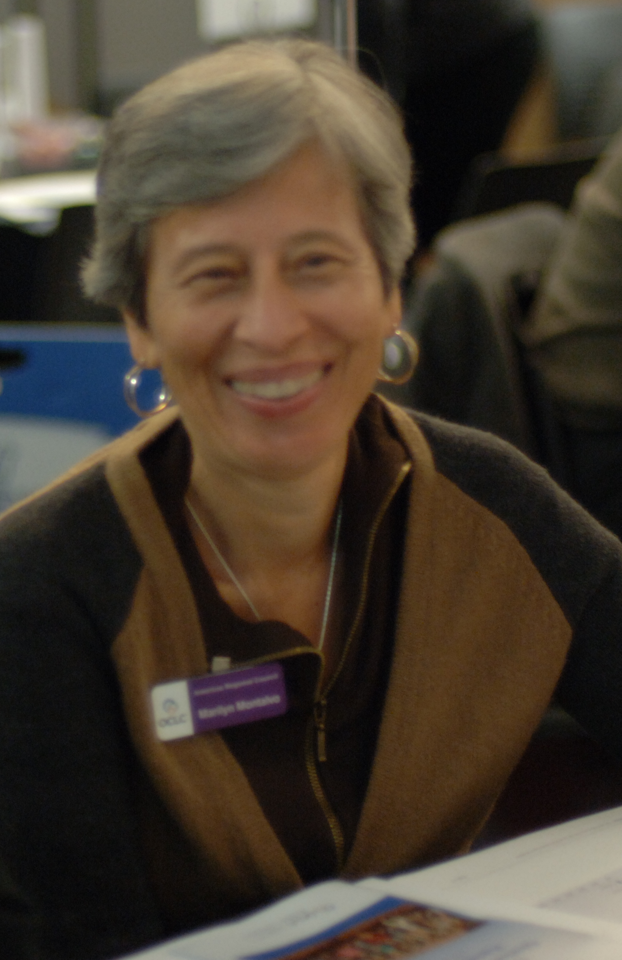
The role of the
Americas Regional Council
In 2013–2014, OCLC members in the Americas elect:
Americas Regional Council Executive Committee (also on Global Council)
Vice Chair/Chair-Elect
Secretary
4 Members-at-Large
OCLC Global Council
10 Global Council Delegates
Notes:
On the ARC Executive Committee, we have the Chair, Vice Chair/Chair-Elect, Secretary and 4 Members-at-Large (1 from Canada, 1 from Latin America and the Caribbean, and 2 from the U.S.). In 2013, members in the Americas approved changed to the bylaws—now members of the ARC Executive Committee will also serve on Global Council.

Slide 9
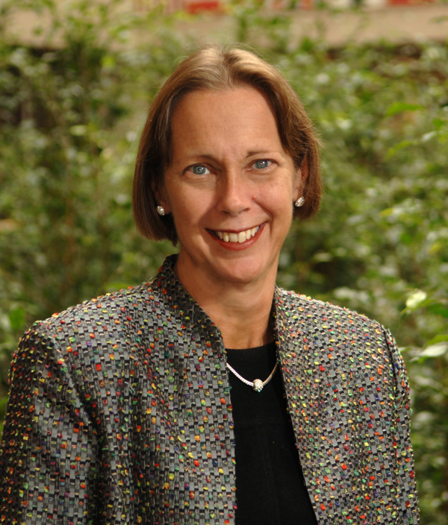
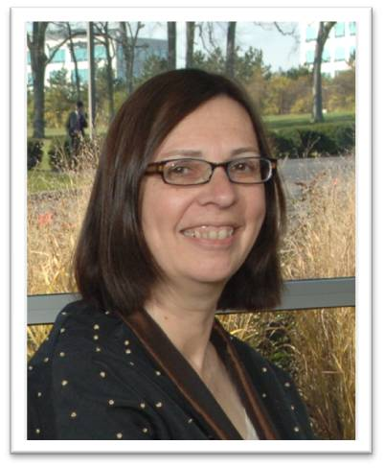
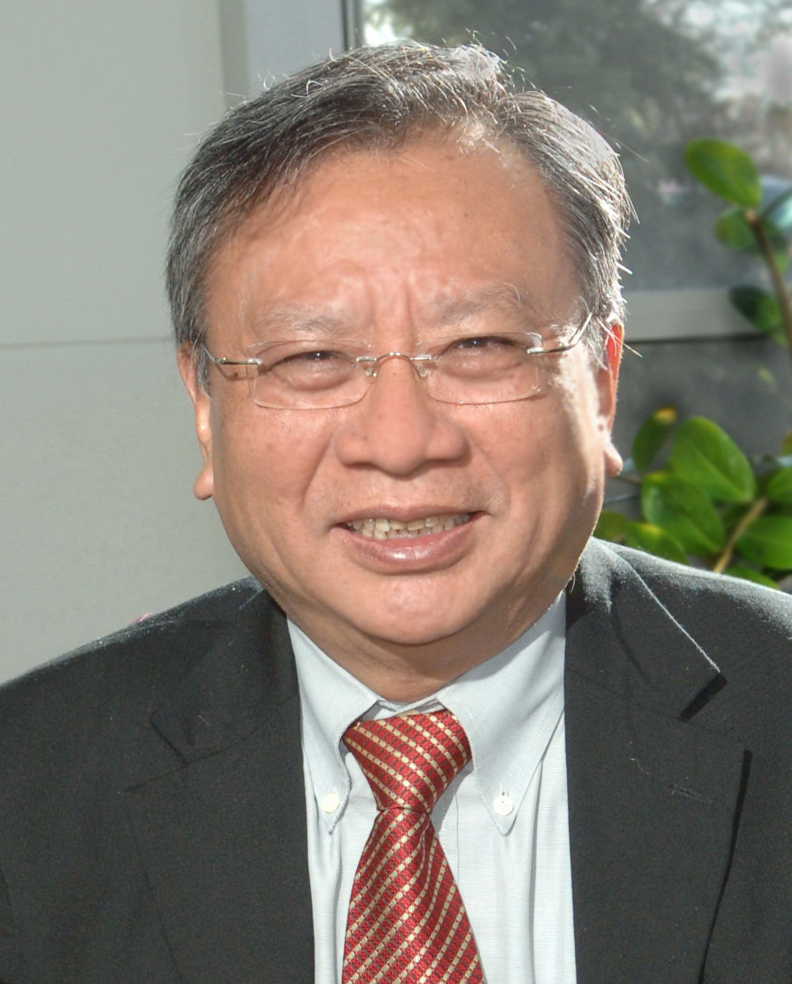
OCLC Global Council Officers
Anne Prestamo
President,
OCLC Global Council
Barbara Preece
Vice President/
President-Elect
OCLC Global Council
ChewLeng Beh
Immediate Past President
OCLC Global Council

Slide 10
Current Global Council delegates from the Americas
Canada
Gwendolyn Ebbett, University of Windsor
Madeleine Lefebvre, Chief Librarian, Ryerson University
Suzanne Payette, Brossard Public Library
Debbie Schachter, Director, Learning Resources, Douglas College

Slide 11
Current Global Council delegates from the Americas
Latin America and the Caribbean
Cheryl King, University of the West Indies, Barbados
Elmelinda Lara, University of the West Indies, UWI Campus, Trinidad and Tobago
Ana María Quiroz, Biblioteca Nacional de Chile

Slide 12
Current Global Council delegates from the Americas
United States
Bonnie Allen, Middle Tennessee State University, Tennessee
Tricia Bengel, Nashville Public Library, Tennessee
Sarah Campbell, Portland Public Library, Maine
Melinda Cervantes, Pima County Public Library, Arizona
Dalia Corkrum, Whitman College, Penrose Library, Washington
Chris Cronin, University of Chicago, Illinois
Deborah Dancik, Willamette University, Oregon
John DeSantis, Dartmouth College, New Hampshire

Slide 13
Current Global Council delegates from the Americas
United States
Debbie Johnson-Houston, McNeese State University, Louisiana
Mary Konkel, College of DuPage Library, Illinois
Oleg Kreymer, Metropolitan Museum of Art, New York
Melinda Webster Loof, Lexington Public Schools/Bowman Elementary, Massachusetts
Kenley Neufeld, Santa Barbara City College, California
Ann Pederson, Altru Health System, North Dakota
Lori Phillips, University of Wyoming, Wyoming
Donna Reed, Portland Community College, Oregon

Slide 14
Current Global Council delegates from the Americas
United States
Jay Starratt, Washington State University, Washington
Cindy Steinhoff, Anne Arundel Community College, Maryland
Jerry Stephens, University of Alabama at Birmingham, Alabama
Wilbur Stolt, University of North Dakota, North Dakota
Jane Treadwell, University of Illinois—Springfield, Illinois
Jon Walker, Pueblo City/County Library, Colorado

Slide 15
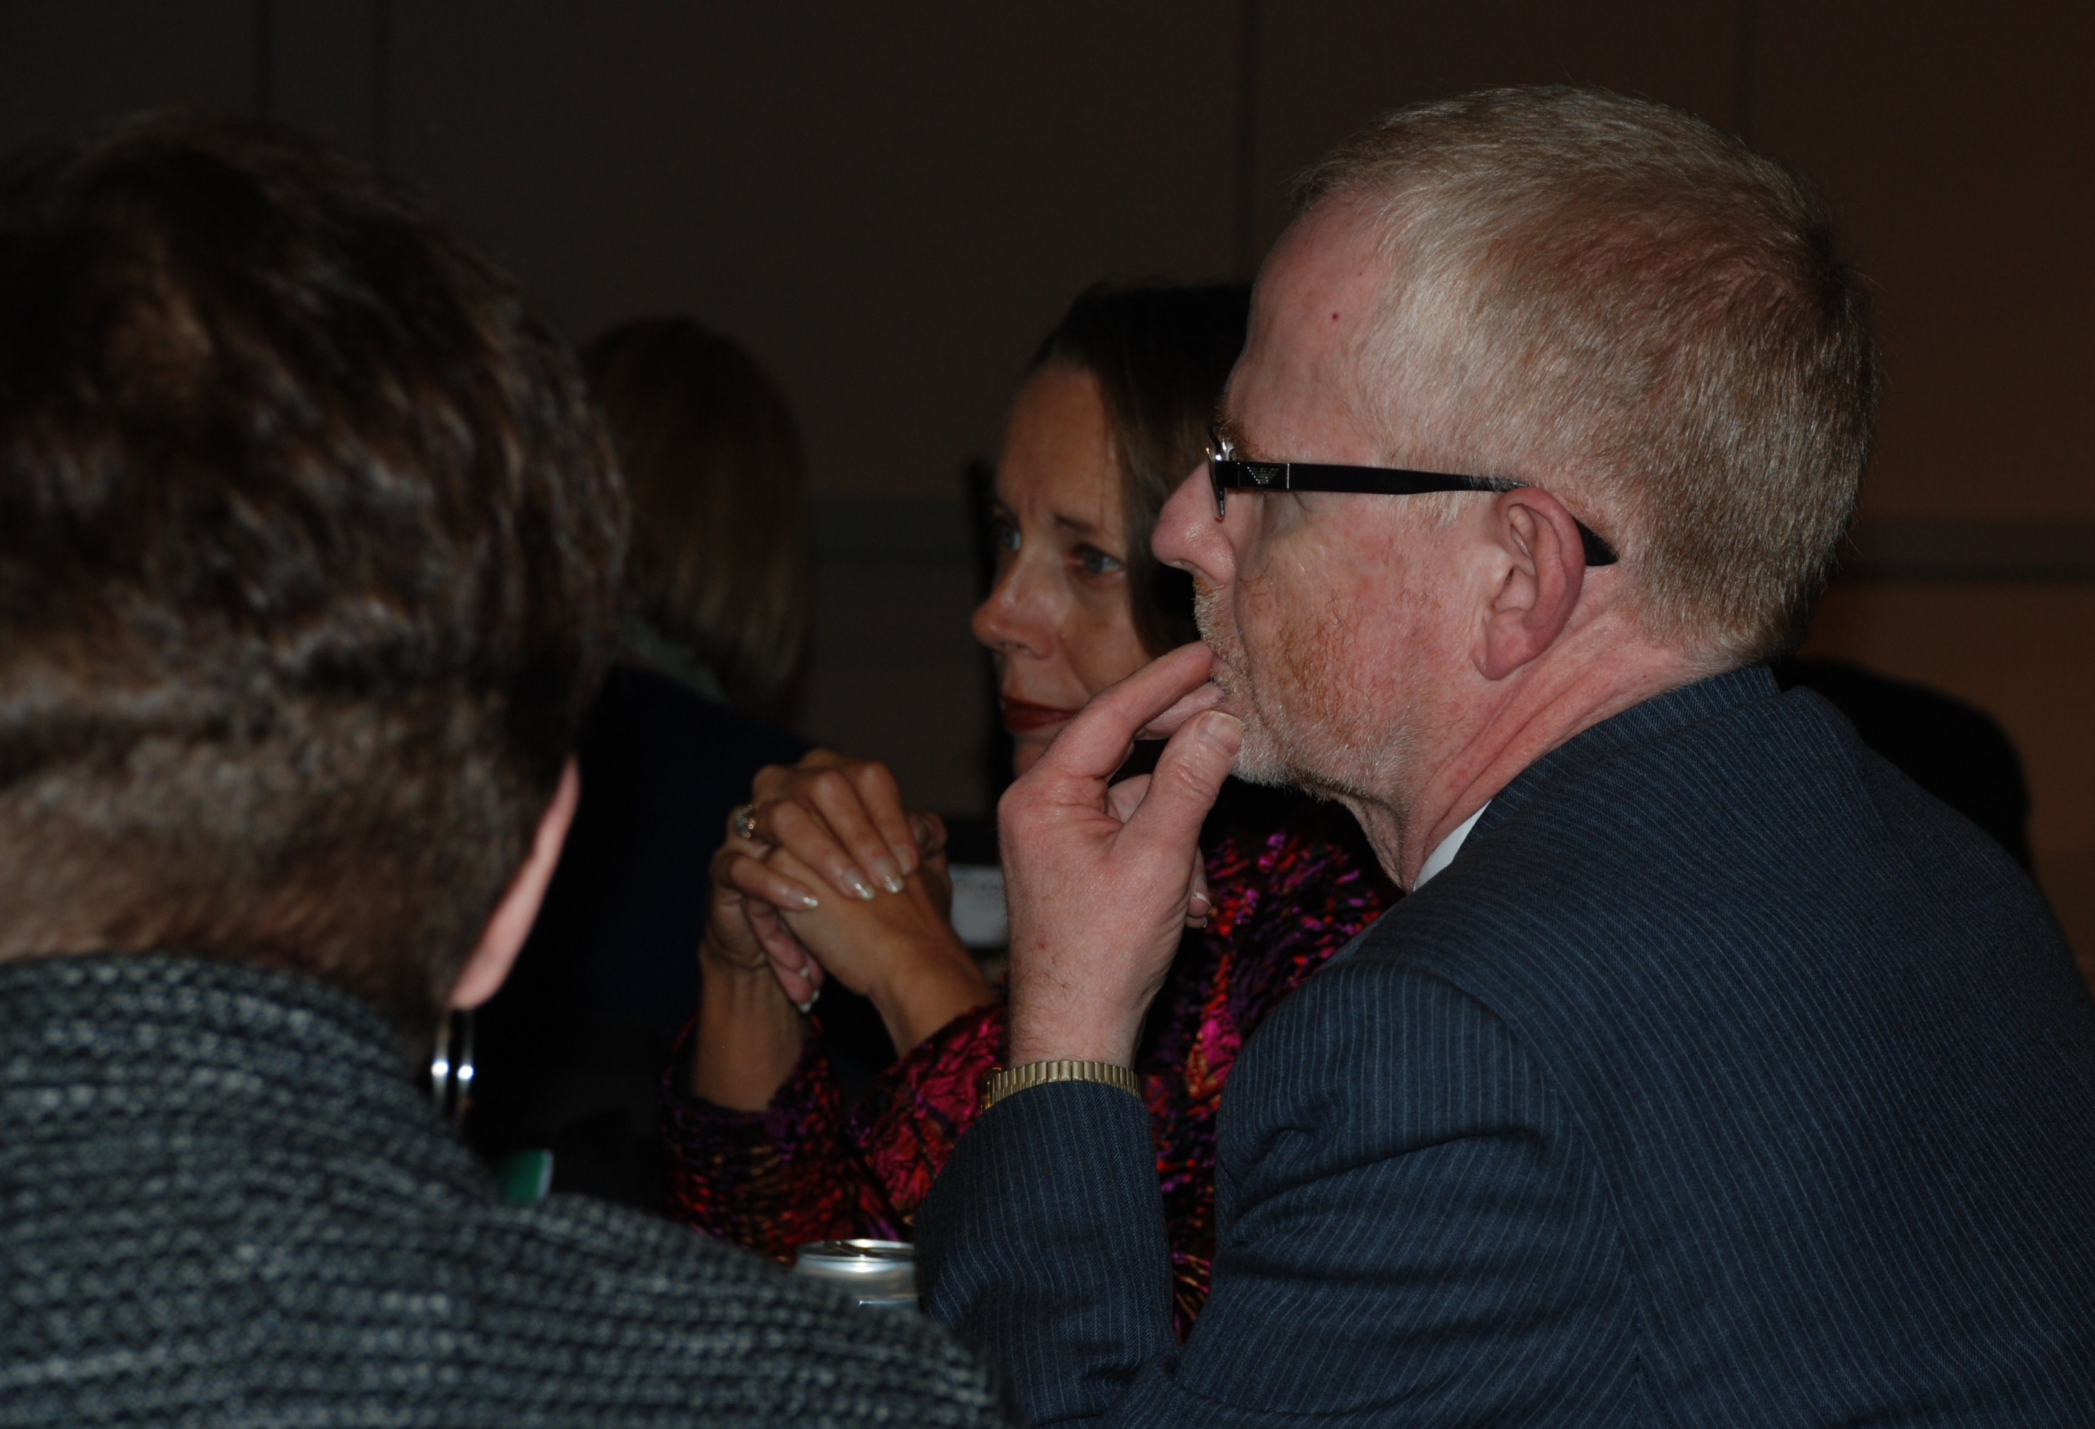
“What is the role of the ARC Executive Committee?”

Slide 16
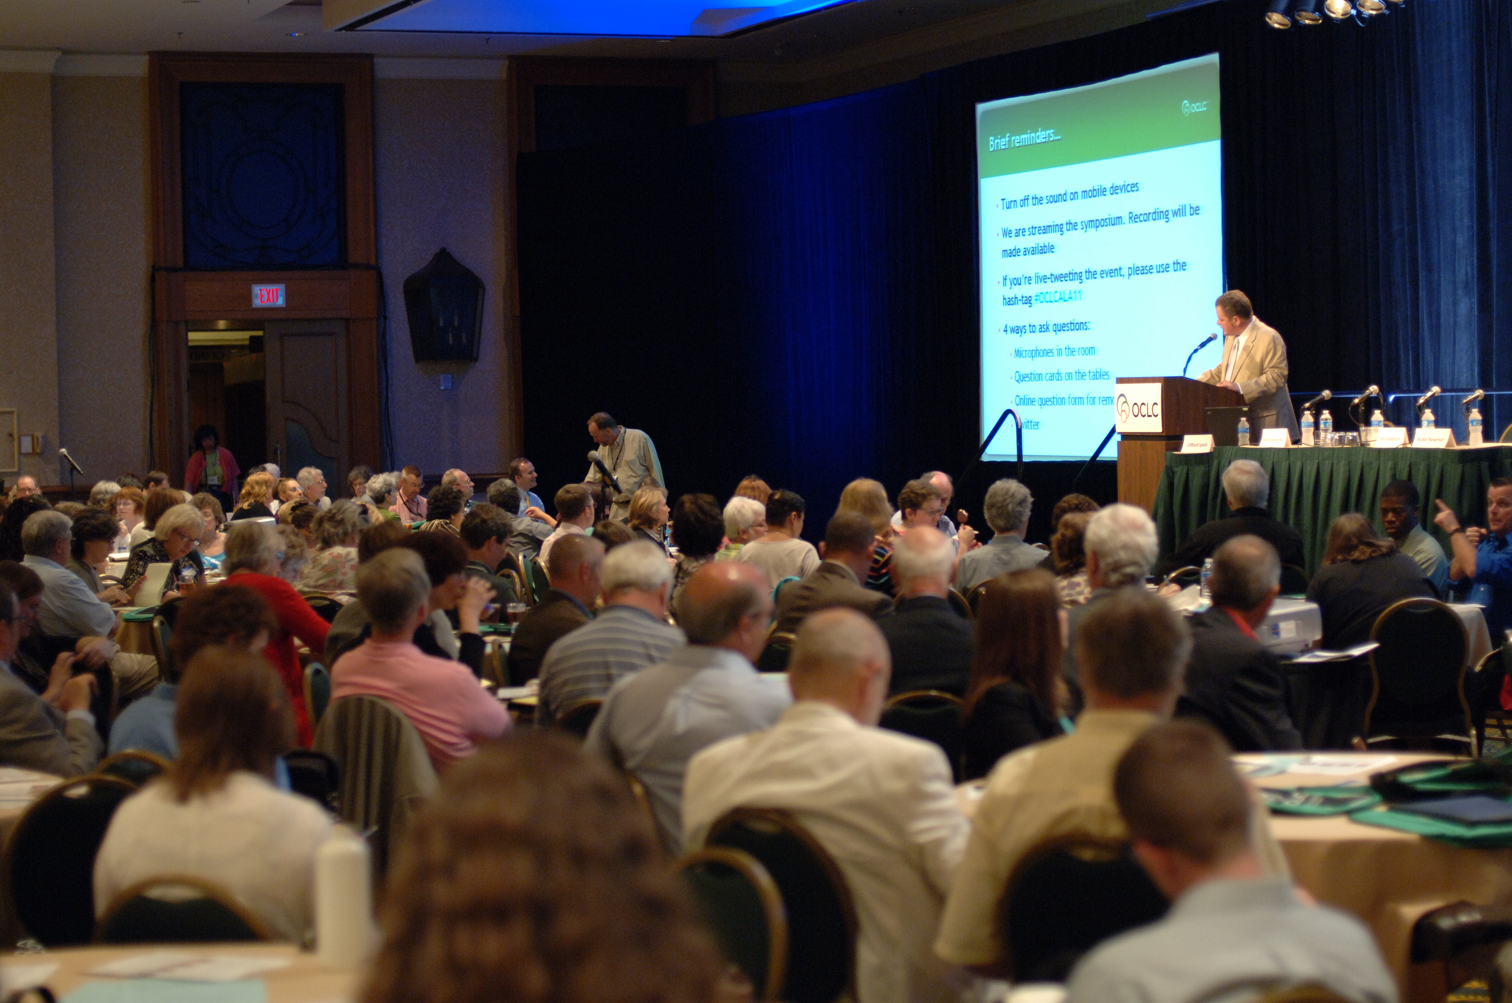
Plan at least one live regional meeting annually.
Plan additional
meetings as needed.

Slide 17
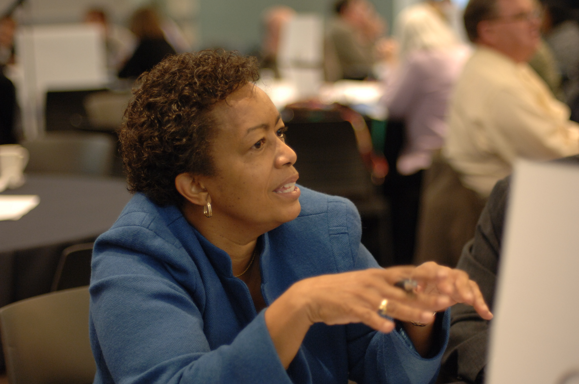
Additional responsibilities of
ARC member-leaders
Plan and monitor
ARC communications with
assistance from OCLC staff
What else? That’s up to YOU!
Your input can shape the ARC agenda
What activities would be of benefit to you?
What interest groups do we need to start?
What kinds of communications would be helpful?
Let your representatives know!

Slide 18
Ways to connect with ARC
Attend Americas Regional Council Meetings
Run for a Regional or Global Council office
Learn more at: www.oclc.org/councils/americas.en.html

Slide 19
Keep in touch with OCLC
Blogs: www.oclc.org/news/blogs.en.html
Sign up for e-mail publications:
www.oclc.org/email.en.html
OCLC Speakers Bureau: www.oclc.org/about/speakers.en.html
Follow us on Twitter: #oclc
Directory (PDF) of Global and Regional Councils:
www.oclc.org/global-council-directory.en.html

Slide 20
Questions?
regionalcouncil.americas@oclc.org
#oclc
Notes:
20
20
20

