Slide 1
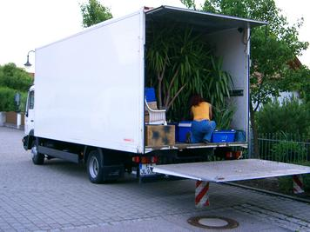
Moving to MARC 21 - Moving Ahead
1
Reinhold Heuvelmann, German National Library
May 10, 2011, OCLC, Dublin (OH)

Slide 2

Layers of Information
2
Reality
Communication
Resources
Rules
Formats
Shell Structures
Coded Character Sets
Bits and Bytes

Slide 3
Libraries in Germany (1)
3
German National Library (Leipzig, Frankfurt)
Large State Libraries: Berlin and Munich
State Libraries
University libraries
Research libraries
Zentrale Fachbibliotheken
(Medicine, Economics, Engineering)
Public libraries
School libraries
Church libraries . . .

Slide 4
Libraries in Germany (2)
4
"Sondersammelgebiete"
  subject-specific
  regional
  material-specific
"Sammlung Deutscher Drucke"
  1913 ff = Deutsche Nationalbibliothek
  1871 – 1912 = StB-PK Berlin
  1801 – 1870 = UB Frankfurt/M.
  1701 – 1800 = SUB Göttingen
  1601 – 1700 = HAB Wolfenbüttel
  1501 – 1600 = BSB München

Slide 5
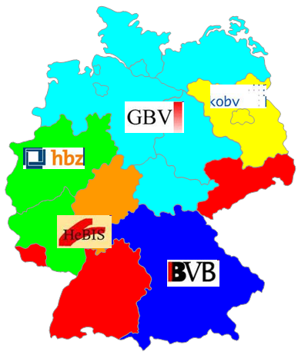

Libraries in Germany (3)
5
German Regional Library Networks
+ Austria: OBV
+ Switzerland: IDS
+ German Union Catalogue of Serials (ZDB)
=>
Consortium of Library Networks

Slide 6
German National Library
6
Central archiving library and national bibliography centre
Collecting, permanently archiving, fully documenting and bibliographically indexing all German and German-language publications from 1913 and making them accessible to the general public
Including online publications
National and international partnerships
Projects
Authority data
Standardization

Slide 7
Standardization for Libraries in Germany, Austria and Switzerland
7
Committee for Library Standards
Office for Library Standards
Expert Groups
  Authority Data
  Data Formats
  Descriptive Cataloging
  Subject Cataloging
Offices for different subareas of standardization

Slide 8
Rules
8
RAK (Regeln für die Alphabetische Katalogisierung)
  RAK, RAK-WB, RAK-ÖB, RAK-NBM, RAK-Musik, RAK-Karten
  regional Rule Interpretations
RNA (Regeln für Nachlässe und Autographen)
RSWK (Regeln für den Schlagwortkatalog)
Dewey Decimal Classification
Project "DDC Deutsch"

Slide 9
Format: MAB
9
"Maschinelles Austauschformat für Bibliotheken" (Mashine-readable exchange format for libraries)
established in 1973 ("MAB1")
revised in 1994 ("MAB2")
Parts: Bibliographic, Authority, Holdings, Classification, Addresses
1998 - 2004: process of internationalization (Unicode, Dublin Core, MAB english, FRBR, XML)

Slide 10
"Changing for international formats and codes (MARC21, AACR2)" (2002 - 2004)
10
internationalization of library standards (cataloging rules and formats)
vivid discussions
feasibility study (strategic, technical, economical aspects), funded by DFG
decisions:
introduction and uniform use of MARC 21 as the exchange format for all libraries in Germany and Austria
active cooperation in the development of new rules

Slide 11
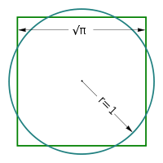
Changeover to MARC 21 (2005 - 2009)
11
  Standard compliance
  Interoperability
  Abandon historic burdens
  Existing rules, models, data, functionalities
  Language of cataloging: German
  MARC 21 as a communications format,
  not as a cataloging format
  MAB "stabilized"

Slide 12
Changeover to MARC 21 (2005 - 2009)
Part 1: Preparations
12
  Training
  Multipart monographs
  Linking techniques
  Mapping MAB to MARC 21
  DDC
  MARBI
  Local Elements
  Translation
  Coded character sets

Slide 13
Decisions
13
Series data in MARC Bibliographic records
Multipart monographs in one record per volume
No ISBD punctuation, if it is redundant to MARC 21 field or subfield coding;
if needed:
at the beginning of a subfield,
or inside a subfield
Non-sorting control character technique

Slide 14
Changeover to MARC 21 (2005 - 2009)
Part 2: Production
14
  Re-programming all existing MAB interfaces and replacing them by their MARC 21 equivalents
  Some minor changes in data and cataloging practice
  Done / to be done in all institutions (networks, libraries)
  Vendors
  German National Library: from 2008 on,
  and retrospectively

Slide 15
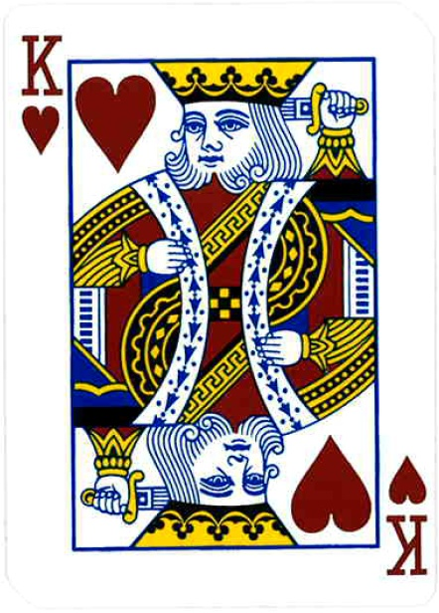
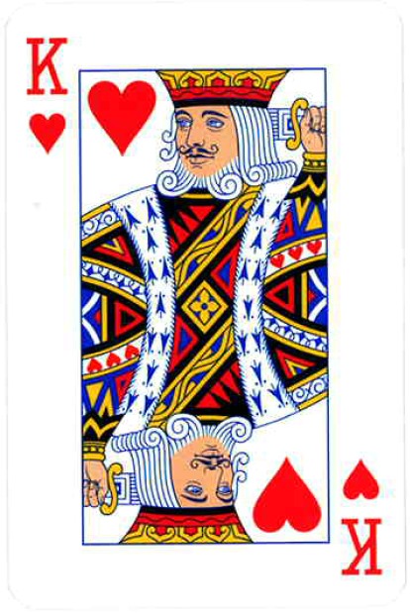
The solution so far …
15

Slide 16

Changeover to MARC 21 (ongoing)
Part 3: Marketing
16
  "Errors"
  Explanations
  Discussions
  Solutions

Slide 17
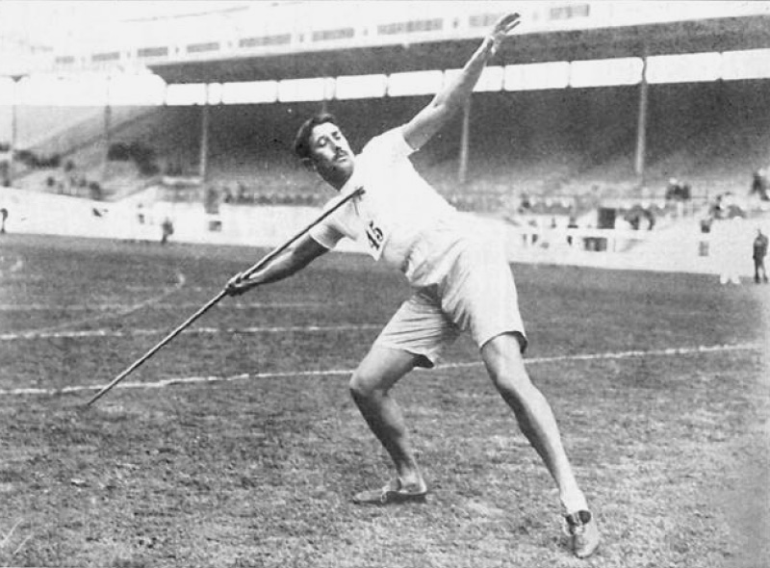
MARC 21, and the Future
17

Slide 18

Part of the Puzzle (1):
FR-Family
18
FRBR
FRAD
FRSAD
FRBR Review Group
=> "FRBR 2.0"

Slide 19

Part of the Puzzle (2):
RDA
19
Rules, Toolkit
Elements, Registry
Semantic Web: Linked Data, URIs, RDF
Syntax ?
RDA/MARC Working Group

Slide 20
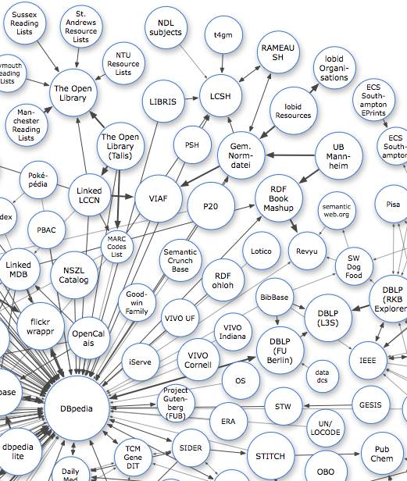
Part of the Puzzle (3):
Authority Control
20
German Project
"Gemeinsame Normdatei" (GND)
VIAF

Slide 21


Part of the Puzzle (4):
MODS & MADS
21
MODS/MADS Editorial Committee

Slide 22
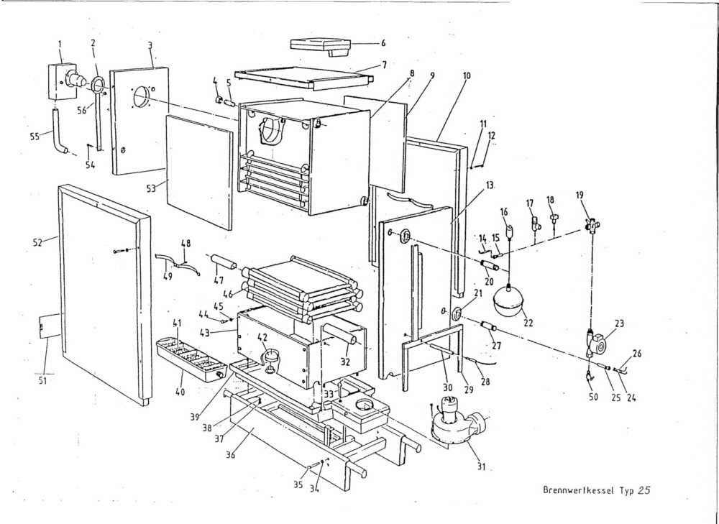
Part of the Puzzle (5):
De-constructing MARC
22
Rules
Cataloging system
Elements
Order
Display
Punctuation
ISO 2709, or XML, or JSON
MARC-8, or Unicode

Slide 23
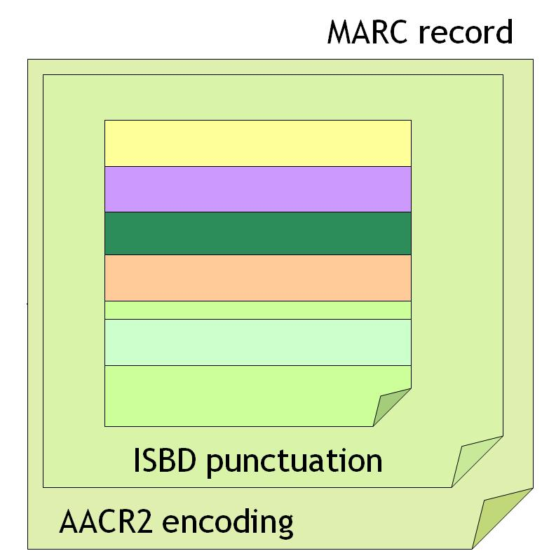
Part of the Puzzle (6):
ISBD & ISBD Punctuation
23
MARC Leader/18 "c"
PCC ISBD and MARC Task Force

Slide 24
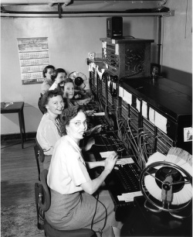
Part of the Puzzle (7):
C o m m u n i c a t i o n s Format
24

Slide 25
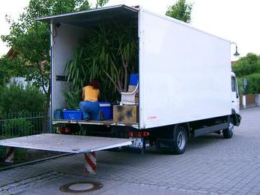
Time to move on …
25

Slide 26







Community & Partnerships
26

Slide 27

Thank you!
Questions?
27
r.heuvelmann@dnb.de

